Slide 1
Airplane Weight and Balance
The Inherent Dangers of Weight and Balance Procedural Complacency
–
What You Don’t Know Can Get You and Your Passengers Killed!
FAA Safety Seminar Attendees
W. J. Doyle, Jr., CFI A&I, AGI, IGI, FAAST Rep
08/01/2000 – 12/31/2020
Notes:
This presentation is an overview of weight & balance procedures and demonstration of several appropriate techniques for calculating weight & balance. The seminar will consider NTSB Accident Data and an nineteen year trend as it relates to weight & balance as the accident causal factor.
What can we learn from others mistakes?
What does the FAA say about flight planning?
What should we consider when planning our flights?
Join us in looking at some flights that will address these and other important questions and considerations.
This presentation was built by FAASTeam Rep William J Doyle, Jr. doylewj@ix.netcom.com

Slide 2
How to Download this Presentation
You can download this presentation at the link below.
  https://williamjdoylejr.net/FAAST/W&B/Weight_and_Balance_2020.pptx
  The link is case-sensitive
  If prompted for a password, click the “Read Only” button
  You can email me doylewj@ix.Netcom.com to request the link

Slide 3
Presentation Agenda
Weight & Balance Accident Trends
Weight & Balance Accident Scenarios
Applicable FARs
Weight & Balance Concepts
Weight & Balance Terms
Weight & Balance Computations
Calculating Weight & Balance Using iPad and ForeFlight
Weight Impact on V-Speeds
How to Query the NTSB Database from a Web Browser
How to Query the NTSB Database from AOPA
Appendix: Weight & CG Change Formulas

Slide 4
NTSB Statistics on
Weight & Balance Accidents in the
United States from 2000 to 2019

Slide 5
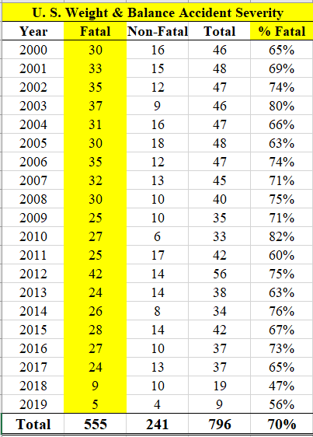
NTSB Weight & Balance Accident Trends
U.S.
2000 – 2019
70% of these accidents involved fatalities.
Notes:
These statistics were drawn from the NTSB accident database at https://www.ntsb.gov/_layouts/ntsb.aviation/index.aspx
The search criteria were:
Date Range 01/01/2000 to 12/31/2019
Country – United States
Injury Severity: All
Category: Airplane
Operation: Part91:General Aviation
Key Words: “Weight and Balance“ or "weight and balance" or “Weight & Balance“ or "weight & balance"
The search returned 796 results that contained the above key words
The results were downloaded as an XML file
The remaining statistics were done in Excel

Slide 6
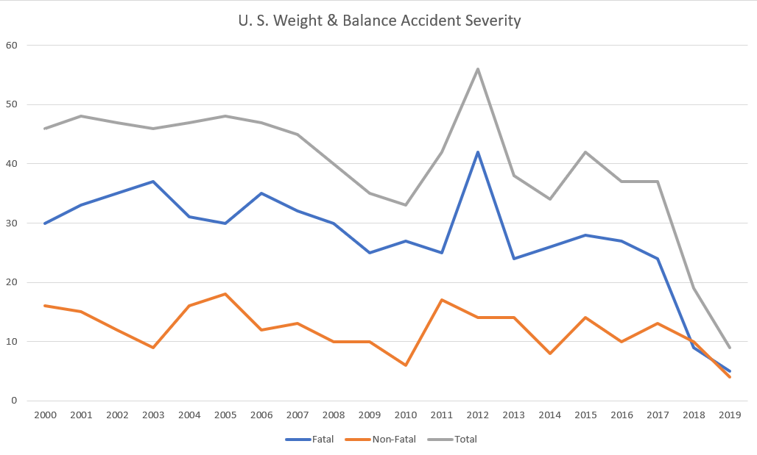
NTSB Weight & Balance Accident Trends
U.S. 2000 – 2019
Notes:
These statistics were drawn from the NTSB accident database at https://www.ntsb.gov/_layouts/ntsb.aviation/index.aspx
The search criteria were:
Date Range 01/01/2000 to 12/31/2020
Country – United States
Injury Severity: All
Category: Airplane
Operation: Part91:General Aviation
Key Words: “Weight and Balance“ or "weight and balance" or “Weight & Balance“ or "weight & balance"
The search returned 796 results that contained the above key words
The results were downloaded as an XML file
The remaining statistics were done in Excel

Slide 7
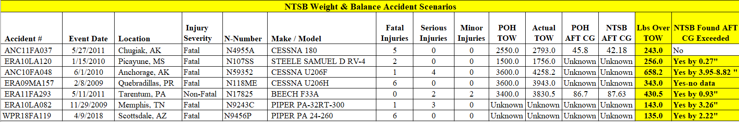
NTSB Weight & Balance Accident Trends
U.S. – 2000 – 2019
TOW = Take-Off Weight
Many of these accidents had an AFT CG that was AFT of the CG limit
N4955A – 5 people (3 children ages 11, 12, 13)
N59532 – boy (age 4) not belted in, died of head trauma
N9456P – 6 people (all adults)

Slide 8
NTSB Report ANC11FA037 on
Cessna 180 N4955A
Accident

Slide 9
Cessna 180 N4955A – NTSB Report ANC11FA037
The accident occurred 5/27/2011
  Pilot had not flown since 6/12/2010 (lapse of 349 days)
  Pilot did not meet the FAA’s recent experience requirement for the required number of takeoff and landings to carry passengers.
    FAR 61.57: 3 takeoffs and landings within 90 days
  Pilot’s logbook noted about 4 hours in the accident airplane
Airplane’s estimated gross weight at the time of the accident was about 243 pounds over its approved maximum takeoff weight.
Witness accounts reported
  Airplane swerving off the runway during the takeoff roll
  Nose-high attitude and rapid roll prior to impact
Per NTSB, pilot likely lost control during the takeoff roll
  Pilot applied excessive nose-up pitch to become airborne.
  Once airborne, pilot failed to attain sufficient airspeed to avoid an aerodynamic stall
  Airplane descended out of control to the ground.

Slide 10
Cessna 180 N4955A – NTSB Report ANC11FA037
Estimated Weight and Balance
  Due to the extensive fire damage, an exact weight and balance calculation could not be made.
  Pilot’s weight was taken from his most current FAA medical examination.
  Weight of the front seat passenger was taken from her reported weight on her Alaska driver’s license.
  Weights for the rear seat passengers (girls: ages 11 and 13, and boy: age 12) were estimated using the Centers for Disease Control (CDC) growth charts showing average weight by age and gender.

Slide 11
Cessna 180 N4955A – NTSB Report ANC11FA037
Items of cargo that were identifiable are listed as follows:
  Chainsaw
  Pistol
  Multiple bags of food and grocery items
  Personal clothing and bags
  Pots
  Kitchen utensils
  Rope
  Bundle of electrical wire
Pilot’s son said that the airplane’s fuel tanks were completely filled prior to the accident flight from the pilot’s personal fuel storage tank.

Slide 12
Cessna 180 N4955A – NTSB Report ANC11FA037
Estimated weights
  Basic Empty Weight (from March 5, 1991) – 1631 pounds
  Pilot and Front seat Passenger – 417 pounds
  Rear Seat Passengers – 293 pounds
  Cargo – 100 pounds
  Fuel (55 gallons) – 330 pounds
  Oil (12 quarts) – 22 pounds
The gross weight of the airplane at the time of the accident was estimated to be 2,793 pounds, or 243 pounds over the approved maximum takeoff gross weight for the airplane.
The estimated center of gravity at the time of the accident was positive 42.18 inches.
The center of gravity range at 2,550 pounds (maximum gross weight) is positive 39.5 inches to positive 45.8 inches

Slide 13
NTSB Report WPR18FA119 on
Piper PA24 N9456P
4/9/2018 Accident

Slide 14
Piper PA24 N9456P – NTSB Report WPR18FA119
Pilot data
  Pilot’s first flight in accident airplane was 4/9/2018 from North Las Vegas Airport (VGT), NV to Scottsdale Airport (SDL), AZ.
  Pilot’s certificates
    ATP ASEL and AMEL
    CFI ASE, AME, IA
    Medical Certificate – 1st Class with the following limitation: "Not valid for any class after 08/31/2018."
  Pilot flight time
    Total flight time 5,200 hours
    Flight time in accident airplane was approximately 2 hours
Student Pilot data
  Student Pilot Certificate - none
  Medical Certificate - none
  Total Flight Time – could not be determined

Slide 15
Piper PA24 N9456P – NTSB Report WPR18FA119
Toxicology Report
  Pilot Toxicology
    Negative for carbon monoxide, ethanol and all drugs tested
  Student Pilot Toxicology
    Negative for carbon monoxide and ethanol
    Testing identified benzoylecgonine in his blood and urine specimens and MDMA in his urine samples.
      Benzoylecgonine is an inactive metabolite of cocaine.
      MDMA is a controlled substance (Ecstasy)

Slide 16
Piper PA24 N9456P – NTSB Report WPR18FA119
Airplane Data
  Make/Model – Piper PA24-260 (Comanche)
  Year of Manufacture – 1970
  Date/Type of Last Inspection – 12/01/2017, Annual
  Airframe Total Time – 6,158 Hours as of last inspection
  Certified Max Gross Weight – 3,200 lbs
  POH Aft CG – 93.0 inches
Accident Data
  NTSB determined takeoff weight – 3,335 lbs (135 lbs over gross)
  NTSB determined Aft CG – 95.2 inches (2.2 inches beyond Aft CG).
  NTSB also identified degraded engine power output due to a preexisting engine cylinder intake valve spring failure.

Slide 17
Piper PA24 N9456P – NTSB Report WPR18FA119
The accident occurred 4/9/2018
  The airline transport pilot, student pilot, and four passengers departed on a cross-country flight from Scottsdale Airport (SDL), AZ to North Las Vegas Airport (VGT), NV.
  Seating
    The airline transport pilot occupied the right front seat
    The student pilot occupied the left front seat
    The four passengers occupied the two middle row and two aft row seats.
    Even though the student pilot was seated in the left seat, the investigation could not determine who was manipulating the flight controls when the accident occurred.

Slide 18
Piper PA24 N9456P – NTSB Report WPR18FA119
Witnesses and airport surveillance camera video indicated that the airplane's wings were rocking during the departure and shortly after rotation.
The controller asked if the airplane was experiencing any difficulties; according to the controller, the pilot responded, “We're good. We're just in training mode."
One witness reported that the engine sounded as if it was not developing enough power.
The last recorded radar data point indicated that the airplane's altitude was about 200 ft above ground level.
A traffic camera, located about 0.5-mile northwest of the end of the runway, showed the airplane in a left bank turning left.
As the turn progressed, the bank angle increased, and the airplane started to descend.
The airplane's wings were nearly vertical before the airplane impacted terrain.
A post-crash fire ensued.

Slide 19
Piper PA24 N9456P – NTSB Report WPR18FA119
Flight Events per NTSB
  Prior to flight - Aircraft loading event
  Initial climb - Loss of engine power (partial)
  Initial climb - Loss of control in flight
  Uncontrolled descent - Collision with terrain/object (non-CFIT)
Probable Cause per NTSB
  The National Transportation Safety Board determines the probable cause(s) of this accident to be:
    The flight instructor's failure to maintain airplane control during the initial climb as a result of the airplane being loaded above its maximum gross weight and beyond its aft center of gravity limits.
    Contributing to the accident was a degraded engine power output due to a preexisting engine cylinder intake valve spring failure, which further reduced the airplane's climb capability.

Slide 20
Piper PA24 N9456P – NTSB Report WPR18FA119
NTSB Findings
  Aircraft-Aircraft oper/perf/capability-Aircraft capability-CG/weight distribution-Capability exceeded - Cause
  Aircraft-Aircraft oper/perf/capability-Aircraft capability-Maximum weight-Capability exceeded - Cause
  Aircraft-Aircraft power plant-Engine (reciprocating)-Recip eng cyl section-Fatigue/wear/corrosion - Factor
  Personnel issues-Task performance-Use of equip/info-Aircraft control - Pilot - Cause
  Personnel issues-Task performance-Planning/preparation-Weight/Balance calculations - Pilot

Slide 21
Piper PA24 N9456P – NTSB Report WPR18FA119
Lessons learned and “take-aways”:
  Determine weight of each crew member and passenger and their baggage before each flight
    Verify using FBO’s scale or portable digital bathroom scale
  Calculate weight and balance before each flight
    Use a computational device such as a tablet, e.g. iPad
    Use an aviation application such as ForeFlight
    Refer to the POH often
  Make sure you are familiar with the airplane and proficient in flying it
    Schedule an orientation flight with a CFI who is proficient in the airplane, even if you are a CFI yourself
  For CFI’s
    Make sure you know something about your student before getting into an airplane with them

Slide 22
Piper PA24 N9456P – NTSB Report WPR18FA119
NTSB Reports
  Aviation Accident Data Summary
    http://williamjdoylejr.net/FAAST/W&B/Accident_WPR18FA119_NTSB_Data_Summary.pdf
  Aviation Accident Final Report
    http://williamjdoylejr.net/FAAST/W&B/Accident_WPR18FA119_NTSB_Final_Report.pdf

Slide 23
Are There Any FARs
That Cover Weight & Balance?
Notes:
FAR 91.103 – Preflight Action

Slide 24
14 CFR 91.103 – Preflight Action
Each pilot in command shall, before beginning a flight, become familiar with all available information concerning that flight. This information must include {but is not limited to} —
  For a flight under IFR or a flight not in the vicinity of an airport, weather reports and forecasts, fuel requirements, alternatives available if the planned flight cannot be completed, and any known traffic delays of which the pilot in command has been advised by ATC;
  For any flight, runway lengths at airports of intended use, and the following takeoff and landing distance information:
    For civil aircraft for which an approved Airplane or Rotorcraft Flight Manual containing takeoff and landing distance data is required, the takeoff and landing distance data contained therein; and
    For civil aircraft other than those specified in paragraph (b)(1) of this section, other reliable information appropriate to the aircraft, relating to aircraft performance under expected values of airport elevation and runway slope, aircraft gross weight, and wind and temperature.

Slide 25
Weight & Balance Concepts from an
Elementary School and
Middle School
Perspective

Slide 26
How Much Can an Airplane Weigh?
Each airplane has a limitation called the maximum gross takeoff weight. Some airplanes also have a maximum gross landing weight.
This weight includes everything
    Airplane (empty)
    Fuel
    Pilot and passengers
    Baggage
There is another component called “Balance.”
The entire process is called “Weight and Balance.”

Slide 27

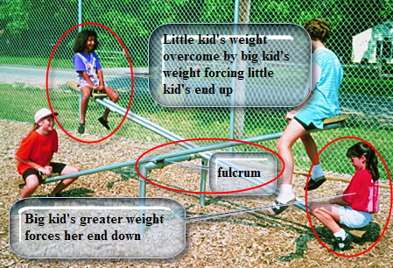
What Does Balance Mean?
Classic example is the playground seesaw:
    Center bar is the fulcrum which is the center of gravity.
    Heavier weight of “big” kid on one end overcomes lesser weight of “little” kid on other end
    This forces the “little” kid to go up
    Is there a way to make the “big” kid go up without adding weight or changing kids?

Slide 28
Weight & Balance Terms
That All Pilots
Should Know

Slide 29
Weight & Balance Terms
Arm (moment arm)
  horizontal distance in inches from the reference datum line to the CG of an item.
  Arms ahead (forward) of the reference datum are minus (–)
  Arms behind (aft) of the reference datum are positive (+)
  When the reference datum is ahead of the airplane, all of the arms are positive and computational errors are minimized
Reference Datum
  imaginary vertical plane from which all distances are measured
Moment
      product of the weight of an item multiplied by its arm. Moments are expressed in inch-pounds (in-lb). Total moment = airplane weight * the distance between the datum and the CG.
Moment Index
  moment divided by a constant such as 100, 1,000, or 10,000. The purpose of using a moment index is to simplify weight and balance computations of aircraft where heavy items and long arms result in large, unmanageable numbers.

Slide 30
Weight & Balance Terms
Station
      a location in the aircraft that is identified by a number designating its distance in inches from the datum. The datum is, therefore, identified as station zero. An item located at station +50 would have an arm of 50 inches.
Center of Gravity (CG)
      imaginary point when aircraft would balance if suspended, i.e. where all of its weight is concentrated
CG Limits
      forward and aft center of gravity locations within which the aircraft must be operated at a given weight

Slide 31
Weight & Balance Terms
Usable Fuel
  fuel available for flight planning and during flight
Unusable Fuel
  fuel remaining in the airplane’s system after a run-out test
Basic Empty Weight
  weight of the standard airplane, optional equipment, unusable fuel, and full operating fluids, e.g. full engine oil
Total Weight (Gross Weight)
  total weight of airplane and everything it is carrying
  Takeoff & Landing weight limitations may be different
  (Note: Cessna 182 and Cirrus SR20)
Maximum Ramp Weight
  maximum weight limit for ground operations such as taxiing
Maximum Takeoff Weight
  maximum weight limit for taking off; may be more than landing weight
Maximum Landing Weight
  maximum weight limit for landing; may be less than takeoff weight

Slide 32
Weight & Balance Terms
Maximum Weight
  weight limit set by the manufacturer
Maximum Zero Fuel Weight
  maximum weight exclusive of usable fuel
Useful Load
  maximum weight minus empty weight:
  weight available for crew, passengers, baggage, fuel
Payload – Important in CAP Context for C172/C182/U206 Missions
  useful load minus full fuel;
  weight available for air crew and baggage
Standard Weights
  fuel weighs 6 pounds per U.S. gallon
  oil weighs 7.5 pounds per U.S. gallon or 1.875 pounds per U.S. quart
Notes:
Emphasize Payload importance

Slide 33
Equipment List for
Weight & Balance

Slide 34
Weight & Balance Equipment List
The aircraft is furnished with an equipment list, which specifies
  all the required equipment
  all equipment approved for installation in the aircraft
The weight and arm of all installed equipment are included on the list and checked prior to the aircraft leaving the factory.
When an aircraft mechanic or repairman adds or removes any item on the equipment list,
  he or she must change the weight and balance record to indicate the new empty weight and EWCG
  the equipment list is revised to show which equipment is actually installed.
  FAA Aircraft Weight & Balance Handbook Figure 2-17 is a comprehensive equipment list that includes all of the items of equipment approved for this particular model of aircraft.

Slide 35
Weight & Balance Equipment List
The pilot’s operating handbook (POH) for each individual aircraft includes an aircraft-specific equipment list of the items from this master list.
When any item is added to or removed from the aircraft, its weight and arm are determined in the equipment list and used to update the weight and balance record.
The POH and airplane flight manual (AFM) also contain CG moment envelopes and loading graphs. Examples of the use of these graphs are given in FAA Aircraft Weight & Balance Handbook Chapter 5, Single-Engine Aircraft Weight and Balance Computations.

Slide 36
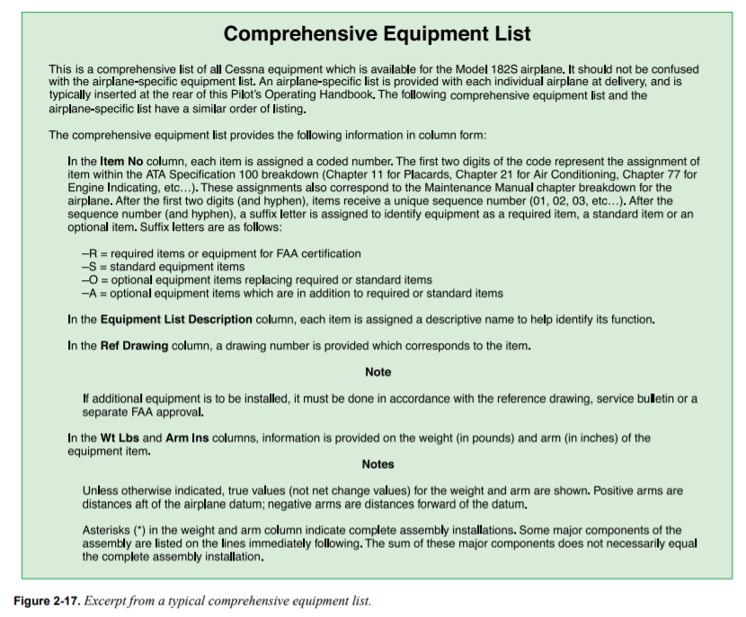
Weight & Balance Equipment List

Slide 37
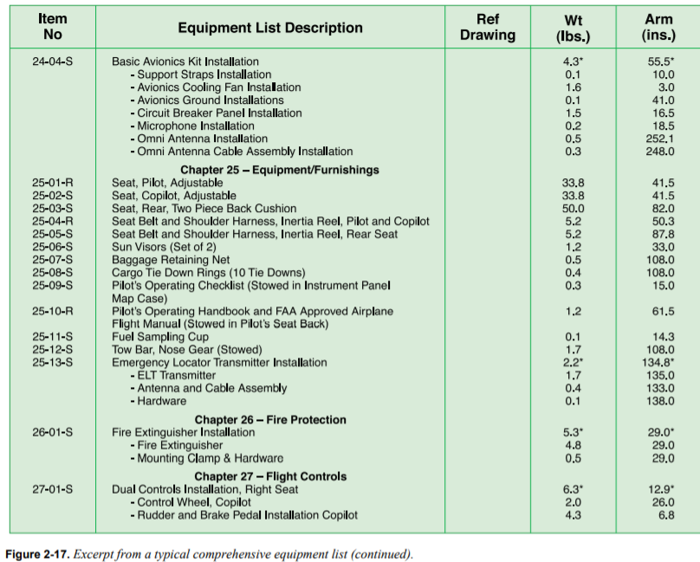
Weight & Balance Equipment List

Slide 38
How to Calculate
Weight & Balance

Slide 39
Weight & Balance Computations
Center of Gravity (CG)
CG Calculation – Computational Method
  By hand (may need for FAA knowledge test)
  Using an Excel spreadsheet
  Using ForeFlight on an iPad/iPhone
    or similar SmartPhone/tablet app
CG Calculation – Graphic Method

Slide 40
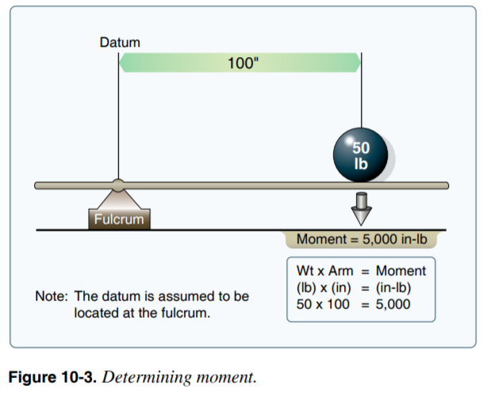
Weight & Balance Computation Concepts
Calculating the Moment
  Given
    Arm = 100 inches
    Weight = 50 pounds
  Layout the formula
    Weight x Arm = Moment
    50 x 100 = 5,000
Notes:
Moment = Weight x Arm

Slide 41
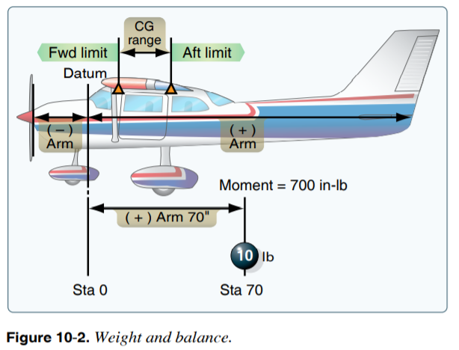
Weight & Balance Computation Concepts
Illustration of Weight and Balance
Notes:
How to figure the Arm necessary to balance a weight

Slide 42
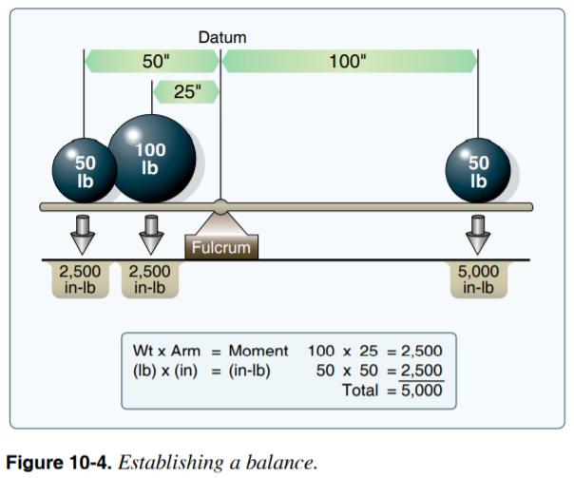
Weight & Balance Computation Concepts
Calculating the Balance
  Given
    Arm = 50 inches
    Weight = 50 pounds
    Arm = 25 inches
    Weight = 100 pounds
  Layout the formula
    Weight x Arm = Moment
    50 x 50 = 2,500
    100 x 25 = 2,500
    Total = 5,000
  Arm to balance a 50 lb weight
    Weight x Arm = Moment
    50 x ? = 5,000
    Moment ÷ Weight = Arm
    5,000 ÷ 50 = 100
Playground Seesaw Example
Moving the little kid to balance the big kid
Notes:
How to figure the Arm necessary to balance a weight

Slide 43
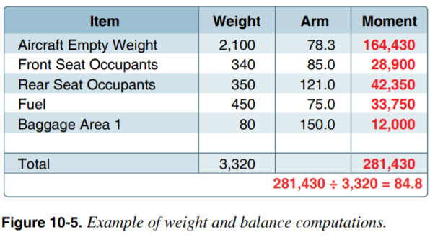
Weight & Balance Computation Concepts
Computational Method
  Aircraft Allowances:
    Maximum gross weight = 3,400 pounds
    CG range = 78–86 inches
  Given:
    Weight of front seat occupants = 340 pounds
    Weight of rear seat occupants = 350 pounds
    Fuel = 75 gallons
    Weight of baggage in area 1 = 80 pounds
  Problem to solve
    Is CG within range?
    Is weight <= gross weight?
Notes:
CG = Total Moment / Total Weight

Slide 44
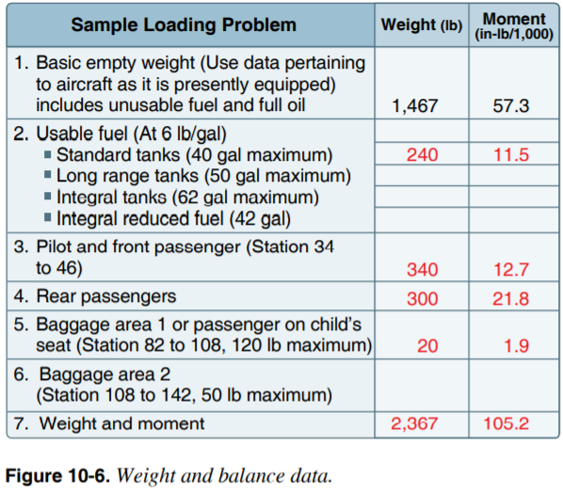
Weight & Balance Calculation – Graph Method
Calculating an airplane’s CG via Graph Method
  To simplify calculations, the moment may sometimes be divided by 100, 1,000, or 10,000.
  Aircraft Allowances:
    Maximum gross weight = 2,400 pounds
  Given:
    Weight of front seat occupants = 340 pounds
    Weight of rear seat occupants = 300 pounds
    Fuel = 40 gallons
    Weight of baggage in area 1 = 20 pounds
  Problem to solve
    Is the Moment within range?
    Is weight <= gross weight?
CG = Moment x 1000 / Weight = ?
CG = 105.2 x 1000 / 2367 = 44.44

Slide 45
Weight & Balance Calculation – Graph Method
Find weight for pilot and front seat passenger
Read from weight scale to diagonal line then straight down for moment
Record moment on worksheet
Repeat for rear seat passengers, baggage, and fuel
Find total weight and total moment lines on CG envelope graph
Check intersection of lines to see if within envelope
Notes:
Steps for the Graph Method

Slide 46
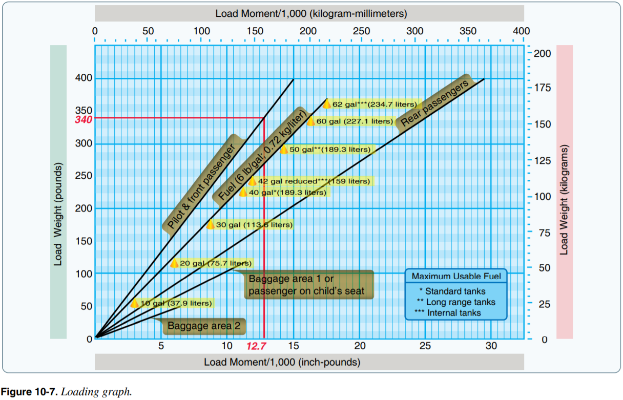
Weight & Balance Calculation – Graph Method

Slide 47
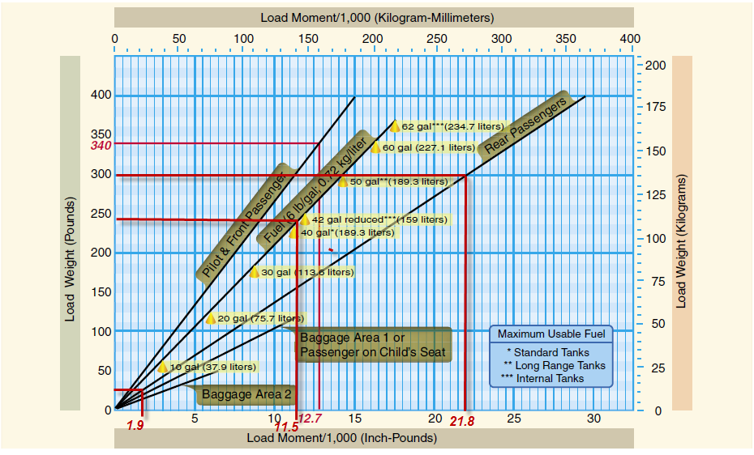
Weight & Balance Calculation – Graph Method

Slide 48
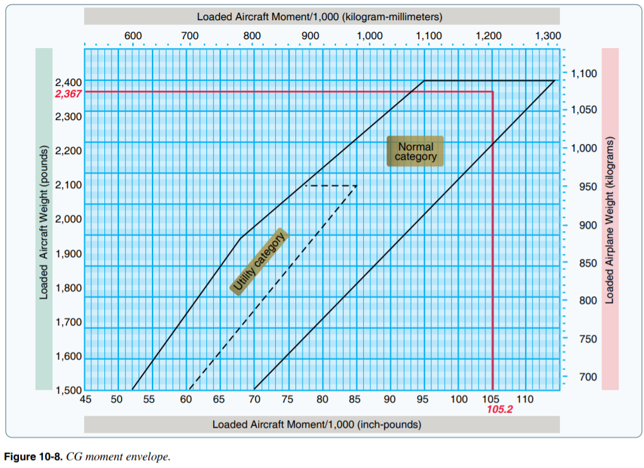
Weight & Balance Calculation – Graph Method

Slide 49
Weight & Balance Calculation – Graph Method
Reference
  Pilots Handbook of Aeronautical Knowledge – Chapter 10
  https://www.faa.gov/regulations_policies/handbooks_manuals/aviation/phak/media/12_phak_ch10.pdf
Cautions
  Slides 46, 47, and 48 should NOT be used for actual flight planning
  Refer to aircraft POH
    See next three slides for examples

Slide 50
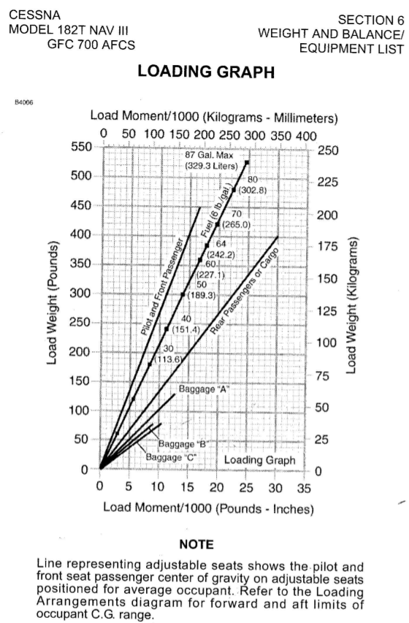
Weight & Balance Calculation – Graph Method for
Cessna 182T NAV III

Slide 51
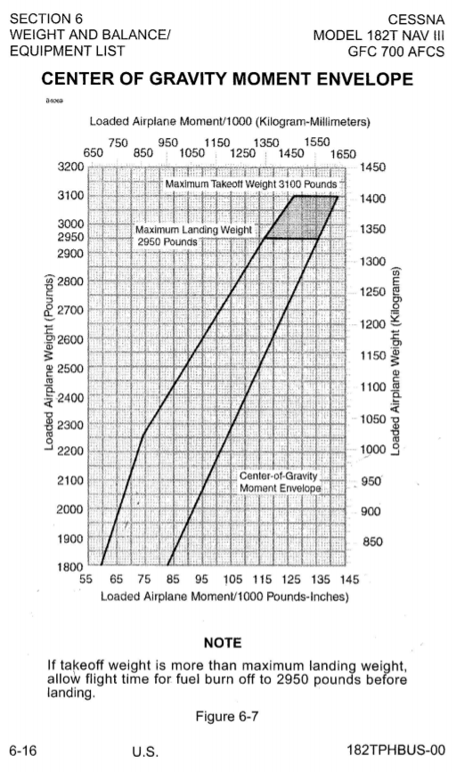
Weight & Balance Calculation – Graph Method for
Cessna 182T NAV III

Slide 52
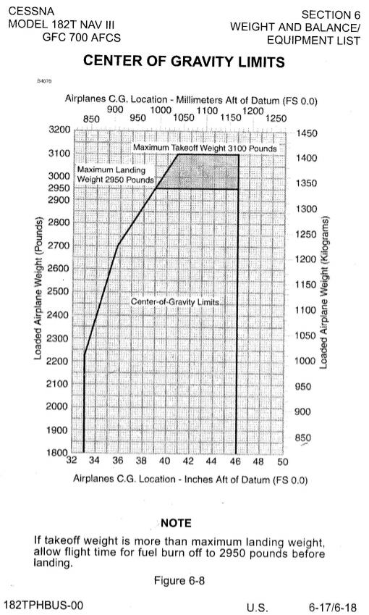
Weight & Balance Calculation – Graph Method for
Cessna 182T NAV III

Slide 53
Weight & Balance Computations
CG Computation -- Spreadsheet Method
Flight Scenario | Left Front | Right Front | Left Rear | Right Rear | Fuel in Gallons
#1 | Pilot: 280 lbs | Passenger: 200 lbs | N/A | N/A | 35
#2 | Pilot: 280 lbs | Passenger: 200 lbs | Cameras &Gear: 20 lbs | Passenger: 175 lbs | 53

Slide 54
CG Calculation - Computational Method
Excel Spreadsheet – Cessna 172S
Individual Items
  Item Name
  Item Weight
  Item Arm
  Item Moment (weight * arm)
CG inches
  Total Moment / Total Weight
CG Worksheet in Excel
  http://williamjdoylejr.net/FAAST/W&B/Weight_Balance_Cessna_172S.xls

Slide 55
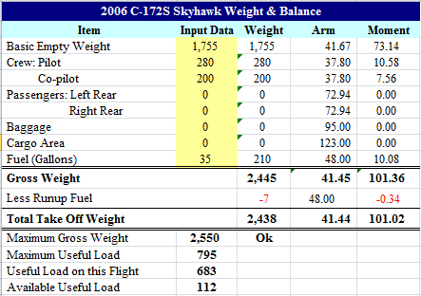
CG Calculation - Computational Method – Scenario #1

Slide 56
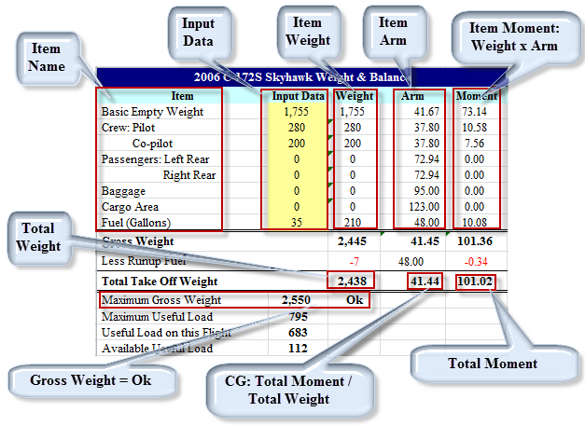
CG Calculation - Computational Method – Scenario #1

Slide 57
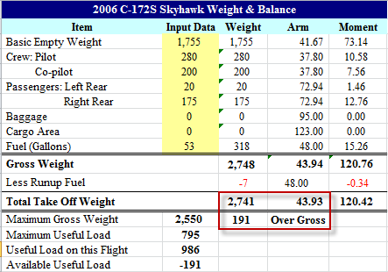
CG Calculation - Computational Method – Scenario #2

Slide 58
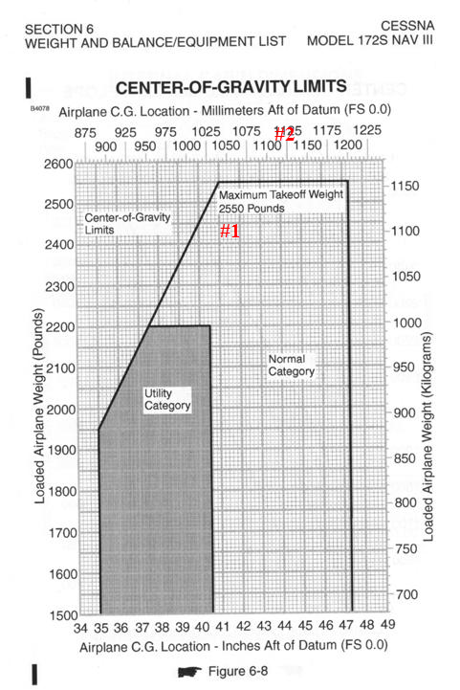
Cessna 172S Center of Gravity Limits
Scenario #1 is within weight and CG limits
Scenario #2 exceeds weight and CG limits

Slide 59
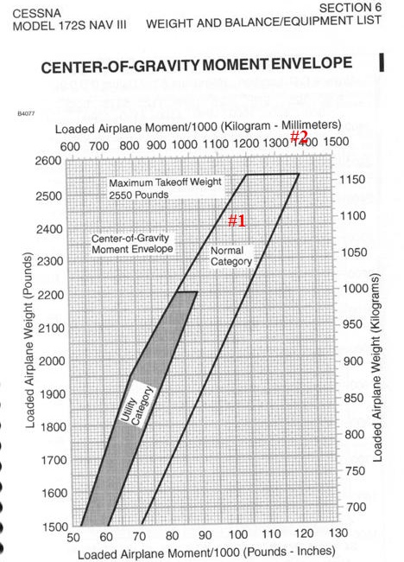
Cessna 172S CG-Moment Envelope
Scenario #1 is within weight and CG limits
Scenario #2 exceeds weight and CG limits

Slide 60
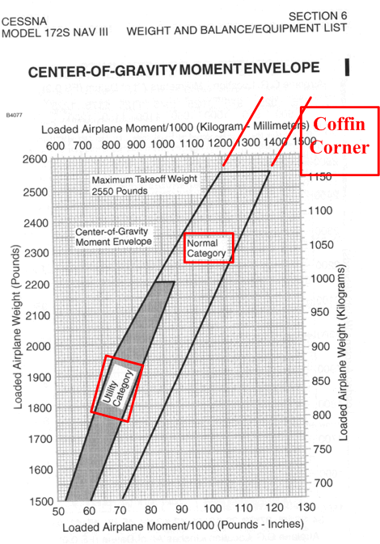
Cessna 172S CG-Moment Envelope – Dangers and Limitations
Coffin Corner –
  Above gross weight limit
  Aft of Aft CG limit
  Stall-Spin accident in making
Normal Category – See POH
  No spins
Utility Category – See POH
  Spins may be okay

Slide 61
Weight Impact on VSpeeds
Notes:
As the airplane flies and burns fuel, the airplane gets lighter
As the airplane gets lighter, certain Vspeeds decrease

Slide 62





Weight Impact on VSpeed
Excel Formula
=SQRT(Flying Weight Cell/Gross Weight Cell)*V_{Speed} Cell
Excel Examples
Notes:
As the airplane flies and burns fuel, the airplane gets lighter
As the airplane gets lighter, certain Vspeeds decrease
Vspeeds in the POH are typically shown at gross weight

Slide 63
Weight & Balance
Scenarios
Notes:
63

Slide 64
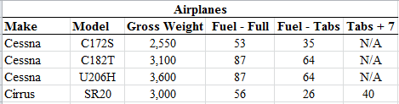
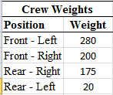
Weight & Balance Scenarios
Airplanes to be used for a cross country flight from Doylestown (KDYL) to Cape May (KWWD) and back
Crew weights and positions
Will each airplane be within weight and CG limits?

Slide 65
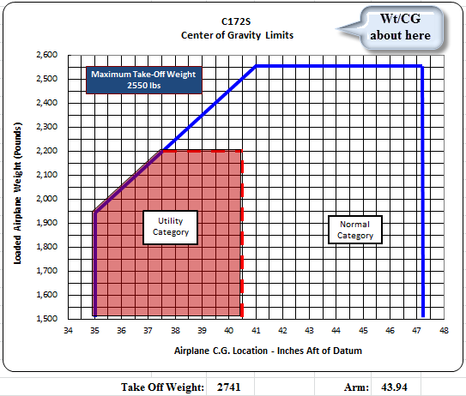
Weight & Balance Scenario – C-172S – Full Fuel
Airplane 191 pounds overweight
CG above the envelope
Airplane not legal to fly
http://williamjdoylejr.net/FAAST/W&B/Weight_Balance_Cessna_172S.xls
Notes:
Airplane is over gross and out of CG limit

Slide 66
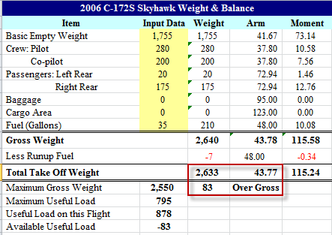
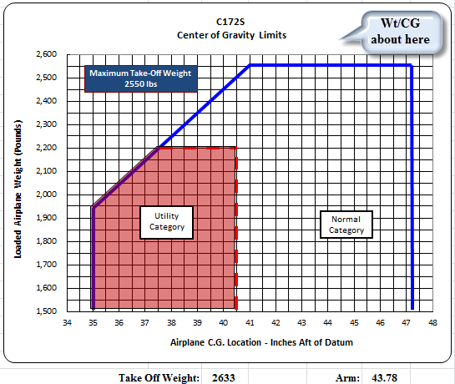
Weight & Balance Scenario – C-172S – Fuel to Tabs
Airplane 83 pounds overweight
CG above the envelope
Airplane not legal to fly
http://williamjdoylejr.net/FAAST/W&B/Weight_Balance_Cessna_172S.xls
Notes:
The fuel could be reduced by 14 gallons to get within the weight limits, but that leaves only 21 gallons of fuel.
A flight from Doylestown Airport (KDYL) to Cape May County Airport (KWWD) would take approximately an hour and burn 9 to 10 gallons with only 11 or 12 gallons remaining.
FAR 91.151 - Fuel Requirements for Flight in VFR Conditions – 30 minute reserve for daytime flight
Return flight to KDYL not legal unless the airplane was refueled at KWWD

Slide 67
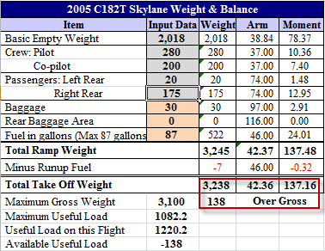
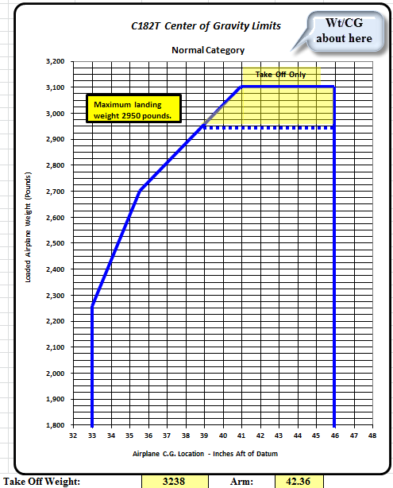
Weight & Balance Scenario – C-182T – Full Fuel
Airplane 138 pounds overweight
CG above the envelope
Airplane not legal to fly
http://williamjdoylejr.net/FAAST/W&B/Weight_and_Balance_Cessna_182T.xls

Slide 68
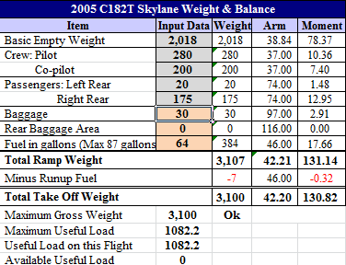
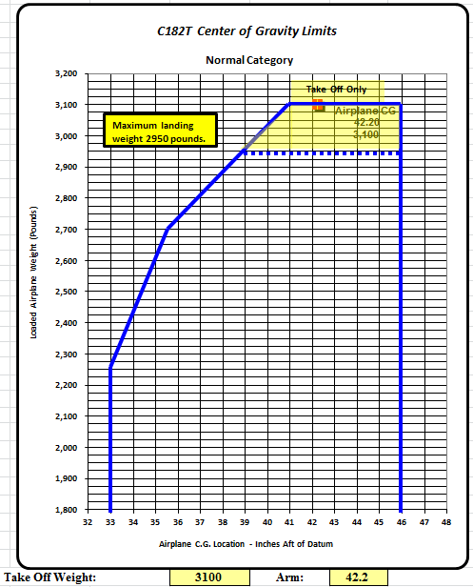
Weight & Balance Scenario – C-182T – Fuel to Tabs
Airplane within weight limit
CG within the envelope
Airplane is legal to fly
http://williamjdoylejr.net/FAAST/W&B/Weight_and_Balance_Cessna_182T.xls

Slide 69
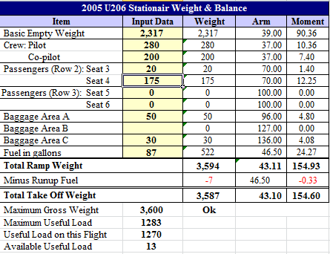
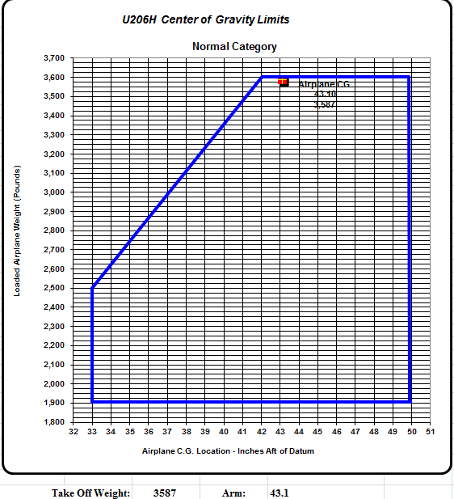
Weight & Balance Scenario – U-206H – Full Fuel
Airplane within weight and CG limits
Airplane is legal to fly
http://williamjdoylejr.net/FAAST/W&B/Weight_Balance_Cessna_U206H.xls
Notes:
With fuel to tabs, the airplane is within the weight and CG limits

Slide 70
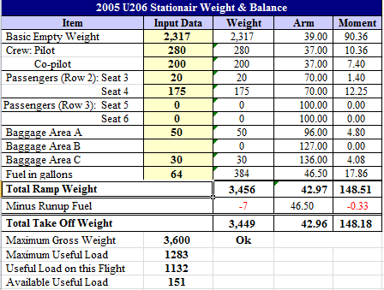
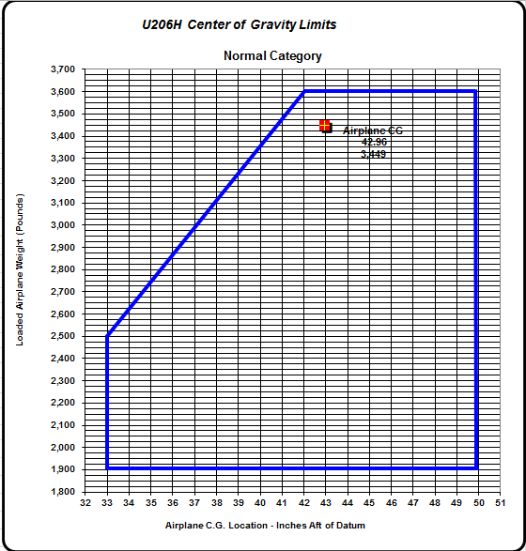
Weight & Balance Scenario – U-206H – Fuel to Tabs
Airplane within weight and CG limits
Airplane is legal to fly
http://williamjdoylejr.net/FAAST/W&B/Weight_Balance_Cessna_U206H.xls
Notes:
Airplane is within the weight and CG limits

Slide 71
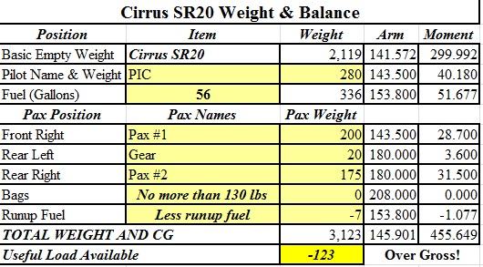
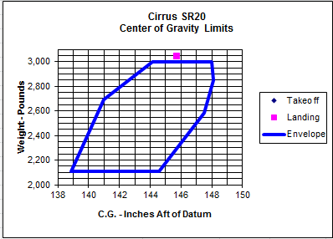
Weight & Balance Scenario – Cirrus SR20 – Full Fuel
Airplane 123 pounds overweight
CG above the envelope
Airplane not legal to fly
http://williamjdoylejr.net/FAAST/W&B/Weight_&_Balance_Cirrus_SR20.xls
Notes:
Airplane is over gross and out of CG limit

Slide 72
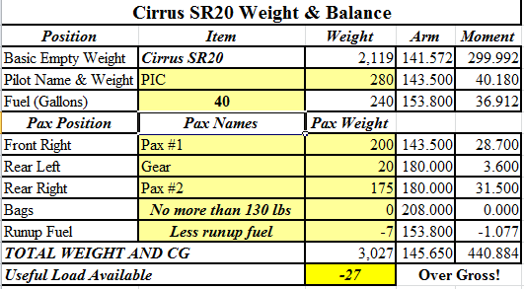
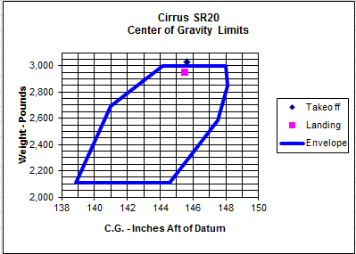
Weight & Balance Scenario – Cirrus SR20 –Tabs + 7
Airplane 27 pounds overweight
CG above the envelope
Airplane not legal to fly
http://williamjdoylejr.net/FAAST/W&B/Weight_&_Balance_Cirrus_SR20.xls
Notes:
Airplane is over gross and out of CG limit

Slide 73
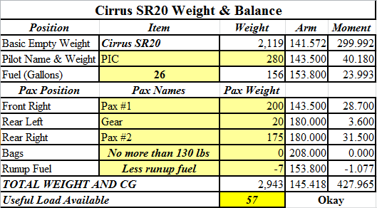
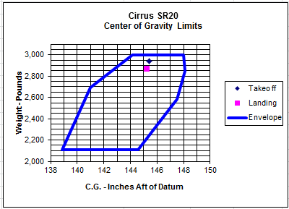
Weight & Balance Scenario – Cirrus SR20 – Fuel to Tabs
Airplane within weight and CG limits
Airplane legal to fly
http://williamjdoylejr.net/FAAST/W&B/Weight_&_Balance_Cirrus_SR20.xls
Notes:
A flight from Doylestown Airport (KDYL) to Cape May County Airport (KWWD) would take approximately an hour and burn about 12 gallons with only 14 gallons remaining.
FAR 91.151 - Fuel Requirements for Flight in VFR Conditions – 30 minute reserve for daytime flight
Return flight to KDYL not legal unless the airplane was refueled at KWWD

Slide 74
Planning a
Flight
Calculating Weight & Balance
Using ForeFlight Mobile Version 12.6
Apple iPad Air, iOS 12.4.8

Slide 75
Planning the Flight – Weight & Balance
2005 Cessna 182T Weight Limitations – Is everything good to go?
  Gross Takeoff Weight = 3,100 pounds
  Basic Empty Weight = 2,060 pounds
  Maximum Useful Load = 1,040 pounds
  Crew, Fuel, and Flight Kits
    Pilot (left front) – 200 pounds
    Passenger (right front) – 245 pounds
    Pilot Flight Kit (left rear) – 10 pounds
    Passenger Flight Kit (right rear) – 10 pounds
    Baggage (chocks, tie-down ropes, oil, etc.) – 30 pounds
    Fuel (64 gallons - tabs) – 384 pounds

Slide 76
Planning the Flight – Weight & Balance
See Pilot’s Guide to ForeFlight Mobile Version 12.6
  http://www.foreflight.com/ipad/guide/pdf
  Aircraft
    creating an aircraft: Pilot’s Guide pages 303-305
    deleting an aircraft: Pilot’s Guide page 307
  Weight & Balance: Pilot’s Guide page 302
See ForeFlight Mobile computation of weight & balance on following slides

Slide 77
ForeFlight Mobile Weight & Balance
You can use these steps to start Weight & Balance calculation
  Launch ForeFlight Mobile
  See Menu Bar at bottom of ForeFlight display
  Tap the “More” button on Menu Bar to see menu
  Tap “Weight & Balance” in right pane of next slide
Tap “More” to See Menu

Slide 78
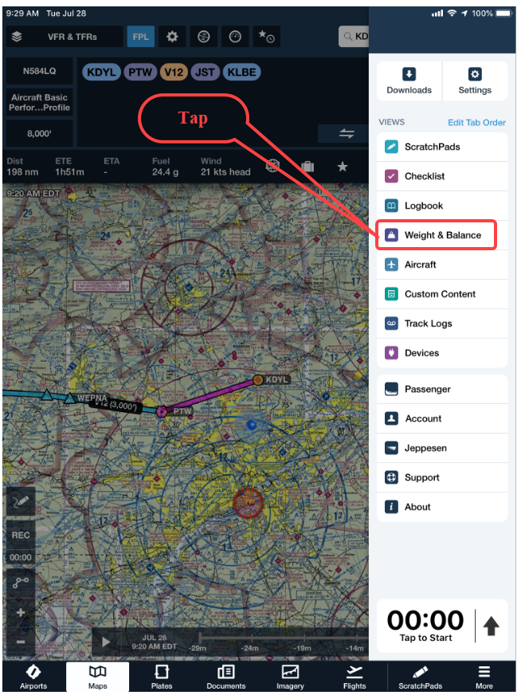
ForeFlight Mobile Weight & Balance

Slide 79

ForeFlight Mobile Weight & Balance

Slide 80
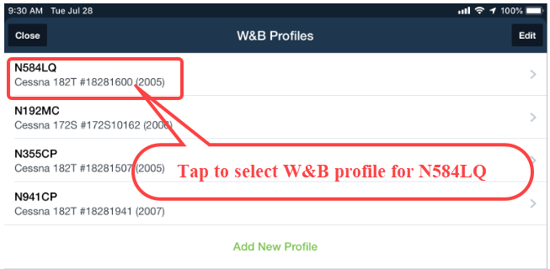
ForeFlight Mobile Weight & Balance

Slide 81
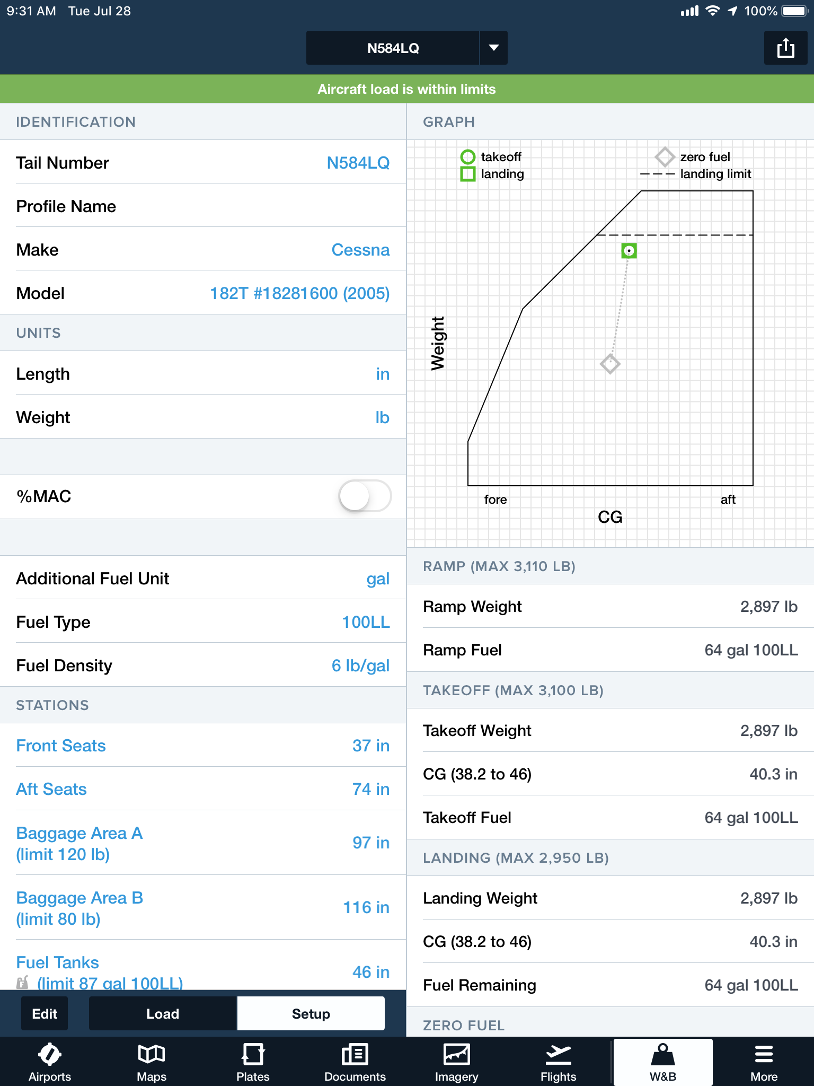
ForeFlight Mobile Weight & Balance – Setting Up An Airplane
This data is available from the weight & balance document in your airplane’s POH

Slide 82
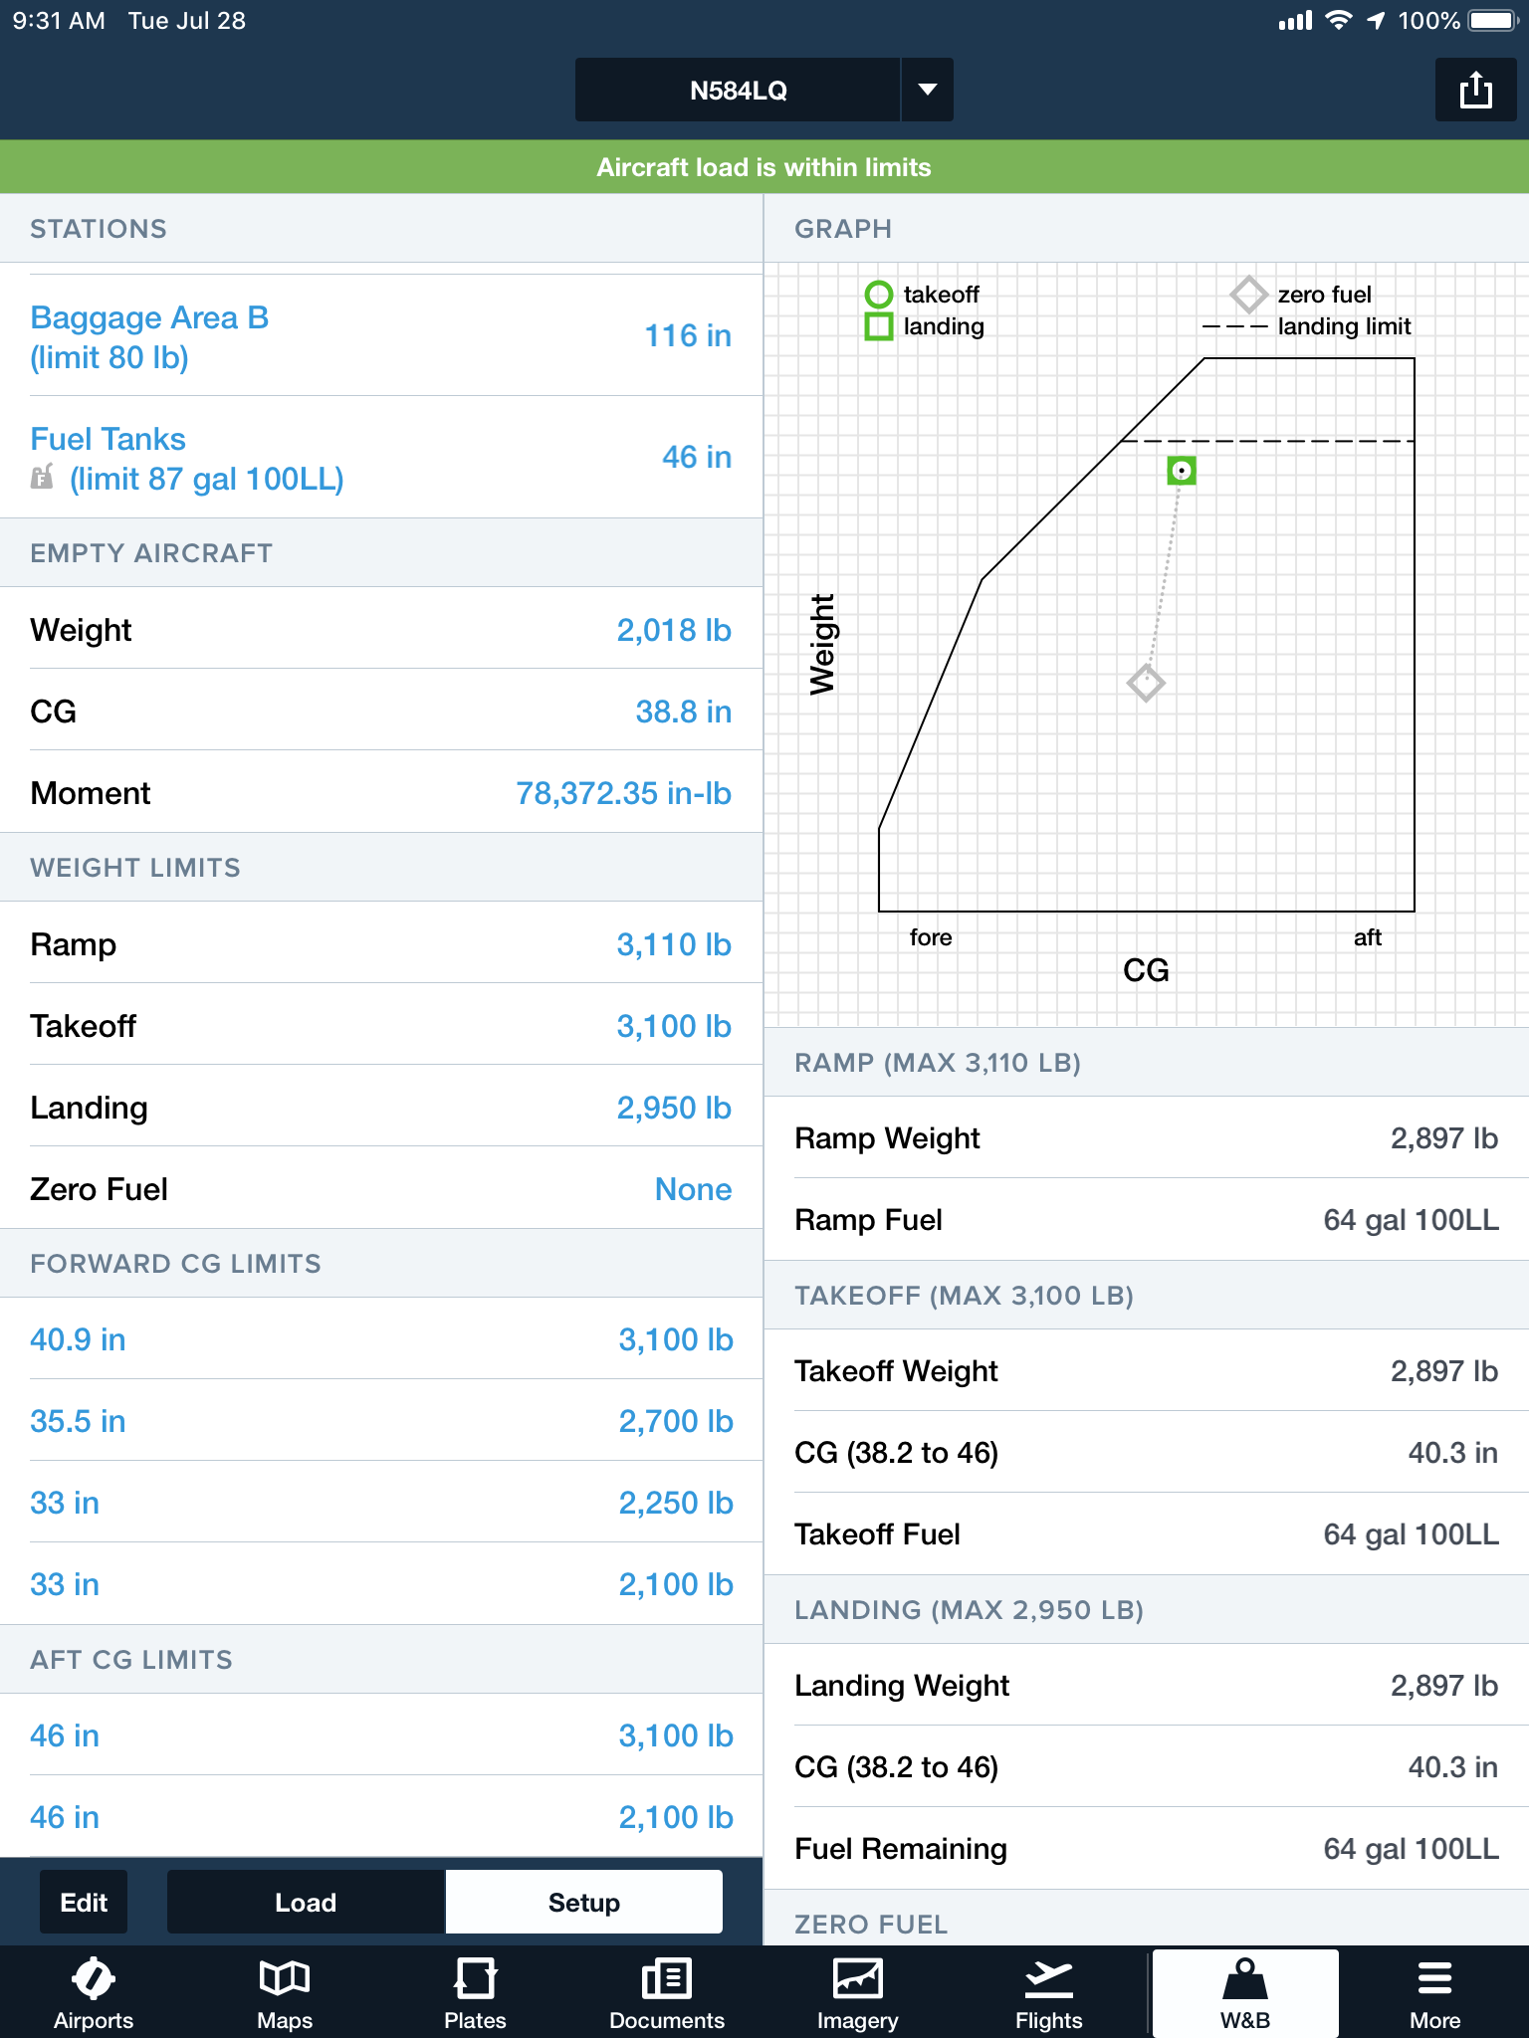
ForeFlight Mobile Weight & Balance – Setting Up An Airplane
This data is available from the weight & balance document in your airplane’s POH

Slide 83
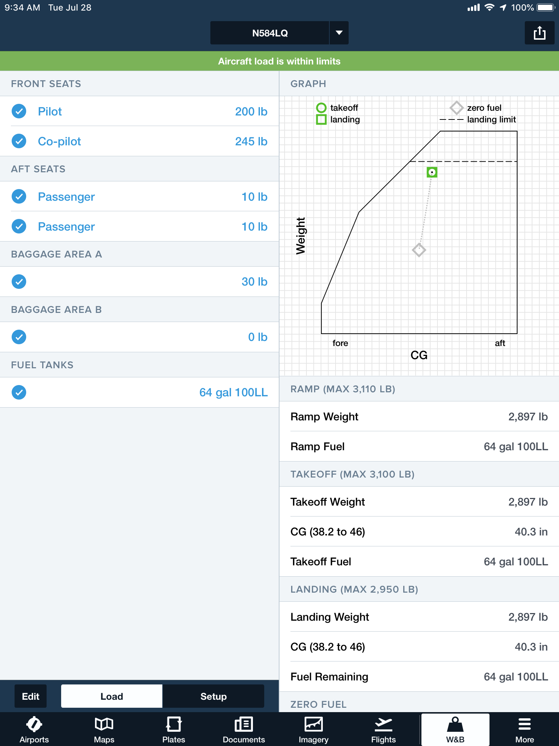

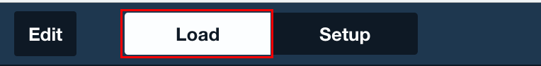
ForeFlight Mobile Weight & Balance – For A Given Flight
This data is unique to a given flight.
Crew weights, baggage weights, and fuel on board can vary.

Slide 84
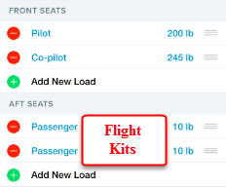
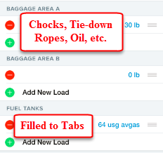

ForeFlight Mobile Weight & Balance – For A Given Flight
This data is unique to a given flight.
Crew weights, baggage weights, and fuel on board can vary.

Slide 85

ForeFlight Mobile Weight & Balance – For A Given Flight
Compare this graph to the CG envelope in the Weight & Balance section of your airplane’s POH

Slide 86
“After Class” Exercise
If you are a ForeFlight user, use ForeFlight Mobile to do a weight & balance computation:
  Setup your airplane
  Enter the following weights:
    Pilot & passenger
    Baggage
    Fuel in US gallons
  Determine the following:
    Is the airplane legal to fly based on its gross weight?
    Is the airplane legal to fly based on its CG envelope?
Feel free to use a different flight planning app as well as a different tablet or SmartPhone

Slide 87
How to Query the
NTSB Database
Notes:
This section introduces the audience to NTSB accident database queries
87

Slide 88

Accessing the NTSB Database
Use your web browser to access the NTSB Database
  http://www.ntsb.gov/_layouts/ntsb.aviation/index.aspx
Notes:
If possible, demonstrate browser usage to the audience
If no Internet connection is available, walk the audience through these slides

Slide 89

Accessing the NTSB Database
Notes:
Here are step-by-step instructions on how to set up a query
Specify a date range.
You can optionally specify a City, if looking for a specific airport.
You can optionally specify a state. Click the drop-down button then type the first initial. “n” gets “Nebraska.” Pressing “n” three more times gets “New Jersey.”
The default for Injury Severity is “All.” You can also click on the drop-down button and select either “Non-Fatal” or “Fatal.”
Enter “United States” as the Country.
For Operation, recommend clicking the drop-down button and selecting “Part 91: General Aviation.”
You can optionally enter a keyword such as “crosswind.” Understand that this will get you every accident that has the keyword “crosswind” in it, which does not necessarily mean that it was a crosswind accident.
If you know the NTSB Accident Number, you can select a specific accident.

Slide 90

Creating an NTSB Database Query
Notes:
Here are step-by-step instructions on how to set up a query
You can optionally enter a keyword such as “Weight and Balance.” Understand that this will get you every accident that has the keyword Weight and Balance” in it, which does not necessarily mean that it was a weight and balance accident.
If you know the NTSB Accident Number, you can select a specific accident.
Click Submit Query when done

Slide 91

Creating an NTSB Database Query

Slide 92

Creating an NTSB Database Query

Slide 93

How Many Weight & Balance Accidents in PA in Last 20 Years?
Notes:
Usage of a keyword returns every accident report containing that key word. It does not necessarily mean that the key word caused the accident only that the key word is somewhere in the report.

Slide 94

How Many Weight & Balance Accidents in PA in Last 20 Years?
Notes:
Usage of a keyword returns every accident report containing that key word. It does not necessarily mean that the key word caused the accident only that the key word is somewhere in the report.

Slide 95

How Many Weight & Balance Accidents in PA in Last 20 Years?
18 Accidents
Notes:
Sample of what the query results look like

Slide 96

How Many Weight & Balance Accidents in PA in Last 20 Years?
18 Accidents
Notes:
Sample of what the query results look like

Slide 97

How Many Weight & Balance Accidents in PA in Last 20 Years?
18 Accidents
56% had fatalities

Slide 98

How Many Weight & Balance Accidents in NJ in Last 20 Years?

Slide 99

How Many Weight & Balance Accidents in NJ in Last 20 Years?

Slide 100

How Many Weight & Balance Accidents in NJ in Last 20 Years?
10 Accidents
Notes:
Sample of what the query results look like

Slide 101

How Many Weight & Balance Accidents in NJ in Last 20 Years?
10 Accidents
60% had fatalities

Slide 102
How Many Weight & Balance Accidents in the Last 20 Years?
Spreadsheets built from the NTSB Database
    United States
      http://williamjdoylejr.net/FAAST/W&B/NTSB_Weight_and_Balance_2000-2019_3.xlsx
    Pennsylvania
      http://williamjdoylejr.net/FAAST/W&B/NTSB_Weight_and_Balance_2000-2019_PA.xlsx
      New Jersey
        http://williamjdoylejr.net/FAAST/W&B/NTSB_Weight_and_Balance_2000-2019_NJ.xlsx

Slide 103
How to Use AOPA to Query the
NTSB Database
Notes:
This section introduces the audience to NTSB accident database queries Using AOPA
103

Slide 104

Querying the NTSB Database from AOPA
Use your web browser to access AOPA
  https://www.aopa.org/
  Click TRAINING & SAFETY
  Click Air Safety Institute
Notes:
If possible, demonstrate browser usage to the audience
If no Internet connection is available, walk the audience through these slides

Slide 105

Querying the NTSB Database from AOPA
When you get to the Air Safety Institute
  Scroll down until you see Safety Content by Media Type

Slide 106

Querying the NTSB Database from AOPA
When you get to the Air Safety Institute
  Scroll down until you see Safety Content by Media Type
  Click on Accident Analysis

Slide 107

Querying the NTSB Database from AOPA
When you get to Accident Analysis
  Click on Accident Database
  You will then get a search form to complete

Slide 108

Querying the NTSB Database from AOPA
When you get to Accident Analysis search form
  Complete the fields indicated below
  Scroll down to enter more search data

Slide 109

Querying the NTSB Database from AOPA
As you continue the Accident Analysis search form
  Select PA 24 as the MODEL. This is a Piper Comanche.
  Select Fatal as the HIGHEST INJURY
  Click the SEARCH button

Slide 110

Querying the NTSB Database from AOPA

Slide 111


Querying the NTSB Database from AOPA
Clicking on the last accident on the page produces the following

Slide 112
Parting Thoughts
Notes:
Emphasize to the audience that they should seriously consider these items

Slide 113
Weight & Balance Suggestions for Non-Owners
Set Yourself Up to Succeed
  Purchase the Airplane Information Manual for each non-owned airplane you fly
  Get a copy of the weight & balance sheet from the POH for each airplane you fly
  Get a weight & balance program and use it for each airplane you fly
    If a ForeFlight user, set up a ForeFlight weight & balance profile for each airplane you fly
    Build your own weight & balance spreadsheet for each airplane you fly
      If you are not computer savvy, find someone who is and ask them to help you build one
    Buy a weight & balance tablet app and use it for each airplane you fly
Find out the fuel policies for the non-owned planes you fly
  Civil Air Patrol
    Cessna 172 – full (40 gallons or 50 gallons depending on whether tanks are long range)
    Cessna 182 – tabs (64 gallons); NJWG uses 50 gallons
  Cirrus SR20 Flying Club
    Tabs + 7 (40 gallons)
  Cessna NAV III (G1000) Flying Club
    Cessna 172S – 35 gallons
    Cessna 182T – 64 gallons (tabs)
Notes:
Think of this in terms of FAR 91.103
Getting the Airplane Information Manual is one of the best investments you can make

Slide 114
Weight & Balance Pre-flight Planning
Do all weight & balance computations at home before you leave for the airport
  Get dressed weight from each passenger; explain to them the importance of accuracy
  Do a computerized calculation with your weight and your passenger(s) weights
  Figure out how much weight is available for fuel and luggage
  Tell your passenger(s) how much luggage they can bring
Don’t be afraid to “manage” your passenger(s)
  Explain to them how the regulations and safety apply to weight & balance
  Don’t be afraid to tell them that not everyone will “fit” onboard
  Don’t be afraid to tell them that certain luggage items will not “fit”
Do a thorough flight planning and fuel needs analysis
  Don’t cut the fuel too close – there could be unexpected complications
Notes:
Think of this in terms of FAR 91.103
Do your planning at home, not on the fly at the airport
Explain the rules and expectations to your passengers beforehand

Slide 115
The Three Most Useless Things to a Pilot
The runway behind you
  Moral: know your aircraft’s take-off minimums and calculate the weight and balance for your flight, your airport’s runway length, density altitude, any obstacles to be cleared
The altitude above you
  Moral: know your aircraft’s power settings for climb, cruise, and descent
The fuel on the ground below you
  Moral: know your aircraft’s fuel capacity, fuel system, GPH burn rate, and winds aloft for the route of flight.
Utilize superior judgment to avoid needing to use superior skill
Notes:
Think of this in terms of FAR 91.103

Slide 116

Notes:
116
Breath – enjoy!

Slide 117
Credits and Information

Slide 118
References and Information
Author of Presentation
  William J. Doyle, Jr., CFI A&I, AGI, IGI, Cessna CFAI
    FAA FAAST Team Representative, PHL FSDO
Downloading this presentation and associated spreadsheets
  https://williamjdoylejr.net/FAAST/W&B/Weight_and_Balance_2020.pptx
  http://williamjdoylejr.net/FAAST/W&B/Weight_Balance_Cessna_172S.xls
  http://williamjdoylejr.net/FAAST/W&B/Weight_and_Balance_Cessna_182T.xls
  http://williamjdoylejr.net/FAAST/W&B/Weight_Balance_Cessna_U206H.xls
  http://williamjdoylejr.net/FAAST/W&B/Weight_&_Balance_Cirrus_SR20.xls
Tom Woods (deceased), FAAST Rep PHL FSDO and NJWG/LGM
  for creating the W&B spreadsheets for Cessna 172S, 182T, and U206H
907 Flight Squadron and the Cirrus Owners and Pilots Association
  for sourcing the Cirrus SR20 W&B spreadsheet to me
Notes:
How to download this presentation

Slide 119
FAA Handbooks (1 of 2)
  Airplane Flying Handbook (FAA-H-8083-3B)
  https://www.faa.gov/regulations_policies/handbooks_manuals/aviation/airplane_handbook/
Pilots Handbook of Aeronautical Knowledge (FAA-H-8083-25A)
  https://www.faa.gov/regulations_policies/handbooks_manuals/aviation/phak/
  Risk Management Handbook (FAA-H-8083-2)
  https://www.faa.gov/regulations_policies/handbooks_manuals/aviation/media/risk_management_hb_change_1.pdf
Advanced Avionics Handbook (FAA-H-8083-6)
  https://www.faa.gov/regulations_policies/handbooks_manuals/aviation/advanced_avionics_handbook/
  https://www.faa.gov/regulations_policies/handbooks_manuals/aviation/media/aah_errata.pdf
Notes:
119
Some good FAA References

Slide 120
FAA Handbooks (2 of 2)
FAA Aircraft Weight & Balance Handbook – FAA-H-8083-1B
  https://www.faa.gov/regulations_policies/handbooks_manuals/aviation/media/FAA-H-8083-1.pdf
Instrument Flying Handbook (FAA-H-8083-15B)
  https://www.faa.gov/regulations_policies/handbooks_manuals/aviation/media/FAA-H-8083-15B.pdf
  https://www.faa.gov/regulations_policies/handbooks_manuals/aviation/media/ifh_errata.pdf
  https://www.faa.gov/regulations_policies/handbooks_manuals/aviation/media/ifh_addendum.pdf
  https://www.faa.gov/regulations_policies/handbooks_manuals/aviation/media/ifh_addendum_b.pdf
  https://www.faa.gov/regulations_policies/handbooks_manuals/aviation/instrument_procedures_handbook/
Notes:
120
Some good FAA References

Slide 121
References and Information
Dr. Al Schnur
  formula for recalculating Vspeeds for weights below gross weight.
  NTSB Accident Database
  http://www.ntsb.gov/_layouts/ntsb.aviation/index.aspx
Electronic Code of Federal Regulations – Title 14 Chapter I--Federal Aviation Administration, Department of Transportation
  Subchapter D – Airmen
  https://www.ecfr.gov/cgi-bin/text-idx?SID=d26e35f6991f05d99f5399e2671b5d3f&mc=true&tpl=/ecfrbrowse/Title14/14CIsubchapD.tpl
  Click on Part 61
  Subchapter F – Air Traffic and General Operating Rules
  Navigate to section using above link (Subchapter D – Airmen)
  Click on Part 91
Notes:
121
Some good FAA References

Slide 122

Notes:
122
Breath – enjoy!

Slide 123
Appendix
Weight & CG
Change Formulas
Notes:
These formulas are from prior FAA Knowledge Tests

Slide 124

Weight Change Formula
Changes in Weight and Moment

Slide 125

Weight Change Formula
Airplane takes off with the following:
  Weight = 6,230 lbs
  CG = 79.0
What is the CG after 50 gallons of fuel burned from station 87?
Solution

Slide 126

Weight Change Formula
Airplane takes off with the following:
  Weight = 3,000 lbs
  CG = 60.0
After takeoff
  25 gallons fuel burned at station 65
  200 lb passenger moves from station 50 to station 90
What is the resulting CG?
Solution

Slide 127

Weight Shift Formula - CG Shifted by Weight Move
Airplane Gross Weight = 10,000 lbs; 500 lbs cargo shifts 50 inches.
How far does the CG move?

Slide 128

Weight Shift Formula -
Weight Shifted to Move CG Two Inches

Slide 129

Weight Shift Formula -
CG Shifted by Weight Move

Slide 130

Weight Shift Formula -
How Far to Move Weight to Shift CG

Slide 131

This Completes
Airplane Weight & Balance
The Inherent Dangers of Weight and Balance Procedural Complacency
What You Don’t Know Can Get You and Your Passengers Killed!
FAA Customer Feedback Website
http://www.faa.gov/about/office_org/headquarters_offices/avs/offices/afs/qms/
PHL FSDO FAAST Program Manager – Eric Sieracki -
Eric.Sieracki@faa.gov
Notes:
131
Remind the attendees that they must sign in to be credited for attendance.
Ask for suggestions of any kind, especially what they would like to have presented as “elective” topics.

