Slide 1
Airplane Weight and Balance
The Inherent Dangers of Weight and Balance Procedural Complacency
–
What You Don’t Know Can Get You and Your Passengers Killed!
FAA Safety Seminar Attendees
W. J. Doyle, Jr., CFI A&I, AGI, IGI, FAAST Rep
2018
Notes:
This presentation is an overview of weight & balance procedures and demonstration of several appropriate techniques for calculating weight & balance. The seminar will consider NTSB Accident Data and an eleven year trend as it relates to weight & balance as the accident causal factor.
What can we learn from others mistakes?
What does the FAA say about flight planning?
What should we consider when planning our flights?
Join us in looking at some flights that will address these and other important questions and considerations.
This presentation was built by FAASTeam Rep William J Doyle, Jr. doylewj@ix.netcom.com

Slide 2

Asking Questions During Webinar

Slide 3
How to Download this Presentation
You can download this presentation at the link below.
  http://williamjdoylejr.net/FAAST/W&B/Weight_and_Balance_2018.pptx
  The link is case-sensitive
  If prompted for a password, click the “Read Only” button
  You can email me doylewj@ix.Netcom.com to request the link

Slide 4
Presentation Agenda
Weight & Balance Accident Trends
Weight & Balance Accident Scenarios
Applicable FARs
Weight & Balance Concepts
Weight & Balance Terms
Weight & Balance Computations
Calculating Weight & Balance Using iPad and ForeFlight
Weight Impact on V-Speeds
A Few Weight & Balance Scenarios
How to Query the NTSB Database
Flight Service Transition from DUATS to Leidos

Slide 5
NTSB Statistics on
Weight & Balance Accidents in the
United States from 2000 to 2017

Slide 6
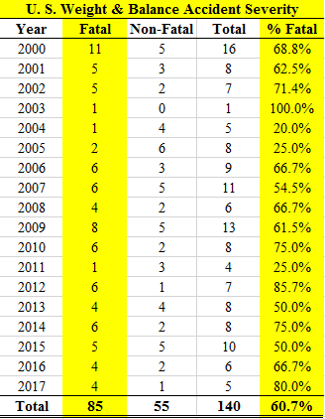
NTSB Weight & Balance Accident Trends
U.S.
2000 – 2017
60.7% of these accidents involved fatalities.
Notes:
These statistics were drawn from the NTSB accident database at https://www.ntsb.gov/_layouts/ntsb.aviation/index.aspx
The search criteria were:
Date Range 01/01/2000 to 12/31/2017
Country – United States
Injury Severity: All
Category: Airplane
Operation: Part91:General Aviation
Key Words: "weight and balance" or "weight & balance" or "weight limitations"
The search returned 478 results that contained the key words "weight and balance" or "weight & balance" or "weight limitations"
140 accidents had weight and balance as a causal factor
337 accidents did not have weight and balance as a causal factor
some of these were due to airplane performance such as density altitude, runway length with weight and balance within limits
others said that weight and balance was not a factor
The results were downloaded as an XML file and then filtered for the 140 accidents where weight and balance was a causal factor
The remaining statistics were done in Excel

Slide 7
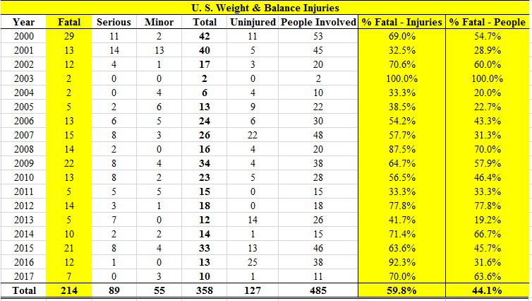
NTSB Weight & Balance Accident Trends U.S. 2000 – 2017
On average there is a 44.1% chance that someone onboard will die if you have an accident where weight & balance is a causal factor
Notes:
These statistics were drawn from the NTSB accident database at https://www.ntsb.gov/_layouts/ntsb.aviation/index.aspx
The search criteria were:
Date Range 01/01/2000 to 12/31/2017
Country – United States
Injury Severity: All
Category: Airplane
Operation: Part91:General Aviation
Key Words: "weight and balance" or "weight & balance" or "weight limitations"
The search returned 478 results that contained the key words "weight and balance" or "weight & balance" or "weight limitations"
140 accidents had weight and balance as a causal factor
337 accidents did not have weight and balance as a causal factor
some of these were due to airplane performance such as density altitude, runway length with weight and balance within limits
others said that weight and balance was not a factor
The results were downloaded as an XML file and then filtered for the 140 accidents where weight and balance was a causal factor
The remaining statistics were done in Excel

Slide 8
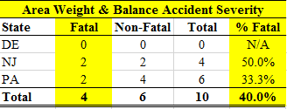
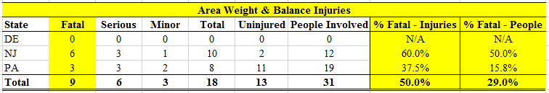
NTSB Weight & Balance Accident Trends
DE/NJ/PA 2000 – 2017
Our area has done better than the national average but there have still been fatalities and serious injuries.
Notes:
These statistics were drawn from the NTSB accident database at https://www.ntsb.gov/_layouts/ntsb.aviation/index.aspx
The search criteria were:
Date Range 01/01/2000 to 12/31/2017
Country – United States
Injury Severity: All
Category: Airplane
Operation: Part91:General Aviation
Key Words: "weight and balance" or "weight & balance" or "weight limitations"
The search returned 478 results that contained the key words "weight and balance" or "weight & balance" or "weight limitations"
140 accidents had weight and balance as a causal factor
337 accidents did not have weight and balance as a causal factor
some of these were due to airplane performance such as density altitude, runway length with weight and balance within limits
others said that weight and balance was not a factor
The results were downloaded as an XML file and then filtered for the 140 accidents where weight and balance was a causal factor
The remaining statistics were done in Excel and filtered for DE, NJ, and PA

Slide 9
NTSB Weight & Balance Accident Trends
U.S. – 2000 – 2017
TOW = Take-Off Weight
Most of these accidents had an AFT CG that was AFT of the CG limit
N4955A – 5 people (3 children ages 11, 12, 13)
N59532 – boy (age 4) not belted in, died of head trauma
Notes:
These statistics were drawn from the NTSB accident database at https://www.ntsb.gov/_layouts/ntsb.aviation/index.aspx
The search criteria were:
Date Range 01/01/2000 to 12/31/2017
Country – United States
Injury Severity: All
Category: Airplane
Operation: Part91:General Aviation
Key Words: "weight and balance" or "weight & balance" or "weight limitations"
The search returned 478 results that contained the key words "weight and balance" or "weight & balance" or "weight limitations"
140 accidents had weight and balance as a causal factor
337 accidents did not have weight and balance as a causal factor
some of these were due to airplane performance such as density altitude, runway length with weight and balance within limits
others said that weight and balance was not a factor
The results were downloaded as an XML file and then filtered for the 140 accidents where weight and balance was a causal factor
The remaining statistics were done in Excel
This is a highlight of six really tragic accidents

Slide 10
Cessna 180 N4955A – NTSB Report ANC11FA037
The accident occurred 5/27/2011
  Pilot’s logbook noted about 4 hours in the accident airplane
  Pilot had not flown since 6/12/2010
  Pilot did not meet the FAA’s recent experience requirement for the required number of takeoff and landings to carry passengers.
Airplane’s estimated gross weight at the time of the accident was about 243 pounds over its approved maximum takeoff weight.
Witness accounts reported
  Airplane swerving off the runway during the takeoff roll
  Nose-high attitude and rapid roll prior to impact
Pilot likely lost control during the takeoff roll
  Pilot applied excessive nose-up pitch to become airborne.
  Once airborne, pilot failed to attain sufficient airspeed to avoid an aerodynamic stall
  Airplane descended out of control to the ground.

Slide 11
Cessna 180 N4955A – NTSB Report ANC11FA037
Estimated Weight and Balance
  Due to the extensive fire damage, an exact weight and balance calculation could not be made.
  Pilot’s weight was taken from his most current FAA medical examination.
  Weight of the front seat passenger was taken from her reported weight on her Alaska driver’s license.
  Weights for the rear seat passengers (girls: ages 11 and 13, and boy: age 12) were estimated using the Centers for Disease Control (CDC) growth charts showing average weight by age and gender.

Slide 12
Cessna 180 N4955A – NTSB Report ANC11FA037
Items of cargo that were identifiable are listed as follows:
  Chainsaw
  Pistol
  Multiple bags of food and grocery items
  Personal clothing and bags
  Pots
  Kitchen utensils
  Rope
  Bundle of electrical wire
Pilot’s son said that the airplane’s fuel tanks were completely filled prior to the accident flight from the pilot’s personal fuel storage tank.

Slide 13
Cessna 180 N4955A – NTSB Report ANC11FA037
Estimated weights
  Basic Empty Weight (from March 5, 1991) – 1631 pounds
  Pilot and Front seat Passenger – 417 pounds
  Rear Seat Passengers – 293 pounds
  Cargo – 100 pounds
  Fuel (55 gallons) – 330 pounds
  Oil (12 quarts) – 22 pounds
The gross weight of the airplane at the time of the accident was estimated to be 2,793 pounds, or 243 pounds over the approved maximum takeoff gross weight for the airplane.
The estimated center of gravity at the time of the accident was positive 42.18 inches.
The center of gravity range at 2,550 pounds (maximum gross weight) is positive 39.5 inches to positive 45.8 inches

Slide 14
Are There Any FARs
That Cover Weight & Balance?
Notes:
FAR 91.103 – Preflight Action

Slide 15
14 CFR 91.103 – Preflight Action
Each pilot in command shall, before beginning a flight, become familiar with all available information concerning that flight. This information must include {but is not limited to} —
  For a flight under IFR or a flight not in the vicinity of an airport, weather reports and forecasts, fuel requirements, alternatives available if the planned flight cannot be completed, and any known traffic delays of which the pilot in command has been advised by ATC;
  For any flight, runway lengths at airports of intended use, and the following takeoff and landing distance information:
    For civil aircraft for which an approved Airplane or Rotorcraft Flight Manual containing takeoff and landing distance data is required, the takeoff and landing distance data contained therein; and
    For civil aircraft other than those specified in paragraph (b)(1) of this section, other reliable information appropriate to the aircraft, relating to aircraft performance under expected values of airport elevation and runway slope, aircraft gross weight, and wind and temperature.

Slide 16
Weight & Balance Concepts from an
Elementary School and
Middle School
Perspective

Slide 17
How Much Can an Airplane Weigh?
Each airplane has a limitation called the maximum gross takeoff weight. Some airplanes also have a maximum gross landing weight.
This weight includes everything
    Airplane (empty)
    Fuel
    Pilot and passengers
    Baggage
There is another component called “Balance.”
The entire process is called “Weight and Balance.”

Slide 18
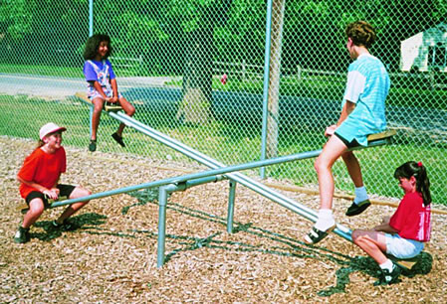
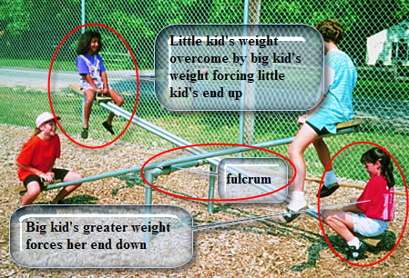
What Does Balance Mean?
Classic example is the playground seesaw:
    Center bar is the fulcrum which is the center of gravity.
    Heavier weight of “big” kid on one end overcomes lesser weight of “little” kid on other end
    This forces the “little” kid to go up
    Is there a way to make the “big” kid go up without adding weight or changing kids?

Slide 19
Weight & Balance Terms
That All Pilots
Should Know

Slide 20
Weight & Balance Terms
Arm (moment arm)
  horizontal distance in inches from the reference datum line to the CG of an item.
  Arms ahead (forward) of the reference datum are minus (–)
  Arms behind (aft) of the reference datum are positive (+)
  When the reference datum is ahead of the airplane, all of the arms are positive and computational errors are minimized
Reference Datum
  imaginary vertical plane from which all distances are measured
Moment
      product of the weight of an item multiplied by its arm. Moments are expressed in inch-pounds (in-lb). Total moment = airplane weight * the distance between the datum and the CG.
Moment Index
  moment divided by a constant such as 100, 1,000, or 10,000. The purpose of using a moment index is to simplify weight and balance computations of aircraft where heavy items and long arms result in large, unmanageable numbers.

Slide 21
Weight & Balance Terms
Station
      a location in the aircraft that is identified by a number designating its distance in inches from the datum. The datum is, therefore, identified as station zero. An item located at station +50 would have an arm of 50 inches.
Center of Gravity (CG)
      imaginary point when aircraft would balance if suspended, i.e. where all of its weight is concentrated
CG Limits
      forward and aft center of gravity locations within which the aircraft must be operated at a given weight

Slide 22
Weight & Balance Terms
Usable Fuel
  fuel available for flight planning and during flight
Unusable Fuel
  fuel remaining in the airplane’s system after a run-out test
Basic Empty Weight
  weight of the standard airplane, optional equipment, unusable fuel, and full operating fluids, e.g. full engine oil
Total Weight (Gross Weight)
  total weight of airplane and everything it is carrying
  Takeoff & Landing weight limitations may be different (Note C182, SR20)
Maximum Ramp Weight
  maximum weight limit for ground operations such as taxiing
Maximum Takeoff Weight
  maximum weight limit for taking off; may be more than landing weight
Maximum Landing Weight
  maximum weight limit for landing; may be less than takeoff weight

Slide 23
Weight & Balance Terms
Maximum Weight
  weight limit set by the manufacturer
Maximum Zero Fuel Weight
  maximum weight exclusive of usable fuel
Useful Load
  maximum weight minus empty weight; weight available for crew, passengers, baggage, fuel
Payload – Important in CAP Context for C172/C182/U206 Missions
  useful load minus full fuel; weight available for air crew and baggage
Standard Weights
  fuel weighs 6 pounds per U.S. gallon
  oil weighs 7.5 pounds per U.S. gallon or 1.875 pounds per U.S. quart
Notes:
Emphasize Payload importance

Slide 24
How to Calculate
Weight & Balance

Slide 25
Weight & Balance Computations
Center of Gravity (CG)
CG Calculation – Computational Method
  By hand (need for FAA knowledge test)
  Using an Excel spreadsheet
  Using ForeFlight on an iPad/iPhone
CG Calculation – Graphic Method

Slide 26
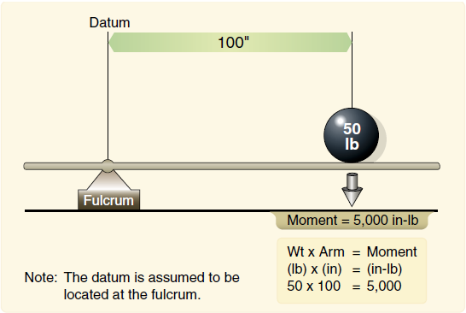
Weight & Balance Computation Concepts
Calculating the Moment
  Given
    Arm = 100 inches
    Weight = 50 pounds
  Layout the formula
    Wt x Arm = Moment
    50 x 100 = 5,000
Notes:
Moment = Weight x Arm

Slide 27
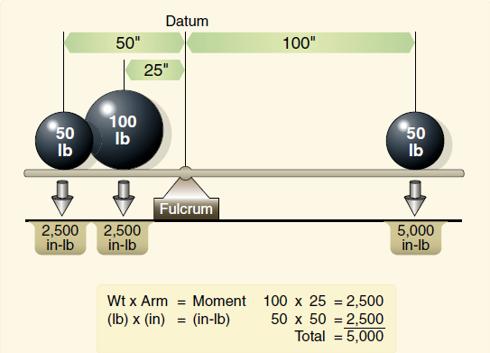
Weight & Balance Computation Concepts
Calculating the Balance
  Given
    Arm = 50 inches
    Weight = 50 pounds
    Arm = 25 inches
    Weight = 100 pounds
  Layout the formula
    Wt x Arm = Moment
    50 x 50 = 2,500
    100 x 25 = 2,500
    Total = 5,000
  Arm to balance a 50 lb weight
    Wt x Arm = Moment
    50 x ? = 5,000
    Moment ÷ Weight = Arm
    5,000 ÷ 50 = 100
Playground Seesaw Example
Moving the little kid to balance the big kid
Notes:
How to figure the Arm necessary to balance a weight

Slide 28
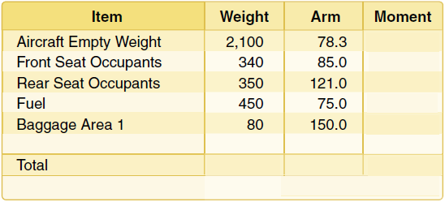
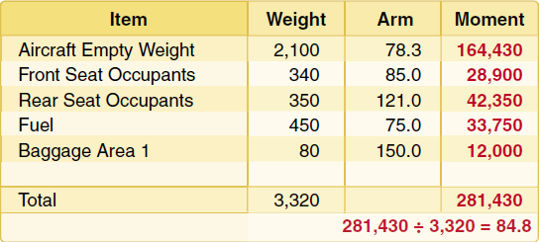
Weight & Balance Computation Concepts
Computational Method
  Aircraft Allowances:
    Maximum gross weight = 3,400 pounds
    CG range = 78–86 inches
  Given:
    Weight of front seat occupants = 340 pounds
    Weight of rear seat occupants = 350 pounds
    Fuel = 75 gallons
    Weight of baggage in area 1 = 80 pounds
  Problem to solve
    Is CG within range?
    Is weight <= gross weight?
Notes:
CG = Total Moment / Total Weight

Slide 29
Weight & Balance Calculation – Graph Method
Find weight for pilot and front seat passenger
Read from weight scale to diagonal line then straight down for moment
Record moment on worksheet
Repeat for rear seat passengers, baggage, and fuel
Find total weight and total moment lines on CG envelope graph
Check intersection of lines to see if within envelope
Notes:
Steps for the Graph Method

Slide 30
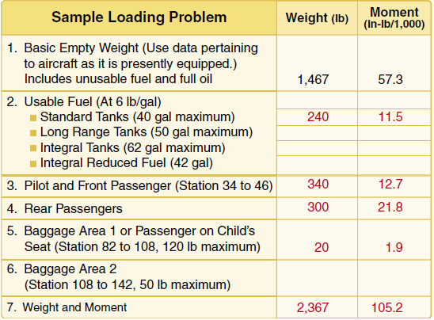
Weight & Balance Calculation – Graph Method
Calculating an airplane’s CG via Graph Method
  To simplify calculations, the moment may sometimes be divided by 100, 1,000, or 10,000.
  Aircraft Allowances:
    Maximum gross weight = 2,400 pounds
  Given:
    Weight of front seat occupants = 340 pounds
    Weight of rear seat occupants = 300 pounds
    Fuel = 40 gallons
    Weight of baggage in area 1 = 20 pounds
  Problem to solve
    Is the Moment within range?
    Is weight <= gross weight?
CG = Moment x 1000 / Weight = ?
CG = 105.2 x 1000 / 2367 = 44.44
Notes:
List the weight for each item
Look up the Moment for each item in slide #25
Plot the Total Weight and Total Moment as indicated on slide #26

Slide 31
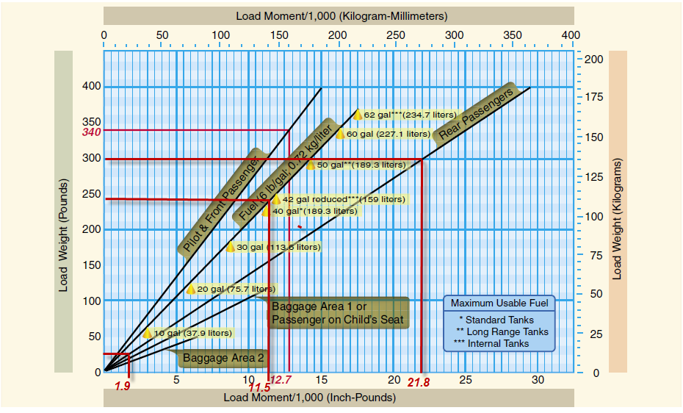
Weight & Balance Calculation – Graph Method
Notes:
See notes on slide #24

Slide 32
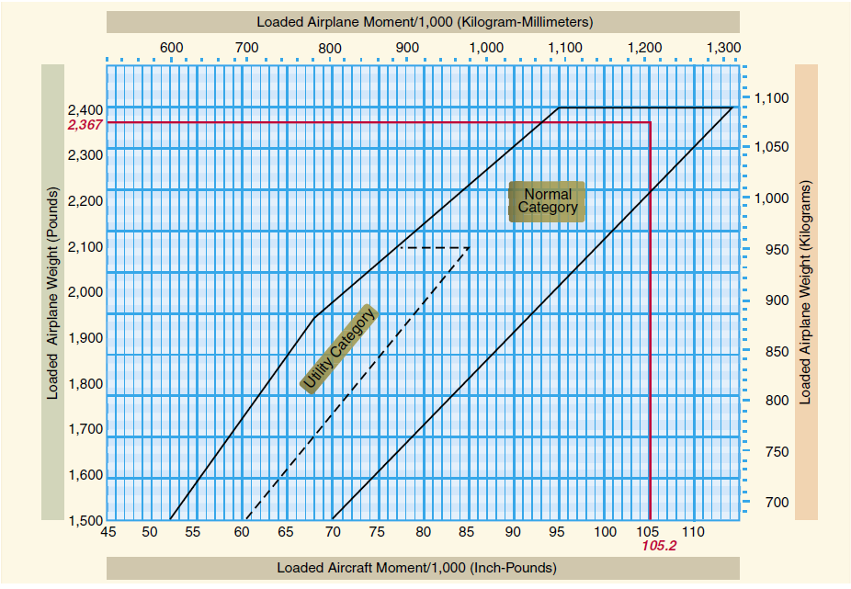
Weight & Balance Calculation – Graph Method
Notes:
See notes on slide #24

Slide 33
Weight & Balance Computations
CG Computation -- Table Method
CG Computation -- Graphic Method
Flight Scenario | Left Front | Right Front | Left Rear | Right Rear | Fuel in Gallons
#1 | Pilot: 280 lbs | Passenger: 200 lbs | N/A | N/A | 35
#2 | Pilot: 280 lbs | Passenger: 200 lbs | Cameras &Gear: 20 lbs | Passenger: 175 lbs | 53
Notes:
Data for slides 28 to 33

Slide 34
CG Calculation - Computational Method
Excel Spreadsheet – Cessna 172S
Individual Items
  Item Name
  Item Weight
  Item Arm
  Item Moment (weight * arm)
CG inches
  Total Moment / Total Weight
CG Worksheet in Excel
  http://williamjdoylejr.net/FAAST/W&B/Weight_Balance_Cessna_172S.xls

Slide 35
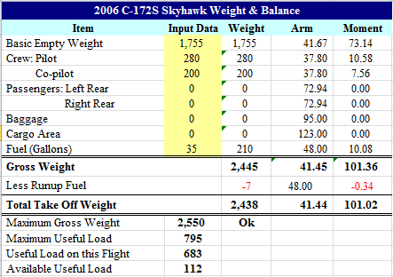
CG Calculation - Computational Method – Scenario #1

Slide 36
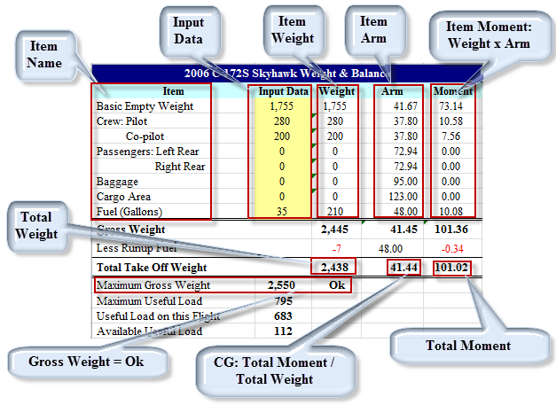
CG Calculation - Computational Method – Scenario #1

Slide 37
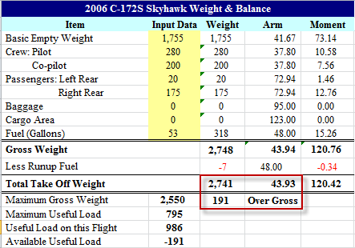
CG Calculation - Computational Method – Scenario #2

Slide 38
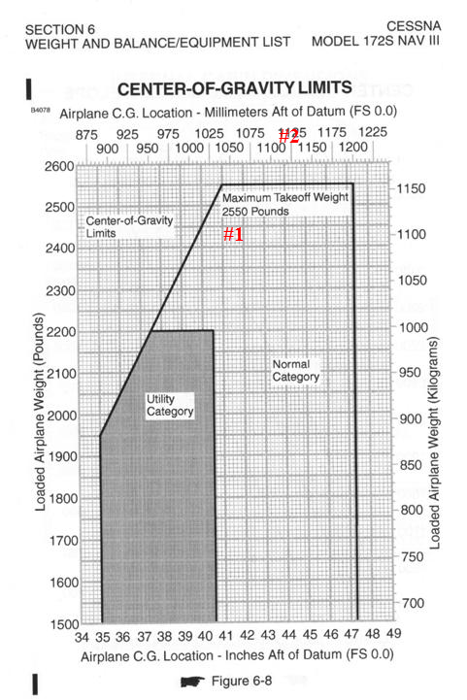
Cessna 172S Center of Gravity Limits
Scenario #1 is within weight and CG limits
Scenario #2 exceeds weight and CG limits

Slide 39
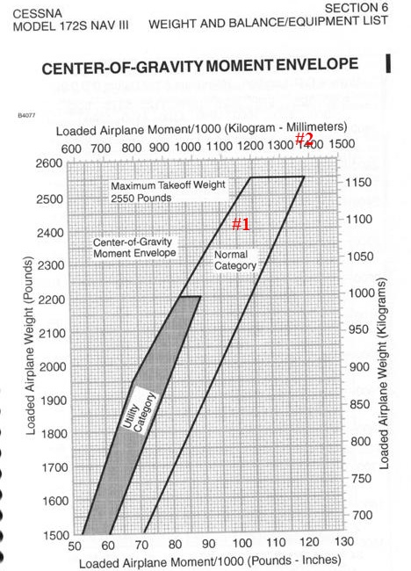
Cessna 172S CG-Moment Envelope
Scenario #1 is within weight and CG limits
Scenario #2 exceeds weight and CG limits

Slide 40
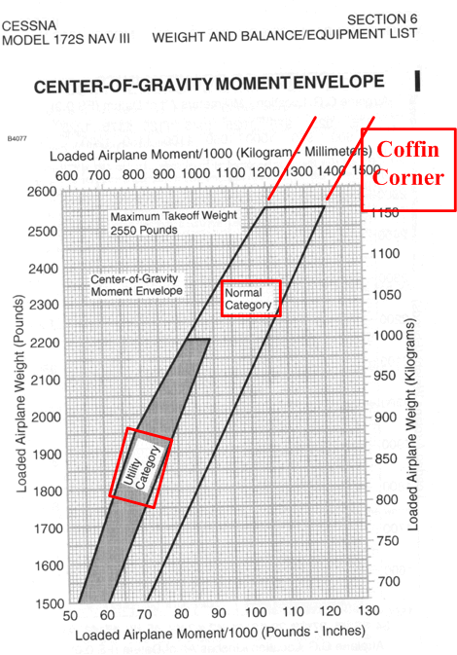
Cessna 172S CG-Moment Envelope – Dangers and Limitations
Coffin Corner –
  Above gross weight limit
  Aft of Aft CG limit
  Stall-Spin accident in making
Normal Category – See POH
  No spins
Utility Category – See POH
  Spins may be okay

Slide 41
Weight Impact on VSpeeds
Notes:
As the airplane flies and burns fuel, the airplane gets lighter
As the airplane gets lighter, certain Vspeeds decrease

Slide 42





Weight Impact on VSpeed
Excel Formula
SQRT(Flying Weight Cell/Gross Weight Cell)*V_{Speed} Cell
Excel Examples
Notes:
As the airplane flies and burns fuel, the airplane gets lighter
As the airplane gets lighter, certain Vspeeds decrease
Vspeeds in the POH are typically shown at gross weight

Slide 43
Weight & Balance
Scenarios
Notes:
This section uses the data from slide #27 and slide #37
43

Slide 44
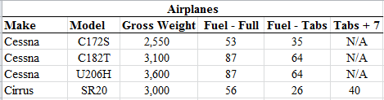
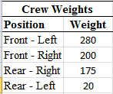
Weight & Balance Scenarios
Airplanes to be used for a cross country flight from Doylestown (KDYL) to Cape May (KWWD) and back
Crew weights and positions
Will each airplane be within weight and CG limits?

Slide 45
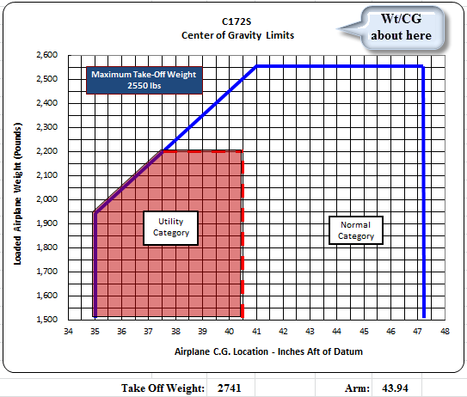
Weight & Balance Scenario – C-172S – Full Fuel
Airplane 191 pounds overweight
CG above the envelope
Airplane not legal to fly
http://williamjdoylejr.net/FAAST/W&B/Weight_Balance_Cessna_172S.xls
Notes:
Airplane is over gross and out of CG limit

Slide 46
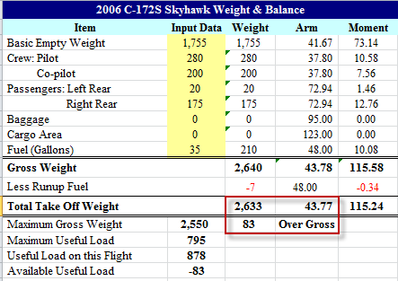
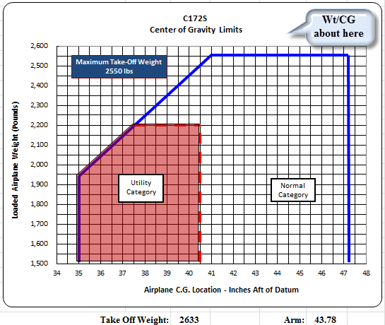
Weight & Balance Scenario – C-172S – Fuel to Tabs
Airplane 83 pounds overweight
CG above the envelope
Airplane not legal to fly
http://williamjdoylejr.net/FAAST/W&B/Weight_Balance_Cessna_172S.xls
Notes:
The fuel could be reduced by 14 gallons to get within the weight limits, but that leaves only 21 gallons of fuel.
A flight from Doylestown Airport (KDYL) to Cape May County Airport (KWWD) would take approximately an hour and burn 9 to 10 gallons with only 11 or 12 gallons remaining.
FAR 91.151 - Fuel Requirements for Flight in VFR Conditions – 30 minute reserve for daytime flight
Return flight to KDYL not legal unless the airplane was refueled at KWWD

Slide 47
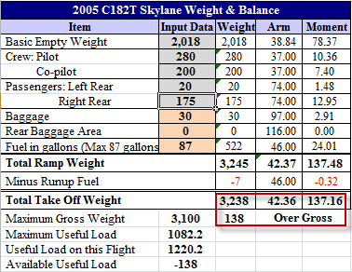
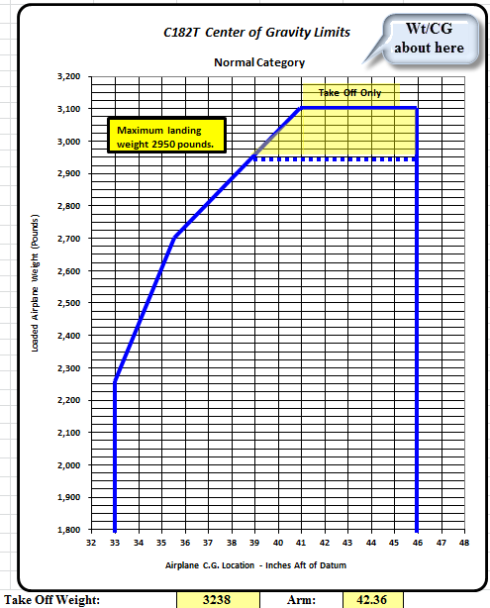
Weight & Balance Scenario – C-182T – Full Fuel
Airplane 138 pounds overweight
CG above the envelope
Airplane not legal to fly
http://williamjdoylejr.net/FAAST/W&B/Weight_and_Balance_Cessna_182T.xls
Notes:
See slide #41 – fuel to tabs

Slide 48
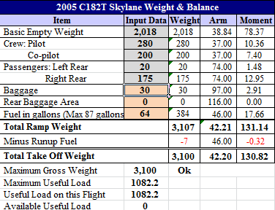
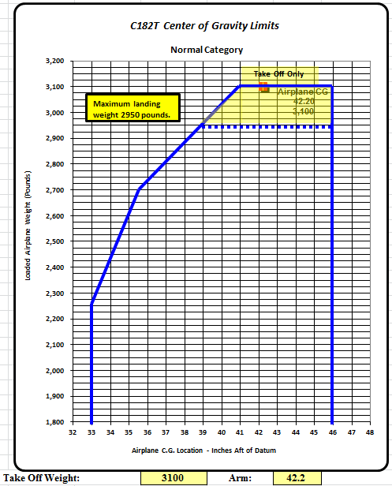
Weight & Balance Scenario – C-182T – Fuel to Tabs
Airplane within weight limit
CG within the envelope
Airplane is legal to fly
http://williamjdoylejr.net/FAAST/W&B/Weight_and_Balance_Cessna_182T.xls

Slide 49
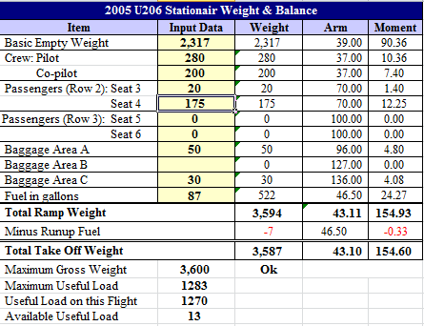
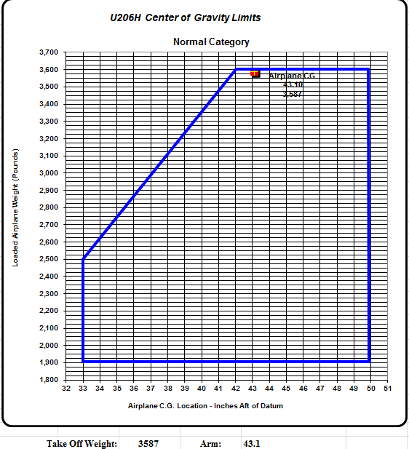
Weight & Balance Scenario – U-206H – Full Fuel
Airplane within weight and CG limits
Airplane is legal to fly
http://williamjdoylejr.net/FAAST/W&B/Weight_Balance_Cessna_U206H.xls
Notes:
With fuel to tabs, the airplane is within the weight and CG limits

Slide 50
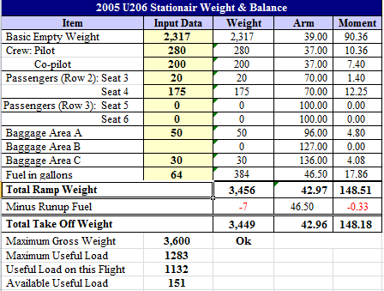
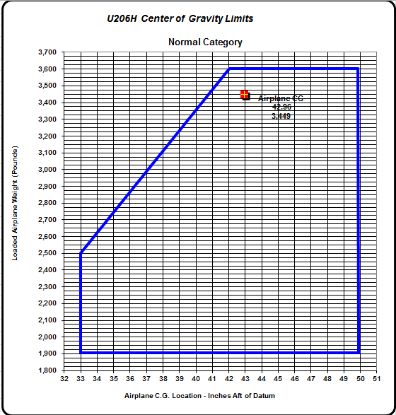
Weight & Balance Scenario – U-206H – Fuel to Tabs
Airplane within weight and CG limits
Airplane is legal to fly
http://williamjdoylejr.net/FAAST/W&B/Weight_Balance_Cessna_U206H.xls
Notes:
Airplane is within the weight and CG limits

Slide 51
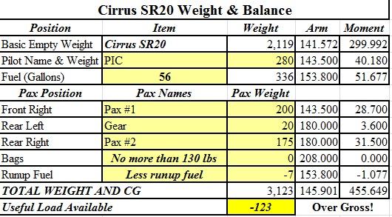
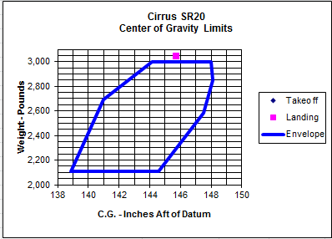
Weight & Balance Scenario – Cirrus SR20 – Full Fuel
Airplane 123 pounds overweight
CG above the envelope
Airplane not legal to fly
http://williamjdoylejr.net/FAAST/W&B/Weight_&_Balance_Cirrus_SR20.xls
Notes:
Airplane is over gross and out of CG limit

Slide 52
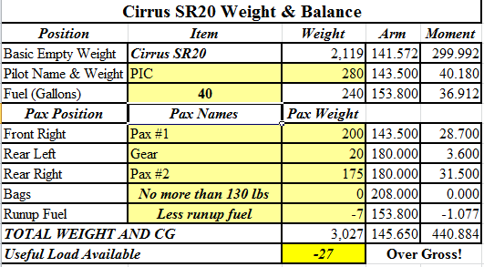
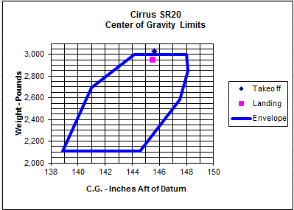
Weight & Balance Scenario – Cirrus SR20 –Tabs + 7
Airplane 27 pounds overweight
CG above the envelope
Airplane not legal to fly
http://williamjdoylejr.net/FAAST/W&B/Weight_&_Balance_Cirrus_SR20.xls
Notes:
Airplane is over gross and out of CG limit

Slide 53
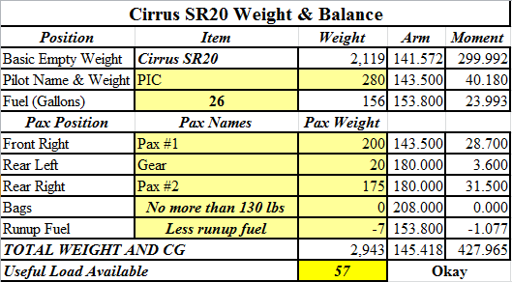
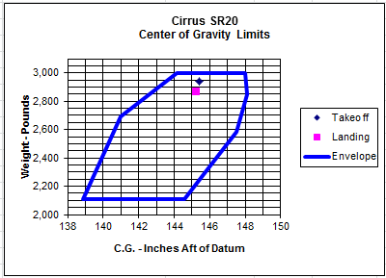
Weight & Balance Scenario – Cirrus SR20 – Fuel to Tabs
Airplane within weight and CG limits
Airplane legal to fly
http://williamjdoylejr.net/FAAST/W&B/Weight_&_Balance_Cirrus_SR20.xls
Notes:
A flight from Doylestown Airport (KDYL) to Cape May County Airport (KWWD) would take approximately an hour and burn about 12 gallons with only 14 gallons remaining.
FAR 91.151 - Fuel Requirements for Flight in VFR Conditions – 30 minute reserve for daytime flight
Return flight to KDYL not legal unless the airplane was refueled at KWWD

Slide 54
Planning a
Flight
Calculating Weight & Balance
Using ForeFlight Mobile Version 9.6
Apple iPad Air, iOS 11.3

Slide 55
Planning the Flight – Weight & Balance
2005 Cessna 182T Weight Limitations – Is everything good to go?
  Gross Takeoff Weight = 3,100 pounds
  Basic Empty Weight = 2,060 pounds
  Maximum Useful Load = 1,040 pounds
  Crew, Fuel, and Flight Kits
    Pilot (left front) – 200 pounds
    Passenger (right front) – 245 pounds
    Pilot Flight Kit (left rear) – 10 pounds
    Passenger Flight Kit (right rear) – 10 pounds
    Baggage (chocks, tie-down ropes, oil, etc.) – 30 pounds
    Fuel (64 gallons - tabs) – 384 pounds

Slide 56
Planning the Flight – Weight & Balance
See Pilot’s Guide to ForeFlight Mobile Version 10.4
  http://www.foreflight.com/ipad/guide/pdf
  Aircraft – creating & deleting Pilot’s Guide pages 244-248
  Weight & Balance - Pilot’s Guide page 243
See ForeFlight Mobile computation of weight & balance on following slides

Slide 57
ForeFlight Mobile Weight & Balance
You can use these steps to start Weight & Balance calculation
  Launch ForeFlight Mobile
  Tap the “More” button to see menu
  Tap “Weight & Balance” in left pane of next slide
Tap “More” to See Menu

Slide 58
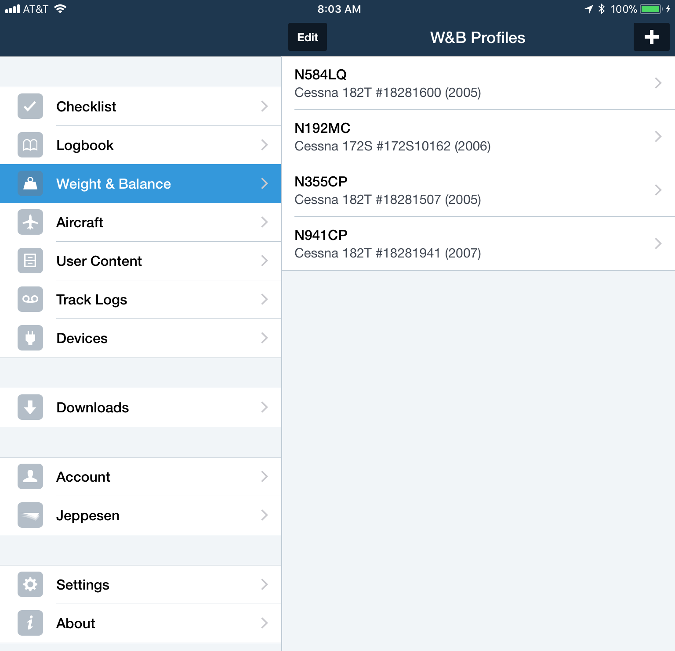
ForeFlight Mobile Weight & Balance
Tap to Select Weight & Balance
Tap to Select W&B Profile for your airplane

Slide 59
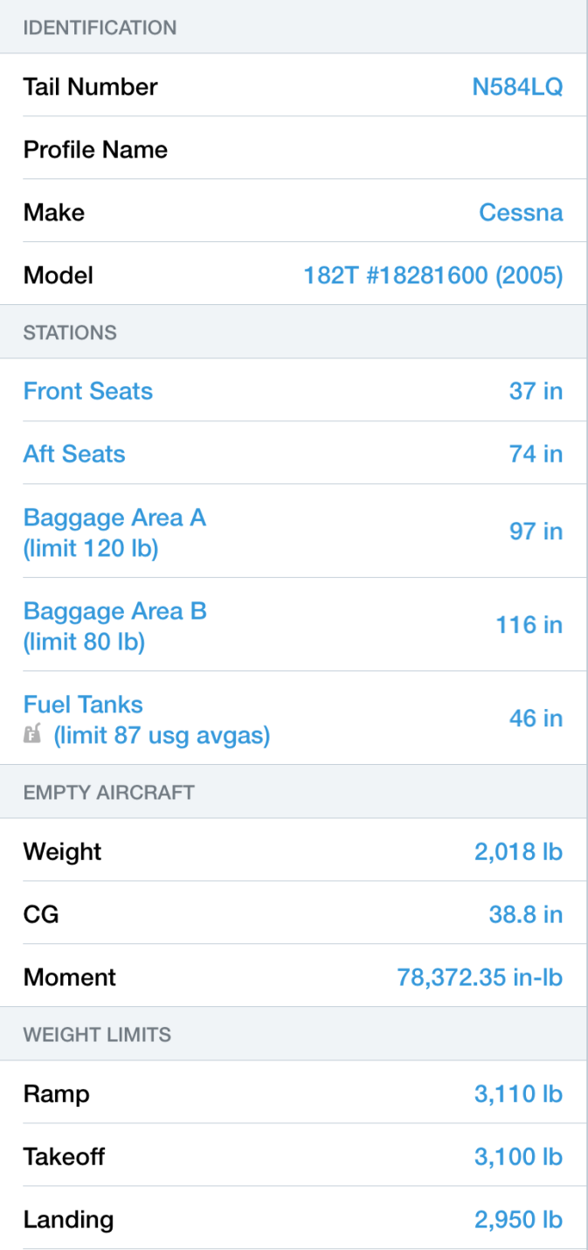
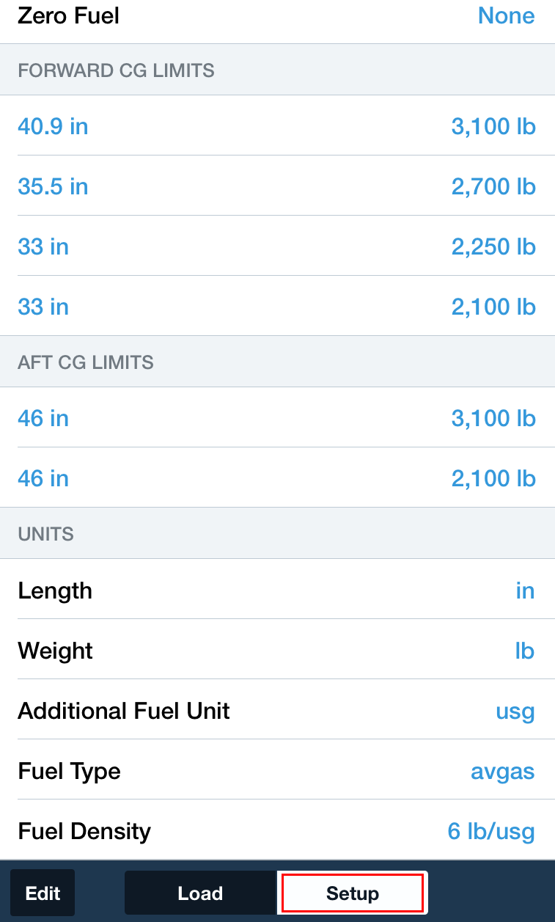
ForeFlight Mobile Weight & Balance – Setting Up An Airplane
This data is available from the weight & balance document in your airplane’s POH

Slide 60
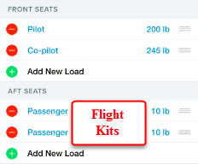
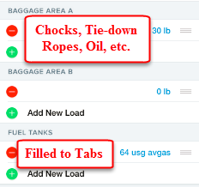
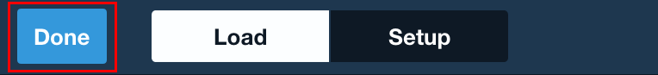
ForeFlight Mobile Weight & Balance – For A Given Flight
This data is unique to a given flight.
Crew weights, baggage weights, and fuel on board can vary.

Slide 61
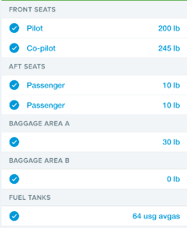

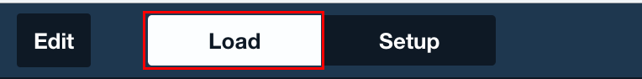
ForeFlight Mobile Weight & Balance – For A Given Flight
This data is unique to a given flight.
Crew weights, baggage weights, and fuel on board can vary.

Slide 62
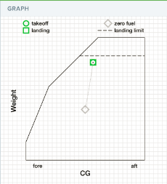
ForeFlight Mobile Weight & Balance – For A Given Flight
Compare this graph to the CG envelope in the Weight & Balance section of your airplane’s POH

Slide 63
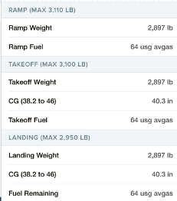
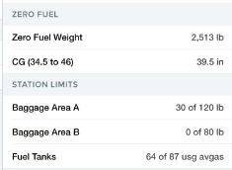
ForeFlight Mobile Weight & Balance – For A Given Flight

Slide 64
Quickie Quiz
Use ForeFlight Mobile to do a weight & balance computation:
  Setup your airplane
  Enter the following weights:
    Pilot & passenger
    Baggage
    Fuel in US gallons
  Determine the following:
    Is the airplane legal to fly based on its gross weight?
    Is the airplane legal to fly based on its CG envelope?

Slide 65
How to Query the
NTSB Database
Notes:
This section introduces the audience to NTSB accident database queries
65

Slide 66
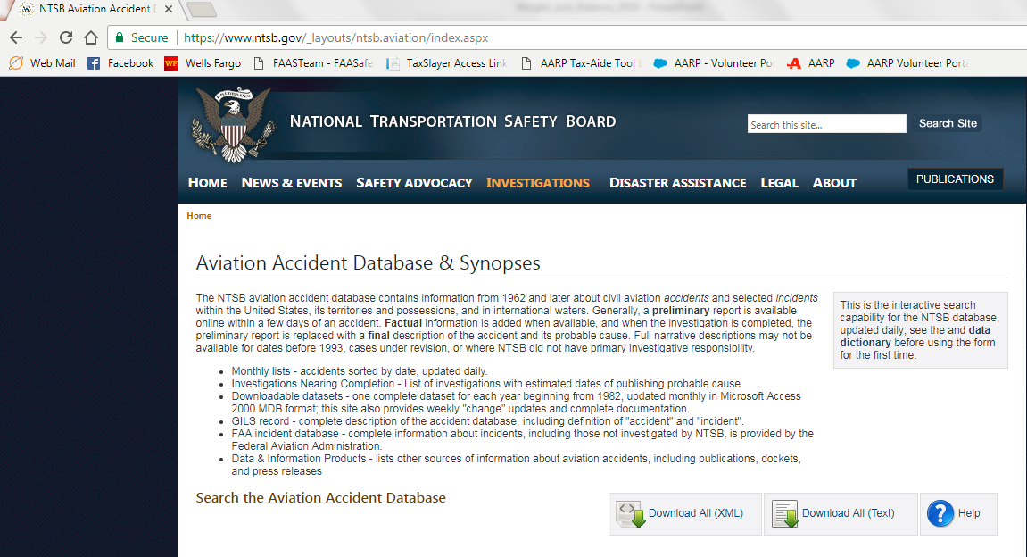
Accessing the NTSB Database
Use your web browser to access the NTSB Database
  http://www.ntsb.gov/_layouts/ntsb.aviation/index.aspx
Notes:
66
If possible, demonstrate browser usage to the audience
If no Internet connection is available, walk the audience through these slides

Slide 67

Accessing the NTSB Database
Notes:
Here are step-by-step instructions on how to set up a query
Specify a date range.
You can optionally specify a City, if looking for a specific airport.
You can optionally specify a state. Click the drop-down button then type the first initial. “n” gets “Nebraska.” Pressing “n” three more times gets “New Jersey.”
The default for Injury Severity is “All.” You can also click on the drop-down button and select either “Non-Fatal” or “Fatal.”
Enter “United States” as the Country.
For Operation, recommend clicking the drop-down button and selecting “Part 91: General Aviation.”
You can optionally enter a keyword such as “crosswind.” Understand that this will get you every accident that has the keyword “crosswind” in it, which does not necessarily mean that it was a crosswind accident.
If you know the NTSB Accident Number, you can select a specific accident.

Slide 68

Creating an NTSB Database Query
Notes:
Here are step-by-step instructions on how to set up a query
You can optionally enter a keyword such as “Weight and Balance.” Understand that this will get you every accident that has the keyword Weight and Balance” in it, which does not necessarily mean that it was a weight and balance accident.
If you know the NTSB Accident Number, you can select a specific accident.
Click Submit Query when done

Slide 69

Creating an NTSB Database Query
Notes:
Here are step-by-step instructions on how to set up a query
You can optionally enter a keyword such as “Weight and Balance.” Understand that this will get you every accident that has the keyword Weight and Balance” in it, which does not necessarily mean that it was a weight and balance accident.
If you know the NTSB Accident Number, you can select a specific accident.
Click Submit Query when done

Slide 70

How Many Weight & Balance Accidents in PA in Last 17 Years?
Notes:
Usage of a keyword returns every accident report containing that key word. It does not necessarily mean that the key word caused the accident only that the key word is somewhere in the report.
In this query there were 369 accident reports containing the key word “Weight and Balance.” Of these, “only” 96 accident reports cited “Weight and Balance” as a causal factor.

Slide 71

How Many Weight & Balance Accidents in PA in Last 17 Years?
Notes:
Usage of a keyword returns every accident report containing that key word. It does not necessarily mean that the key word caused the accident only that the key word is somewhere in the report.
In this query there were 369 accident reports containing the key word “Weight and Balance.” Of these, “only” 96 accident reports cited “Weight and Balance” as a causal factor.

Slide 72

How Many Weight & Balance Accidents in PA in Last 17 Years?
Notes:
Sample of what the query results look like

Slide 73

How Many Weight & Balance Accidents in PA in Last 17 Years?
Notes:
Sample of what the query results look like

Slide 74

How Many Weight & Balance Accidents in NJ in Last 17 Years?
Notes:
Sample of what the query results look like

Slide 75

How Many Weight & Balance Accidents in NJ in Last 17 Years?
Notes:
Sample of what the query results look like

Slide 76

How Many Weight & Balance Accidents in NJ in Last 17 Years?
Notes:
Sample of what the query results look like

Slide 77
Parting Thoughts
Notes:
Emphasize to the audience that they should seriously consider these items

Slide 78
Weight & Balance Suggestions for Non-Owners
Set Yourself Up to Succeed
  Purchase the Airplane Information Manual for each non-owned airplane you fly
  Get a copy of the weight & balance sheet from the POH for each airplane you fly
  Get some sort of a weight & balance program for each airplane you fly
    Setup a ForeFlight weight & balance profile for each airplane you fly
    Build your own weight & balance spreadsheet for each airplane you fly
      If you are not computer savvy, find someone who is and ask them to help you build one
    Buy a weight & balance tablet app for each airplane you fly
Find out the fuel policies for the non-owned planes you fly
  Civil Air Patrol
    Cessna 172 – full (40 gallons or 50 gallons depending on whether tanks are long range)
    Cessna 182 – tabs (64 gallons); NJWG uses 50 gallons
  Cirrus SR20 Flying Club
    Tabs + 7 (40 gallons)
  Cessna NAV III (G1000) Flying Club
    Cessna 172S – 35 gallons
    Cessna 182T – 64 gallons (tabs)
Notes:
Think of this in terms of FAR 91.103
Getting the Airplane Information Manual is one of the best investments you can make

Slide 79
Weight & Balance Pre-flight Planning
Do all weight & balance computations at home before you leave for the airport
  Get dressed weight from each passenger; explain to them the importance of accuracy
  Do a computerized calculation with your weight and your passenger(s) weights
  Figure out how much weight is available for fuel and luggage
  Tell your passenger(s) how much luggage they can bring
Don’t be afraid to “manage” your passenger(s)
  Explain to them how the regulations and safety apply to weight & balance
  Don’t be afraid to tell them that not everyone will “fit” onboard
  Don’t be afraid to tell them that certain luggage items will not “fit”
Do a thorough flight planning and fuel needs analysis
  Don’t cut the fuel too close – there could be unexpected complications
Notes:
Think of this in terms of FAR 91.103
Do your planning at home, not on the fly at the airport
Explain the rules and expectations to your passengers beforehand

Slide 80
The Three Most Useless Things to a Pilot
The runway behind you
  Moral: know your aircraft’s take-off minimums and calculate the weight and balance for your flight, your airport’s runway length, density altitude, any obstacles to be cleared
The altitude above you
  Moral: know your aircraft’s power settings for climb, cruise, and descent
The fuel on the ground below you
  Moral: know your aircraft’s fuel capacity, fuel system, GPH burn rate, and winds aloft for the route of flight.
Utilize superior judgment to avoid needing to use superior skill
Notes:
Think of this in terms of FAR 91.103

Slide 81
Flight Service Transitions to Leidos Pilot Web Portal
Notice Number: NOTC7670
DUATS Discontinued
Effective 05/16/2018

Slide 82
Flight Service Transitions to Leidos Pilot Web Portal
The FAA will discontinue the Direct User Access Terminal Service (DUATS II) Program, effective May 16, 2018.
  Internet services, including access to weather and aeronautical information, flight plan filing and automated services will remain available at no charge to pilots at www.1800wxbrief.com.
To continue to receive free services, users are encouraged to register with www.1800wxbrief.com.
  Over the next 60 days, the FAA will work with current DUATS II providers on transition activities, including conducting pilot outreach, establishing commercial interfaces, and providing user migration assistance.

Slide 83

Flight Service Transitions to Leidos Pilot Web Portal
  https://www.1800wxbrief.com

Slide 84

Flight Service Transitions to Leidos Pilot Web Portal
  https://www.1800wxbrief.com

Slide 85

Just a Real Nice Picture
Notes:
85
Breath – enjoy!

Slide 86
Credits and Information

Slide 87
References and Information
Author of Presentation
  William J. Doyle, Jr., CFI A&I, AGI, IGI, Cessna CFAI
    FAA FAAST Team Representative, PHL FSDO
Downloading this presentation and associated spreadsheets
  http://williamjdoylejr.net/FAAST/W&B/Weight_and_Balance_2018.pptx
  http://williamjdoylejr.net/FAAST/W&B/Weight_Balance_Cessna_172S.xls
  http://williamjdoylejr.net/FAAST/W&B/Weight_and_Balance_Cessna_182T.xls
  http://williamjdoylejr.net/FAAST/W&B/Weight_Balance_Cessna_U206H.xls
  http://williamjdoylejr.net/FAAST/W&B/Weight_&_Balance_Cirrus_SR20.xls
Maj Tom Woods (deceased), FAAST Rep PHL FSDO and NJWG/LGM
  for creating the W&B spreadsheets for Cessna 172S, 182T, and U206H
907 Flight Squadron and the Cirrus Owners and Pilots Association
  for sourcing the Cirrus SR20 W&B spreadsheet to me
Notes:
How to download this presentation

Slide 88
References and Information
Dr. Al Schnur
  formula for recalculating Vspeeds for weights below gross weight.
FAA Airplane Flying Handbook – FAA-H-8083-3B
  https://www.faa.gov/regulations_policies/handbooks_manuals/aviation/airplane_handbook/
Pilot’s Handbook of Aeronautical Knowledge – FAA-H-8083-25B
  https://www.faa.gov/regulations_policies/handbooks_manuals/aviation/phak/
  Chapter 10 – Weight & Balance
    https://www.faa.gov/regulations_policies/handbooks_manuals/aviation/phak/media/12_phak_ch10.pdf
FAA Aircraft Weight & Balance Handbook – FAA-H-8083-1B
  https://www.faa.gov/regulations_policies/handbooks_manuals/aviation/media/FAA-H-8083-1.pdf
NTSB Accident Database
  https://www.ntsb.gov/_layouts/ntsb.aviation/index.aspx
Notes:
88
Some good FAA and NTSB References

Slide 89
References and Information
Electronic Code of Federal Regulations – Title 14 Chapter I--Federal Aviation Administration, Department of Transportation, Subchapter D – Airmen
  https://www.ecfr.gov/cgi-bin/text-idx?SID=c568dda2ee8f3a2cf796dcd614c3b4de&mc=true&tpl=/ecfrbrowse/Title14/14cfrv2_02.tpl#0
Notes:
89
Some good FAA References

Slide 90

Just a Real Nice Picture
Notes:
90
Breath – enjoy!

Slide 91
Appendix
Weight Change Formulas
Notes:
These formulas are from prior FAA Knowledge Tests

Slide 92

Weight Change Formula
Changes in Weight and Moment
Notes:
These formulas are from prior FAA Knowledge Tests

Slide 93

Weight Change Formula
Airplane takes off with the following:
  Weight = 6,230 lbs
  CG = 79.0
What is the CG after 50 gallons of fuel burned from station 87?
Solution
Notes:
These formulas are from prior FAA Knowledge Tests

Slide 94

Weight Change Formula
Airplane takes off with the following:
  Weight = 3,000 lbs
  CG = 60.0
After takeoff
  25 gallons fuel burned at station 65
  200 lb passenger moves from station 50 to station 90
What is the resulting CG?
Solution
Notes:
These formulas are from prior FAA Knowledge Tests

Slide 95

Weight Shift Formula - CG Shifted by Weight Move
Airplane Gross Weight = 10,000 lbs; 500 lbs cargo shifts 50 inches.
How far does the CG move?
Notes:
These formulas are from prior FAA Knowledge Tests

Slide 96

Weight Shift Formula -
Weight Shifted to Move CG Two Inches
Notes:
These formulas are from prior FAA Knowledge Tests

Slide 97

Weight Shift Formula -
CG Shifted by Weight Move
Notes:
These formulas are from prior FAA Knowledge Tests

Slide 98

Weight Shift Formula -
How Far to Move Weight to Shift CG
Notes:
These formulas are from prior FAA Knowledge Tests

Slide 99

This Completes
Airplane Weight & Balance
The Inherent Dangers of Weight and Balance Procedural Complacency
What You Don’t Know Can Get You and Your Passengers Killed!
FAA Customer Feedback Website
http://www.faa.gov/about/office_org/headquarters_offices/avs/offices/afs/qms/
PHL FSDO FAAST Program Manager – Eric Sieracki -
Eric.Sieracki@faa.gov
Notes:
99
Remind the attendees that they must sign in to be credited for attendance.
Ask for suggestions of any kind, especially what they would like to have presented as “elective” topics.

