Slide 1
The National FAA Safety Team Presents
Winter is Coming! And So Is The New President! Don’t Get Busted On The Wilmington VIP/Security TFR
FAA Safety Webinar Participants
FAAST Rep Bill Doyle, CFI A&I, AGI, IGI
Winter 2020-2021
Updated 12/14/2020

Slide 2
How to Download this Presentation
You can download this presentation at the link below.
http://williamjdoylejr.net/FAAST/TFRs/ILG_TFR/TFRs_Wilmington_DE_2021_01_20.pptx - PowerPoint
http://williamjdoylejr.net/FAAST/TFRs/ILG_TFR/TFRs_Wilmington_DE_2021_01_20.pdf - PDF
The links are case-sensitive
If prompted for a password, click the “Read Only” button
You can email me doylewj@ix.Netcom.com to request the link(s)

Slide 3
Presentation Agenda
Purpose of Presentation
Some FARs You Really Need to Understand: 91.103 & 91.141
How to Get TFR Alerts
TFR Awareness: VIP TFR at Wilmington, DE – Pre-01/20/2021
TFR Awareness: VIP TFR at Wilmington, DE – 01/20/2021 and After
Pre-Flight Planning: What You Can Do
In-Flight Cautions with Avionics and Electronic Flight Bags (EFBs)
Task Management
Summary to Avoid TFRs and Getting Busted
Intercept Procedures
Appendix – Inflight Cautions with ForeFlight
Appendix – SRM: The 5 P’s
Appendix – Airspace: A, B, C, & D

Slide 4
Purpose of Presentation

Slide 5
Purpose of Presentation
This presentation is intended to give pilots a “heads up” of the coming flight restrictions (TFRs) when Joe Biden is inaugurated as President of the United States.
Effective Date and Duration of TFR
The TFR Effective Date is the date of the Inauguration (01/20/2021)
The TFR Duration will be at least until 01/20/2025
TFR Dimensions – based on previous Presidential TFRs
Vertical Dimension: Surface to 17,999 Feet AGL
Horizontal Dimension: Outer Ring (30 NM radius) and Inner Ring (10 NM radius)
TFR Procedures
This presentation uses the procedures from President Trump’s Bedminster TFR
The presentation will be updated once the FAA publishes President Biden’s Wilmington TFR

Slide 6
Some FARs You Really Need to Understand - 14 CFR 91.103 – Preflight Action 14 CFR 91.141 - Flight restrictions in the proximity of the President and other parties

Slide 7
14 CFR 91.103 – Preflight Action
Each pilot in command shall, before beginning a flight, become familiar with all available information concerning that flight. This information must include (BUT IS NOT LIMITED TO) —
(a) For a flight under IFR or a flight not in the vicinity of an airport, weather reports and forecasts, fuel requirements, alternatives available if the planned flight cannot be completed, and any known traffic delays of which the pilot in command has been advised by ATC;
(b) For any flight, runway lengths at airports of intended use, and the following takeoff and landing distance information:
(1) For civil aircraft for which an approved Airplane or Rotorcraft Flight Manual containing takeoff and landing distance data is required, the takeoff and landing distance data contained therein; and
(2) For civil aircraft other than those specified in paragraph (b)(1) of this section, other reliable information appropriate to the aircraft, relating to aircraft performance under expected values of airport elevation and runway slope, aircraft gross weight, and wind and temperature.

Slide 8
14 CFR 91.141 – Flight restrictions in the proximity of the President and other parties.
No person may operate an aircraft over or in the vicinity of any area to be visited or traveled by the President, the Vice President, or other public figures contrary to the restrictions established by the Administrator and published in a Notice to Airmen (NOTAM).

Slide 9
Quickie Quiz
How do the following FARs apply to you?
FAR 91.103?
FAR 91.141?

Slide 10
How to Get TFR Alerts (FAASafety.gov)

Slide 11
How to Get TFR Alerts
Sign onto www.faasafety.gov
Log onto your existing account
If you don’t have an account, you can create one.
Click on “My Preferences and Profile”
On General tab
Click “Selected ATC Notices” near bottom of screen
Click “Save”

Slide 12
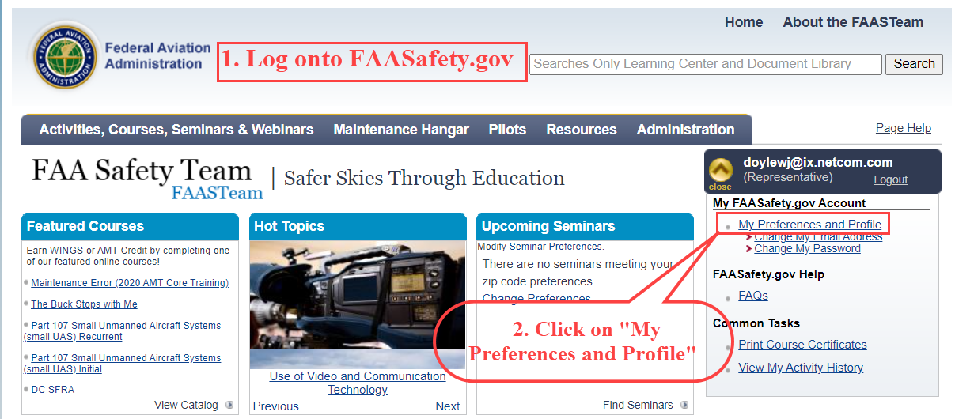
How to Get TFR Alerts
http://www.faasafety.gov//

Slide 13
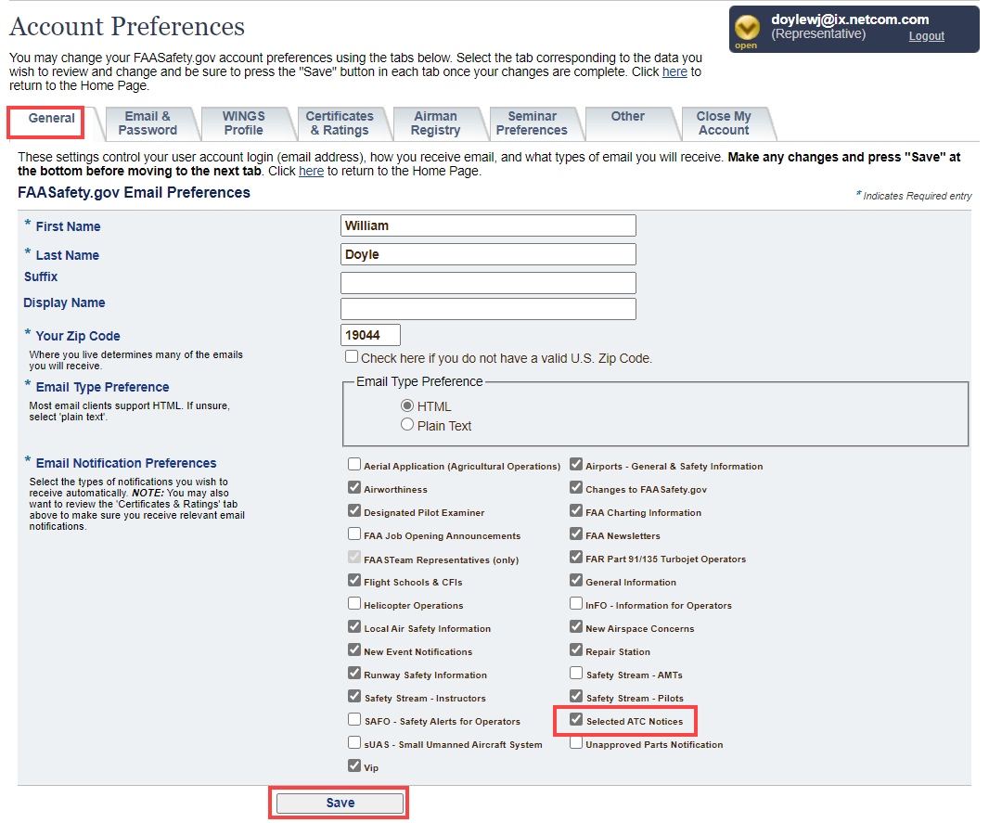
How to Get TFR Alerts

Slide 14
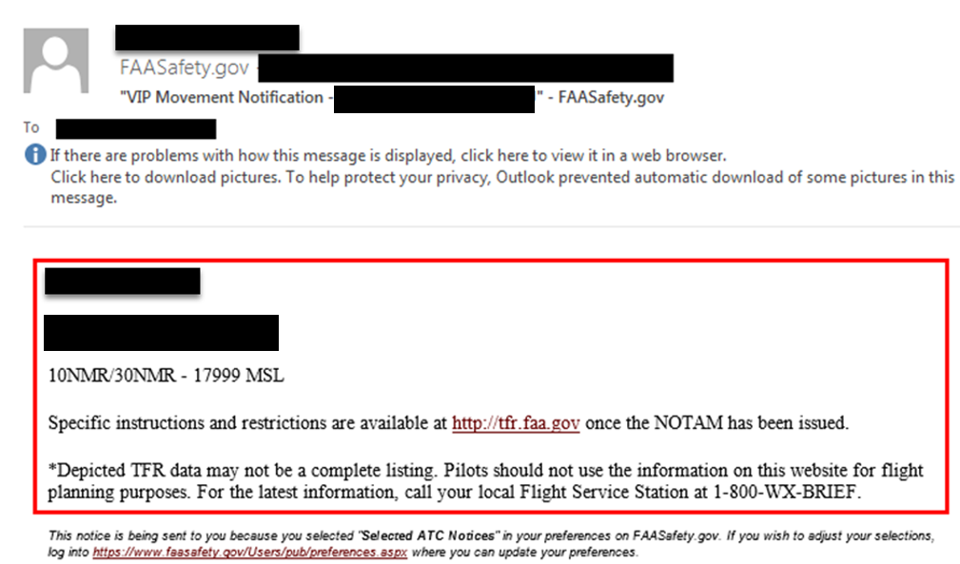
How to Get TFR Alerts
Sample email alert

Slide 15
How to Get TFR Alerts from AOPA
This an automatic benefit of membership in AOPA (www.aopa.org)
If TFRs are planned for your area, AOPA will send you an email alert
If you do not want these alerts, you can contact AOPA Member Services at 1-800-872-2672 and opt out (not recommended)
The next slide shows the first page of the AOPA email alert on the Morristown/Bedminster TFR

Slide 16
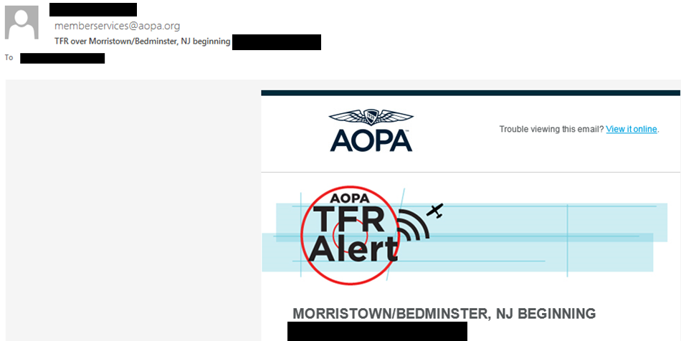
How to Get TFR Alerts
Sample email alert from AOPA

Slide 17
Quickie Quiz
How can you find out about upcoming TFRs?
When and how they are announced?
Before you fly?
While you are in the air?

Slide 18
TFR Awareness

Slide 19
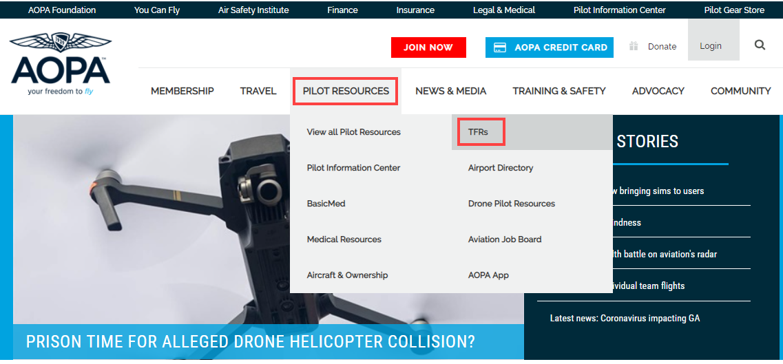
AOPA TFR Awareness
Enter https://www.aopa.org
Click “Pilot Resources”
Click “TFRs”

Slide 20
AOPA TFR Awareness
Enter in one step
https://www.aopa.org/go-fly/tfrs

Slide 21
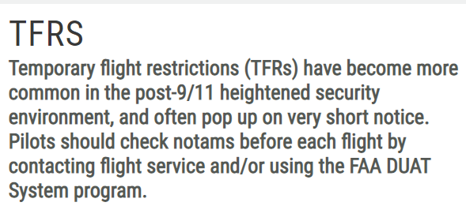
AOPA TFR Awareness
https://www.aopa.org/go-fly/tfrs

Slide 22
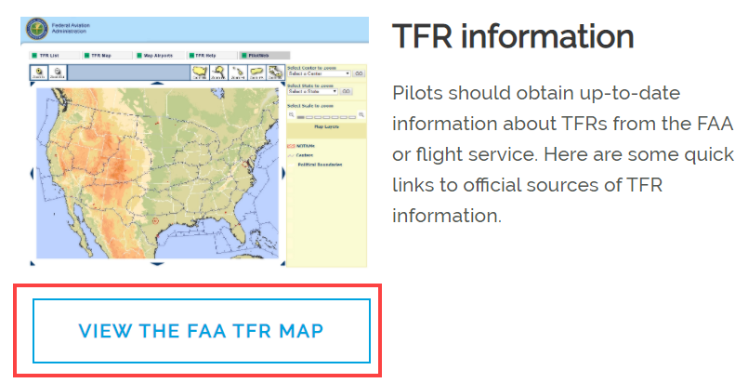
TFR Awareness

Slide 23
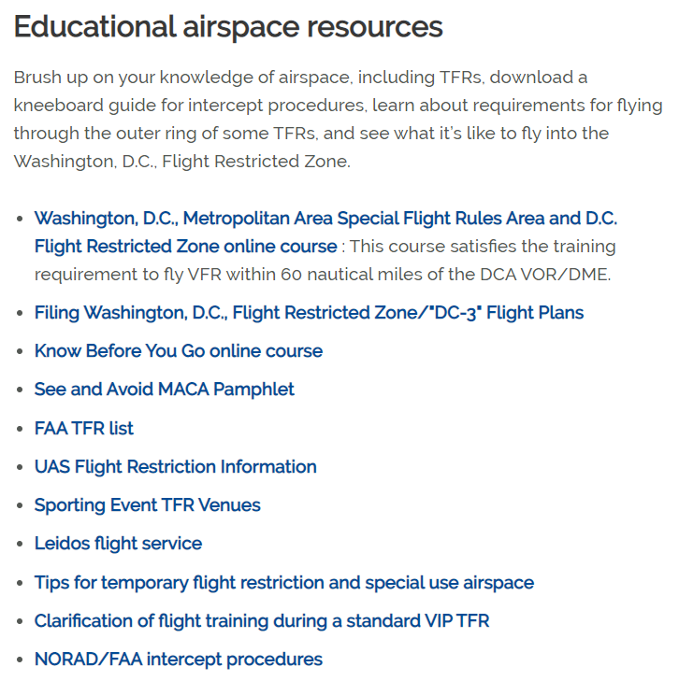
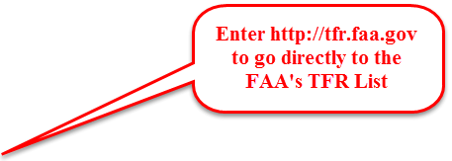
TFR Awareness

Slide 24
TFR Awareness Wilmington, DE Prior to 01/20/2021

Slide 25
VIP TFR at Wilmington, DE – Pre-01/20/2021
Valid
From 11/29/2020 to 01/20/2021
Location
Dupont (DQO) VORTAC 008° Radial at 5.6 NM
Dimensions
Width = 3NM Radius
Height = Surface to 2,999 Feet AGL

Slide 26
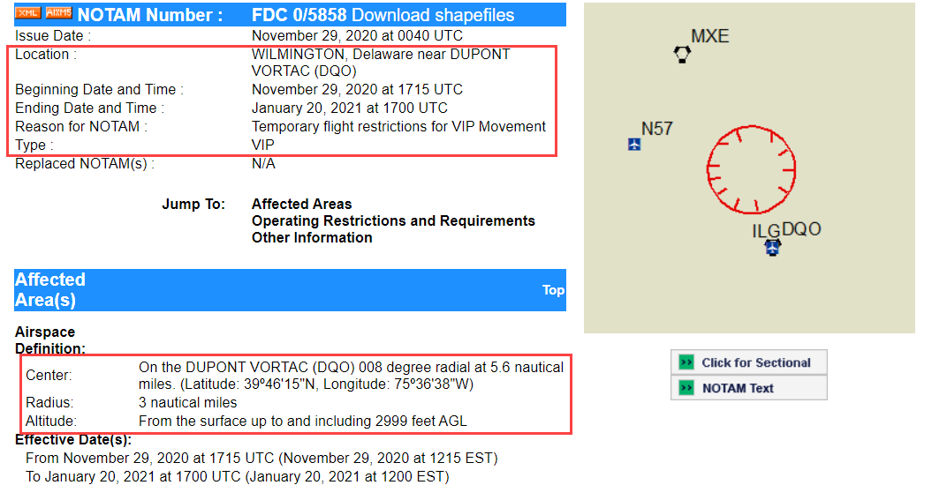
VIP TFR at Wilmington, DE – Pre-01/20/2021

Slide 27
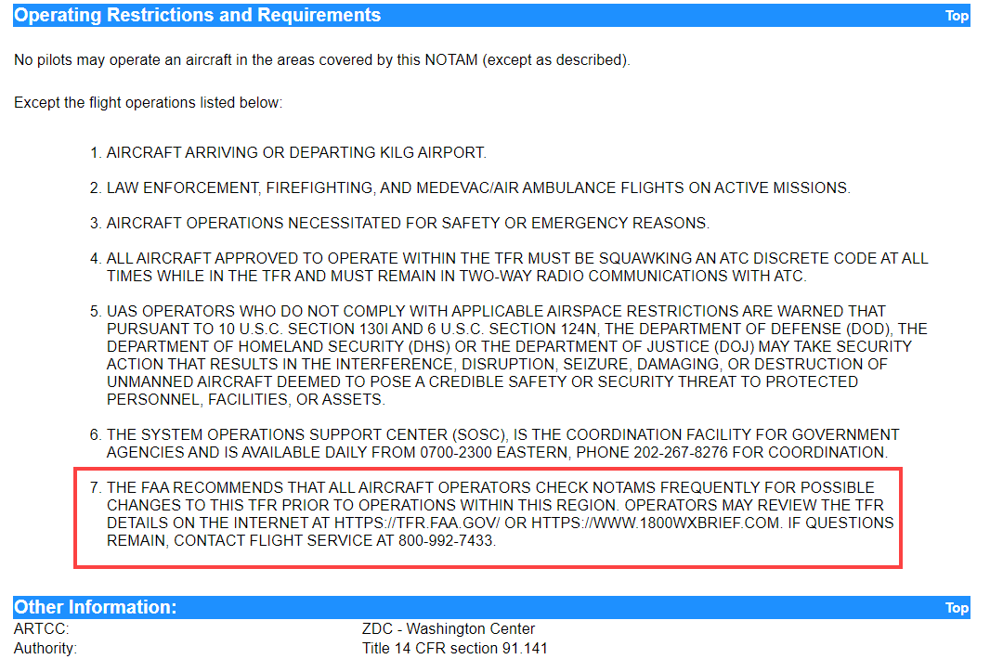
VIP TFR at Wilmington, DE – Pre-01/20/2021

Slide 28
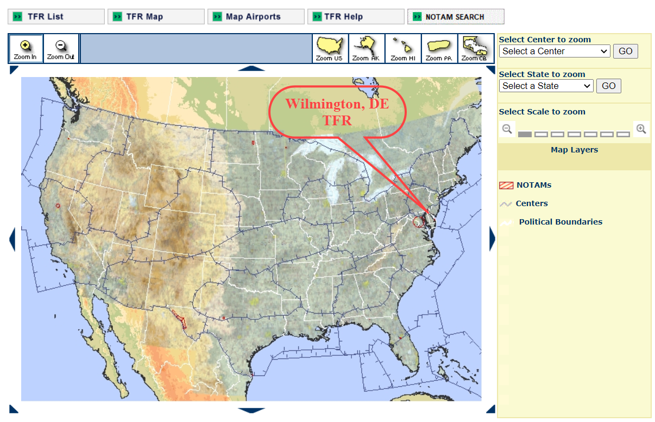
FAA TFR Map

Slide 29
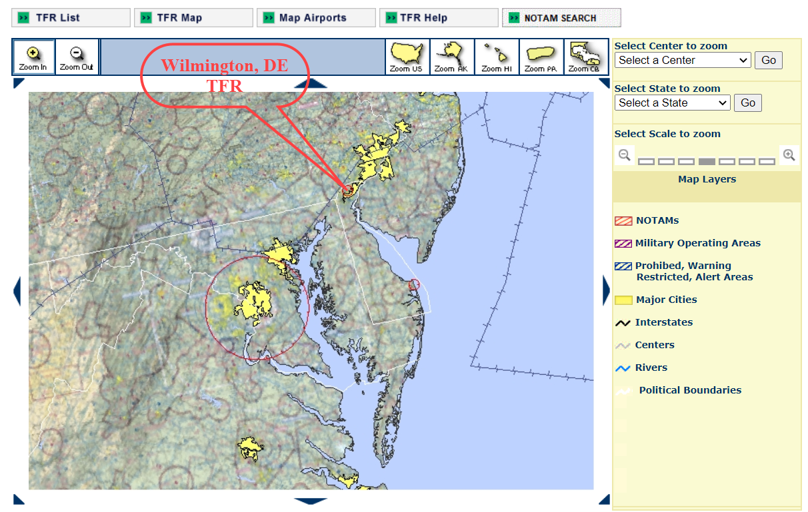
FAA TFR Map

Slide 30
FAA TFR List – Filtering Technique
Enter http://tfr.faa.gov
In State window
Click drop-down menu button
Select “Delaware”
Click “GO” button
See results below and on next slide

Slide 31
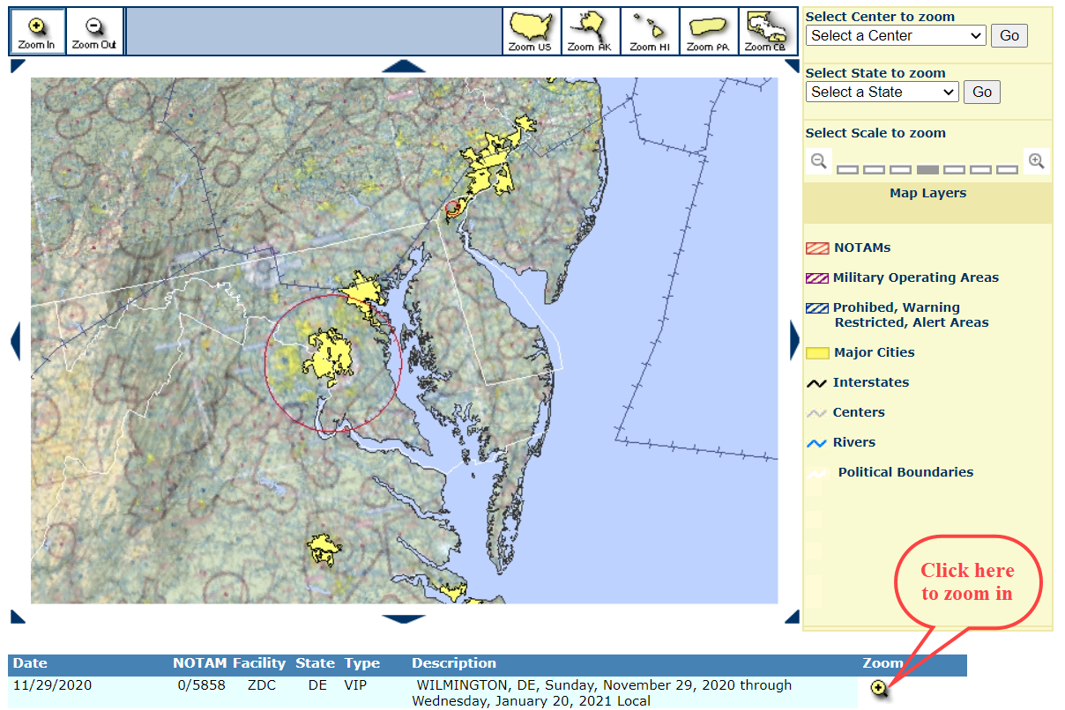
FAA TFR List – Filtered by State (Delaware)

Slide 32
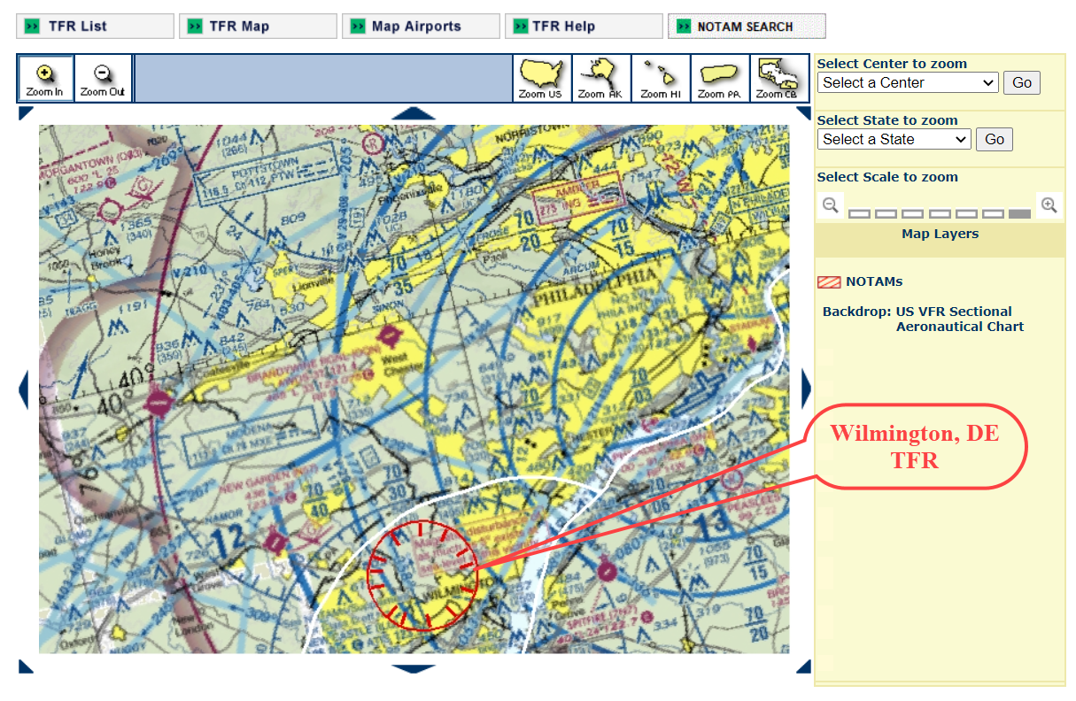
FAA TFR List – Filtered by State (Delaware)

Slide 33
TFR Awareness Wilmington, DE Starting on 01/20/2021

Slide 34
VIP TFR at Wilmington, DE – 01/20/2021 and After
The FAA has not yet announced this TFR. The characteristics and restrictions shown are based previous Presidential TFRs
Valid
From 01/20/2021 for at least 4 years
Location
Dupont (DQO) VORTAC 008° Radial at 5.6 NM
Dimensions
Width
Inner Ring (No Fly Zone) = 10NM Radius
Outer Ring = 30NM Radius
Height = Surface to 17,999 Feet AGL
See next slide for illustration of TFR on Washington Sectional

Slide 35
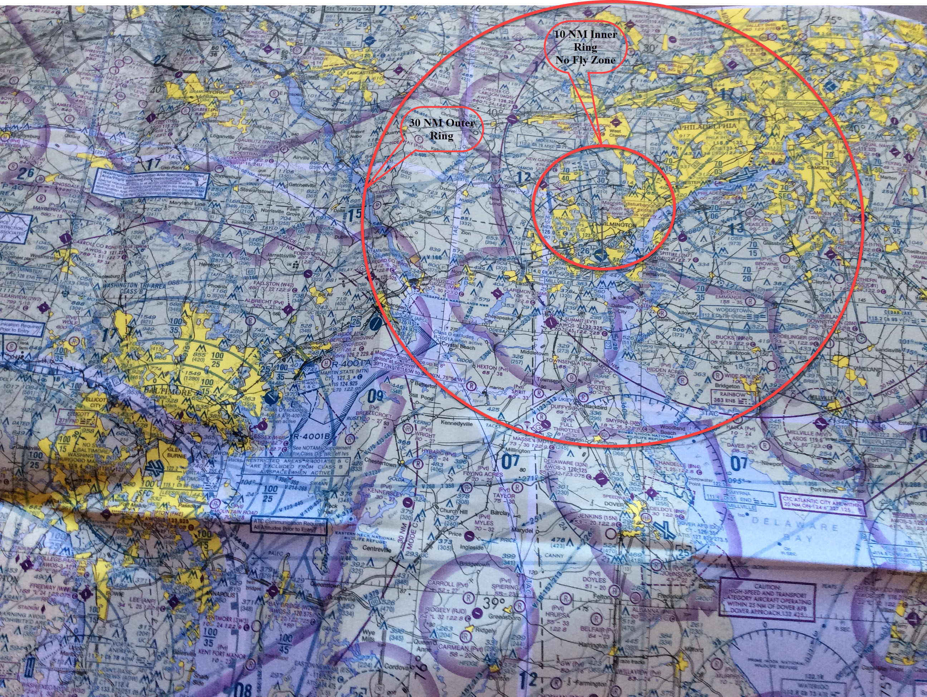

Slide 36
VIP TFR – Wilmington, DE Starting 01/20/2021
All operations within the Inner Ring, No-Fly Zone, 10 NM (Area B), are prohibited except for:
Approved law enforcement, military aircraft directly supporting the United States Secret Service (USSS) and the office of the President of the United States
Approved air ambulance flights
Regularly scheduled commercial passenger and all-cargo carriers operating under one of the following TSA-Approved standard security programs/procedures:
aircraft operator standard security program (AOSSP)
full all-cargo aircraft operator standard security program (FACAOSSP)
model security program (MSP)
twelve five standard security program (TFSSP) all cargo
all-cargo international security procedure (ACISP) and are arriving into and/or departing from 14 cfr part 139 airports.
All emergency/life saving flight (medical/law enforcement/firefighting) operations must coordinate with ATC prior to their departure at 516-683-2966 to avoid potential delays.

Slide 37
VIP TFR – Wilmington, DE Starting 01/20/2021
For operations within the airspace between the Inner Ring, 10 NM (Area B), and the 30 NM Outer Ring (Area A):
All aircraft operating within the Outer Ring are limited to aircraft arriving or departing local airfields
Workload permitting, ATC may authorize transit operations
Aircraft may not loiter
All aircraft must be on an active IFR or VFR flight plan with a discrete transponder code assigned by an Air Traffic Control (ATC) facility
Aircraft must be squawking the discrete transponder code prior to departure and at all times while in the TFR
Aircraft must remain in two-way radio communications with ATC

Slide 38
VIP TFR – Wilmington, DE Starting 01/20/2021
Unauthorized operations within this TFR:
Flight training
Practice instrument approaches
Aerobatic flight
Glider operations
Seaplane operations
Parachute operations
Ultralight, hang gliding, and balloon operations
Agriculture/crop dusting
Animal population control flight operations

Slide 39
VIP TFR – Wilmington, DE Starting 01/20/2021
Unauthorized operations within this TFR (continued):
Banner towing operations
Sightseeing operations
Maintenance test flights
Model aircraft operations
Model rocketry
Unmanned aircraft systems (UAS) - drones
Utility and pipeline survey operations

Slide 40
VIP TFR (Wilmington, DE) Starting 01/20/2021 Most Likely Affected Public Use Airports Check NOTAMS Often

Slide 41
VIP TFR at Wilmington, DE – 01/20/2021 and After
Affected Public Use Airports
10 NM Ring
KILG – New Castle
DQO – Dupont VORTAC
N57 – New Garden
30 NM Ring
VCN – Cedar Lake VOR
0W3 – Harford County
17N – Cross Keys
19N – Camden County (borderline)
28N – Vineland Downtown
29N – Krolinger

Slide 42
VIP TFR at Wilmington, DE – 01/20/2021 and After
Affected Public Use Airports (continued)
30 NM Ring (continued)
58M – Claremont
7N7 – Spitfire Aerodrome
KEVY – Summit
KLOM – Wings
KMQS – Chester County
KPHL – Philadelphia International
KPTW – Heritage
KOQN – Brandywine Regional
MD1 – Massey
N10 – Perkiomen Valley

Slide 43
VIP TFR at Wilmington, DE – 01/20/2021 and After
Affected Public Use Airports (continued)
30 NM Ring (continued)
N47 – Pottstown
N48 – Horsham Valley (Heliport)
N81 – Hammonton
O03 – Morgantown
Excluded Public Use Airports (Cutouts)
If any airports are excluded, they will be identified when the FAA announces the TFR.

Slide 44
Departure & Arrival Procedures for VIP TFRs At Non-Towered Airports Check NOTAMS Often

Slide 45
VFR Departure Procedures for VIP TFRs at Non-Towered Airports
Make sure you have filed your VFR flight plan before calling for your clearance
LEIDOS (Flight Service) has a national number that you can use to get your clearance and squawk code
You can call 1-800-WXBRIEF (1-800-992-7433)
Flight Service will do everything necessary to get you your clearance and squawk code
Recommend using a cell phone
You can do this from the cockpit of your airplane
If your headset and your cell phone both support Blue Tooth, you can filter out engine noise

Slide 46
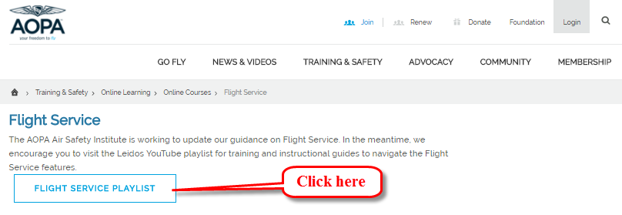
VFR Departure & Arrival Procedures for VIP TFRs at Non-Towered Airports
AOPA Air Safety Institute is working to update its guidance on Flight Service. In the meantime, they suggest you visit the Leidos YouTube playlist for ...
https://www.aopa.org/training-and-safety/online-learning/online-courses/flight-service

Slide 47
VFR Departure & Arrival Procedures for VIP TFRs at Non-Towered Airports
Be thoroughly aware of whatever practices that ATC uses for your airport.
As necessary, review these practices with a flight instructor at your airport
Sometimes ATC may use an airport just outside the 30 NM ring as a gateway.
Suggest that you contact ATC while you are flight planning to see if there is a gateway airport.

Slide 48
IFR Departure Procedures for VIP TFRs at Non-Towered Airports
At some non-towered airports it is not possible to establish radio communications with ATC on the ground. Examples are:
Doylestown (KDYL)
Greenwood Lake (4N1)
So what can you do?
Make sure you have the phone number for the ATC facility
You can get this phone number from Flight Service by calling 800-992-7433 (800-WX-BRIEF)
Recommend using a cell phone
You can do this from the cockpit of your airplane
If your headset and your cell phone both support Blue Tooth, you can filter out engine noise

Slide 49
IFR Departure Procedures for VIP TFRs at Non-Towered Airports
Make sure you have filed your IFR flight plan before calling for your clearance
Your clearance should be something like what is shown below
“Cessna 12345, cleared from the Doylestown Airport (KDYL) to the (Destination) Airport via Direct Yardley VOR (then rest of route), climb and maintain x,000 expect y,000 One Zero minutes after departure. Departure frequency is 1xx.xx, Squawk xxxx.”
Read back the clearance
See next slide

Slide 50
IFR Departure Procedures for VIP TFRs at Non-Towered Airports
After you correctly read back the clearance, Clearance Delivery will probably ask you how much time you need.
Give them a realistic estimate. This includes the following:
Setting up the route of flight in your avionics
Preselecting your altitude if your airplane is so equipped
Entering the squawk code in your transponder
Entering the departure frequency in COM1 Standby
Taxiing to the departure runway
Doing your run-up.
Clearance Delivery may tell you to call them back for a release.
Don’t ask for a release until all of your pre-departure tasks are completed.

Slide 51
IFR Departure Procedures for VIP TFRs at Non-Towered Airports
When you get the release, it will be something like this:
“Cessna 12345, current time is xx:xx Zulu, released at yy:yy Zulu, void if not off by zz:zz Zulu.”
As soon as Clearance Delivery says “current time is,” look at your watch to see the current time in local time (EST).
This will give you a perspective on the time window you have.
If you are getting close to your void time,
Call Clearance Delivery
Tell them you need a new release
Remember there is a TFR in effect
Don’t try to play “Beat the clock!”

Slide 52
Departure Procedures for VIP TFRs at Non-Towered Airports
If you take off within the constraints of your clearance and release time, you should not have any problems.
Make sure your transponder is set to ALT with assigned squawk code
As you depart the pattern,
Make sure the departure frequency is your Active COM1 frequency
As soon as workload permits and you reach a safe altitude
Call the departure frequency and check in with them.
You should be able to get a sense of the optimum altitude for calling ATC from:
Your prior approaches to this airport
Your flight instructor
Other factors to consider are:
Workload when departing into VMC
Workload when departing into IMC

Slide 53
VIP TFR (Wilmington, DE) 01/20/2021 or Later Quickie Quiz Check NOTAMS Often

Slide 54
Quickie Quiz – Wilmington TFR
The Wilmington VIP TFR is active. You are on an IFR flight plan from KDYL to KMQS. You are on the ILS Runway 29 approach to KMQS. You are inbound from EFECO (FAF) and you have the airport in sight. What do you do next?
Cancel IFR, squawk 1200 and do the visual.
Continue the approach. The Tower will close the flight plan for you after you land.
Continue the approach. Contact Philadelphia Clearance Delivery to close the flight plan after you land via radio on frequency 125.6 or via phone at 800-354-9884 or 215-492-4122.
KMQS is inside the 30 NM Ring. You are not authorized to land at KMQS.

Slide 55
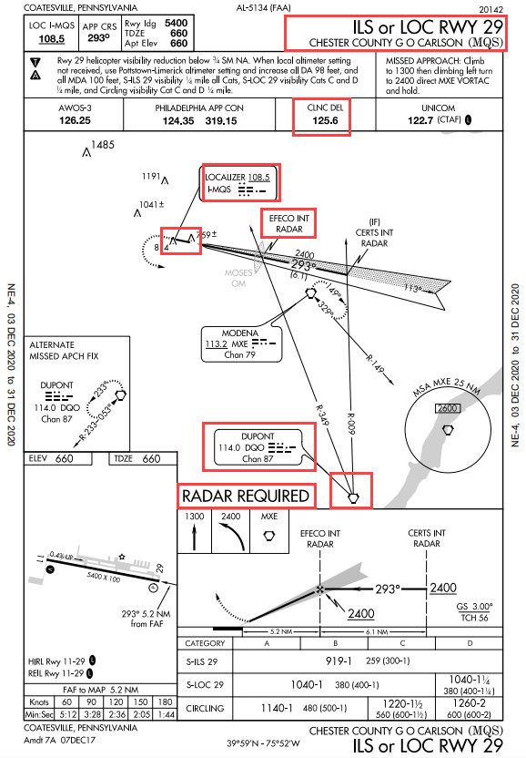
Quickie Quiz – Wilmington TFR

Slide 56
Quickie Quiz – Wilmington TFR
The Wilmington VIP TFR is active. You are on the ground at KVAY. You want to fly to KMQS on an IFR flight plan. What do you need to do?
File an IFR flight plan.
Call Millville (MIV) Flight Service Station (FSS) at 1-800-WXBRIEF.
Get a clearance, a discreet squawk code, and a release time.
All of the above.
None of the above.

Slide 57
Quickie Quiz – Wilmington TFR
The Wilmington VIP TFR is active. You are planning a flight from KMQS to KTTN. Is it okay to open your flight plan in the air after you depart KMQS?
Yes, you can initially squawk 1200 then get a discrete squawk in the air after you open your flight plan.
No, the TFR requires you to open your flight plan (both VFR and IFR) and obtain a discrete squawk code on the ground prior to departing KMQS, which is in 30 NM Outer Ring.
KMQS is in the 10 NM Radius No Fly Zone.

Slide 58
Quickie Quiz – Wilmington TFR
The Wilmington VIP TFR is active. You are on the ground at Greenwood Lake Airport (4N1). You want to fly to KMQS on an IFR flight plan. What do you need to do?
File an IFR flight plan.
Call Flight Service 1-800-WXBRIEF on your cell phone.
Get a clearance, a discreet squawk code, and a release time.
All of the above.
None of the above.

Slide 59
Pre-Flight Planning What Can You Do?

Slide 60
Pre-Flight Planning
First Steps
Determine departure, destination, and route of flight
Get a weather briefing for the route of flight
Determine whether there are any TFRs along route of flight. Are there VIP TFRs or Stadium TFRs?
Perform a risk assessment for the flight
What’s Next?
Create a NavLog, either manually or electronically, for each flight leg
Magnetic Course (MC), Magnetic Heading (MH), and Wind
Time and Distance
Fuel burned
Determine fuel requirements and whether to land and refuel enroute
Determine safe altitude for each leg, recognizing airspace and TFRs
Determine how to get in-flight advisories
Determine CTAF, Tower, ATIS, and ASOS frequencies for route of flight

Slide 61
Pre-Flight Planning Tools
Ground-based pre-flight planning
ForeFlight (iPad or iPhone) or
iFlightPlanner for AOPA (previously AOPA Flight Planner) or
DUATS (discontinued; use iFlightPlanner for AOPA)
Sectional and TAC Charts
Washington Sectional – recommend drawing the Wilmington TFR on your sectional
See next slide for tools to draw the TFR on your Washington Sectional
New York Sectional
Philadelphia TAC

Slide 62
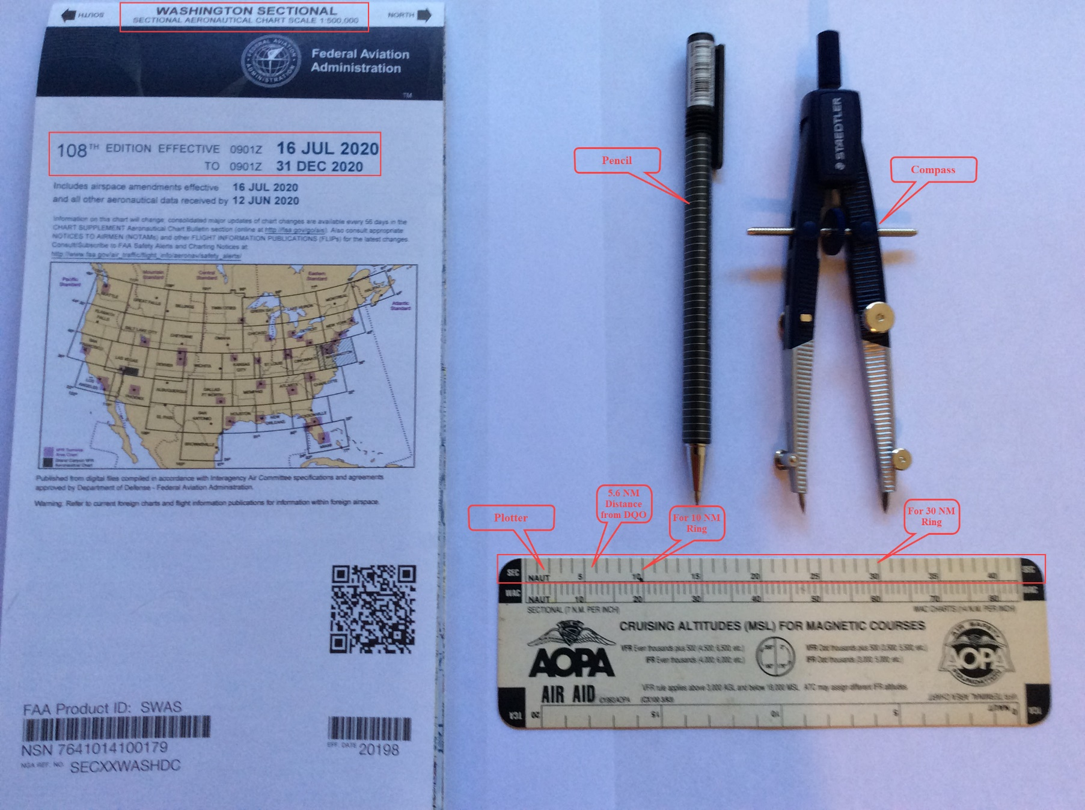
Pre-Flight Planning Tools
Tools to Draw Wilmington TFR on your Washington Sectional

Slide 63
Flight Management Tools
Air-based Flight Monitoring & Navigation
Know fuel on board and burn rate in GPH
ForeFlight (iPad or iPhone)
Is your OS/IOS current?
Are your Apps current?
Have you downloaded the most current charts and approach plates?
Is your battery at full charge?
Did you pre-flight your EFB the night before your flight?
Do you connect to a Stratus in flight?
If not, do you know the limitations of your iPhone or iPad?
Sectional and TAC Charts (paper) – Are they open?
Washington Sectional – recommend drawing the Wilmington TFR on your sectional
New York Sectional
Philadelphia TAC

Slide 64
In-Flight Advisories
How to Contact Flight Service – Source: Flight Service
In Eastern Pennsylvania, call Williamsport Radio on 122.2
In New Jersey and Delaware, call Millville Radio on 122.2
If bad reception, try Leesburg Radio on 122.2

Slide 65
In-Flight Advisories
How to Request Flight Following – Source: ForeFlight and Charts
From over/near KMQS, call Philadelphia Approach on 124.35
From over/near KDYL, call Philadelphia Approach on 123.8
From over/near KPNE, call Philadelphia Approach on 123.8
From over/near KTTN, call Philadelphia Approach on 123.8
From over/near KMIV, call Atlantic City Approach on 124.6
From over/near N14, call McGuire Approach on 126.475
North of Lake Nockamixon, call Allentown Approach
3,000 feet and below at 119.65
Above 3,000 feet at 124.45

Slide 66
Task Management

Slide 67
Task Management
Goals
Reduce workload in flight
Maintain Situational Awareness
What You Can Do
Do flight planning at home
Make a NAV Log for planned route of flight
Consider iFlightPlanner for AOPA (https://iflightplanner.aopa.org/My/)
Print the NAV Log in a kneeboard format
Develop a radio strategy – Get Flight Following Where Possible
COM1 Active & Standby – CTAFs, Control Towers, Approach Controls
COM2 Active & Standby – Ground Control, Clearance Delivery, ATIS, ASOS, 121.5
NAV1, NAV2 Active & Standby – VORs along route of flight
Make a list of frequencies to be used prior to flight, set up on the ground
Have checklist(s) handy, refer to them as needed
Have sectional charts handy and open to route of flight

Slide 68
Task Management
How to Prioritize and Lighten Workload
Make sure you are aware of TFRs and/or NOTAMS and can comply with them
Preset as much as possible
Learn how to effectively trim the airplane
Use autopilot pilot, if available, on enroute phase, but don’t neglect hand-flying skills
Organize cockpit for placement of charts and NAV logs
Things you can do when 25 miles out from destination airport
Put ASOS for destination in COM2 Active
You will hear the ASOS when in range
Decide if the surface winds are within your capabilities and the airplane’s
Put CTAF or Tower in COM1 Active (act in accordance with IFR flight plan)
Listening to traffic you will get a sense of runway being used
Things you can do when 10 miles out from destination airport
Perform pre-landing checklist
Set up for the approach to the landing runway

Slide 69
Quickie Quiz
How do you use task management in your airplane?

Slide 70
Summary to Avoid TFRs and Getting Busted

Slide 71
Summary to Avoid TFRs and Getting Busted
Preliminaries
Register for TFR alerts
Know limitations of your airplane’s avionics as well as your EFB’s
Keep your avionics and EFB software and databases up to date and your subscriptions current
Keep your backup paper charts current
Before You Leave Home for the Airport
Get an electronic briefing
Get a telephone briefing from LEIDOS – (800) 992-7433
Specifically ask if there are TFRs: VIP TFRs, Stadium TFRs
File an IFR flight plan, if you are instrument rated, instrument current and your airplane is instrument equipped/capable
You can file IFR even when it is severe clear

Slide 72
Summary to Avoid TFRs and Getting Busted
When You Get to the Airport
Get an updated briefing
Do a thorough pre-flight inspection
Get as much fuel as you can carry within weight and balance limitations
Enter your route of flight in avionics and EFB before starting engine
After Takeoff
Activate flight plan and/or request flight following
If airport underneath TFR, will need to activate before takeoff
Do what you can to automate your workload
Get in-flight advisories to determine location of TFRs
Request course/altitude change as necessary to avoid TFRs

Slide 73
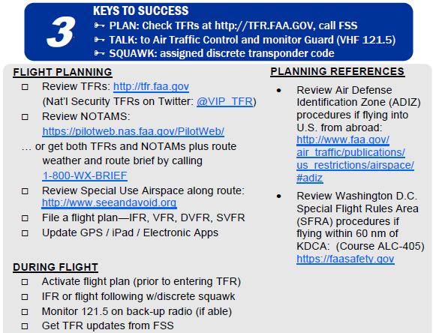
Tips for Temporary Flight Restrictions (TFR) and Special Use Airspace
Notes:
Source:
Tips for Temporary Flight Restrictions and Special Use Airspace
http://www.aopa.org/-/media/Files/AOPA/Home/Flight-Planning/TipsForTempFlightRestrictions.pdf

Slide 74
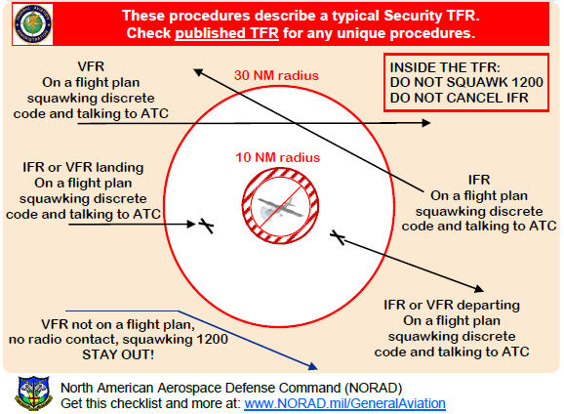
Tips for Temporary Flight Restrictions (TFR) and Special Use Airspace
Notes:
Source:
Tips for Temporary Flight Restrictions and Special Use Airspace
http://www.aopa.org/-/media/Files/AOPA/Home/Flight-Planning/TipsForTempFlightRestrictions.pdf

Slide 75
NORAD & FAA Intercept Procedures

Slide 76
NORAD & FAA Intercept Procedures
Get Intercept Procedures “Knee Board Card” at link below.
https://www.aopa.org/-/media/files/aopa/home/go-flying/tfrs/noradandfaainterceptprocedures.pdf?la=en

Slide 77
NORAD & FAA Intercept Procedures

Slide 78
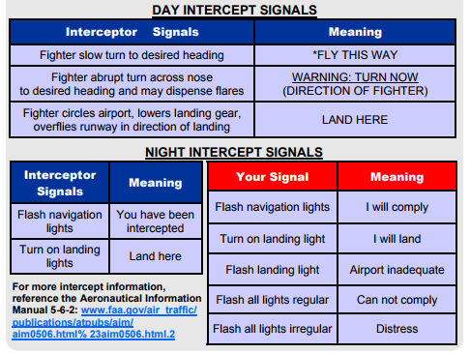
NORAD & FAA Intercept Procedures

Slide 79
References and Information
Electronic Code of Federal Regulations – Title 14 Chapter I--Federal Aviation Administration, Department of Transportation
Subchapter D – Airmen
Electronic Code of Federal Regulations (eCFR)
Scroll down and click on Part 61
Subchapter F – Air Traffic and General Operating Rules
Electronic Code of Federal Regulations (eCFR)
Scroll down and click on Part 91
Notes:
79
Some good FAA References

Slide 80
Parting Thoughts
Notes:
Emphasize to the audience that they should seriously consider these items

Slide 81
The Three Most Useless Things to a Pilot
The runway behind you
Moral: know your aircraft’s take-off minimums and calculate the weight and balance for your flight, your airport’s runway length, density altitude, any obstacles to be cleared
The altitude above you
Moral: know your aircraft’s power settings for climb, cruise, and descent
The fuel on the ground below you
Moral: know your aircraft’s fuel capacity, fuel system, GPH burn rate, and winds aloft for the route of flight.
Utilize superior judgment to avoid needing to use superior skill
Moral: know your aircraft’s systems and how to use them
Notes:
Think of this in terms of FAR 91.103

Slide 82
FAASTeam on Winter is Coming! And So Is The New President! Don’t Get Busted On The Wilmington VIP/Security TFR
Questions?
Comments?
Ideas?
Notes:
82
This is not a comprehensive training session, we are here to present areas where pilots could see themselves making similar mistakes and to make suggestions for where pilots could improve their judgment.
Consider getting some refresher training from your CFI. Better yet, do a WINGS Phase.

Slide 83
This Completes
Winter is Coming! And So Is The New President! Don’t Get Busted On The Wilmington VIP/Security TFR
FAA Customer Feedback Website
http://www.faa.gov/about/office_org/headquarters_offices/avs/offices/afs/qms/
PHL FSDO FAAST Program Manager – Eric Sieracki -
Eric.Sieracki@faa.gov
Notes:
83
Remind the attendees that they must sign in to be credited for attendance.
Ask for suggestions of any kind, especially what they would like to have presented as “elective” topics.

Slide 84
Credits and Information

Slide 85
References and Information
Author of Presentation – William J. Doyle, Jr.
CFI A&I, AGI, IGI, Cessna CFAI
FAA FAAST Team Representative, PHL FSDO
Presentation for the Wilmington VIP TFR – Uses PowerPoint 2003 and Later
If prompted for a password, click on the Read Only button
http://williamjdoylejr.net/FAAST/TFRs/ILG_TFR/TFRs_Wilmington_DE_2021_01_20.pptx - PowerPoint
http://williamjdoylejr.net/FAAST/TFRs/ILG_TFR/TFRs_Wilmington_DE_2021_01_20.pdf - PDF
Presentation for Bedminster, NJ TFR – Uses PowerPoint 2003 and Later
If prompted for a password, click on the Read Only button
http://williamjdoylejr.net/FAAST/TFRs/TFRs_Bedminster_NJ_Spring_Summer_2019.ppt
Glossary for non-pilot friends or family – Uses Word 2003 and Later
http://williamjdoylejr.net/FAAST/TFRs/ILG_TFR/Glossary.docx
Notes:
Some FAAST References

Slide 86
FAA Handbooks
Airplane Flying Handbook (FAA-H-8083-3B)
https://www.faa.gov/regulations_policies/handbooks_manuals/aviation/airplane_handbook/media/airplane_flying_handbook.pdf
Pilots Handbook of Aeronautical Knowledge (FAA-H-8083-25A)
https://www.faa.gov/regulations_policies/handbooks_manuals/aviation/phak/
Notes:
86
Some good FAA References

Slide 87
References and Information
AOPA Safety Advisor – Airspace for Everyone
http://www.aopa.org/-/media/Files/AOPA/Home/Pilot-Resources/ASI/Safety-Advisors/sa02.pdf
AOPA Safety Advisor – Operations at Non-Towered Airports
http://www.aopa.org/-/media/Files/AOPA/Home/Pilot-Resources/ASI/Safety-Advisors/sa08.pdf
AOPA Safety Advisor – Operations at Towered Airports
http://www.aopa.org/-/media/Files/AOPA/Home/Pilot-Resources/ASI/Safety-Advisors/sa07.pdf
AOPA Safety Advisor – Do the Right Thing – Decision Making for Pilots
https://www.aopa.org/training-and-safety/online-learning/safety-spotlights/do-the-right-thing
Tips for Temporary Flight Restrictions and Special Use Airspace
http://www.aopa.org/-/media/Files/AOPA/Home/Flight-Planning/TipsForTempFlightRestrictions.pdf
Notes:
87
Some good AOPA References

Slide 88
References and Information (cont’d)
NTSB Accident Database
http://www.ntsb.gov/_layouts/ntsb.aviation/index.aspx
Electronic Code of Federal Regulations – Title 14 Aeronautics and Space
http://www.ecfr.gov/cgi-bin/text-idx?SID=c709ce7f1eaf0f1b557578c87c378358&mc=true&tpl=/ecfrbrowse/Title14/14chapterI.tpl
ALC-42: Airspace, Special Use Airspace and TFRs
https://www.faasafety.gov/gslac/ALC/course_content.aspx?enroll=true&cID=42
ALC-62: Aeronautical Decision Making for VFR Pilots
https://www.faasafety.gov/gslac/ALC/course_content.aspx?enroll=true&cID=62
Notes:
88
Some good FAA References

Slide 89
Appendix

Slide 90
Appendix In-Flight Cautions with ForeFlight Mobile Version 12.10.1

Slide 91
ForeFlight Mobile – In-Flight Cautions
ForeFlight Mobile on iPad or iPhone with no ADS-B receiver
Will provide GPS positioning and GPS navigation data
Will not provide ADS-B data
Will not provide TFR data
High risk of pilot deviation and unauthorized TFR penetration
Recommendations, if unable to get an ADS-B receiver
Use the "Pack" feature before flight (while the iPad or iPhone is connected to the internet) to get TFR data available as of the time of the "Pack.“
See pages 185 – 188 of the Pilot’s Guide to ForeFlight Mobile for more information on the “Pack” feature
http://www.foreflight.com/ipad/guide/pdf
Notes:
This slide is based on information received from ForeFlight Technical Support.

Slide 92
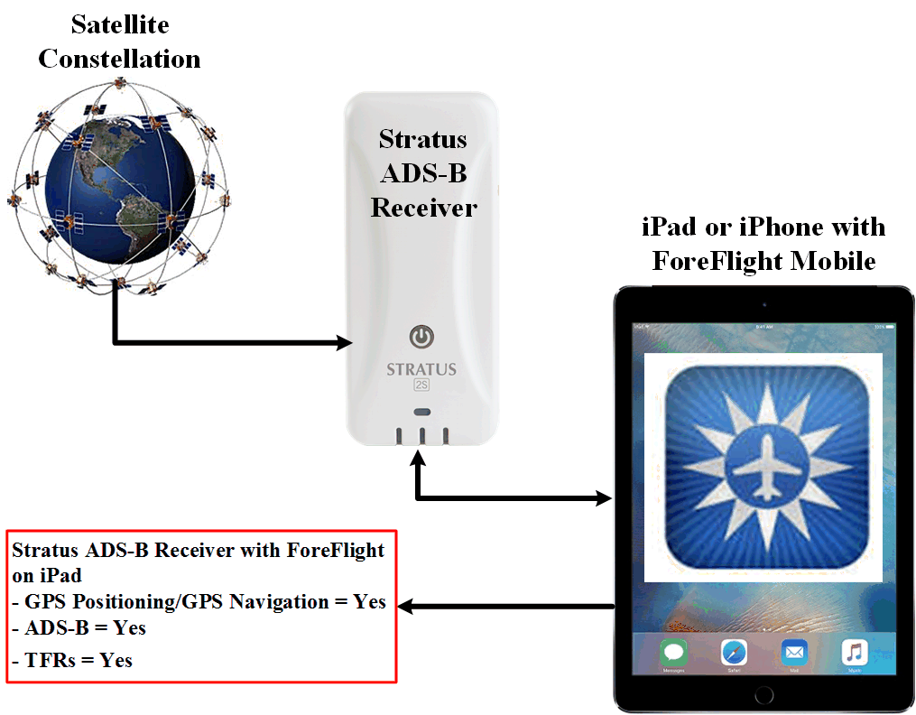
In-Flight Cautions – ForeFlight Mobile & Stratus ADS-B
Notes:
This slide is based on information received from ForeFlight Technical Support.

Slide 93
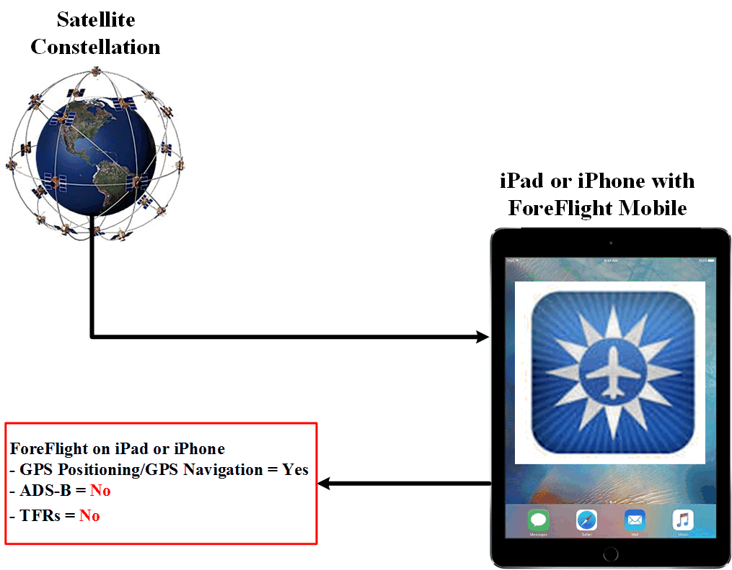
In-Flight Cautions – ForeFlight Mobile & iPad or iPhone
Notes:
This slide is based on information received from ForeFlight Technical Support.

Slide 94
Appendix SRM - Risk Management The 5 P’s

Slide 95
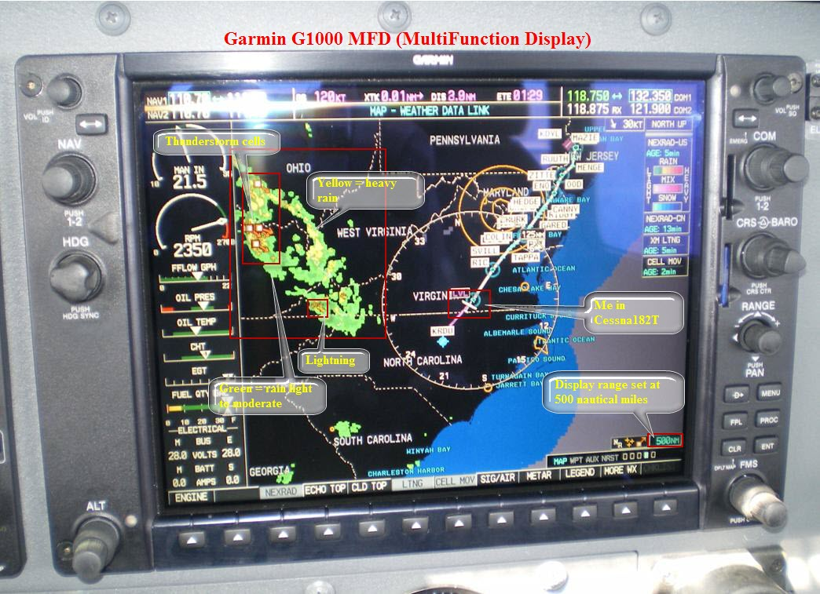
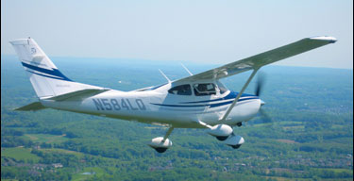
SRM 5P Check
Plan
Weather
Route
Publications – NOTAMS & TFRs
ATC Reroutes and Delays
Fuel Remaining
Plane
Mechanical Status
Inspection Status
Automation Status
Database Currency
Circuit Breakers
Backup Systems

Slide 96
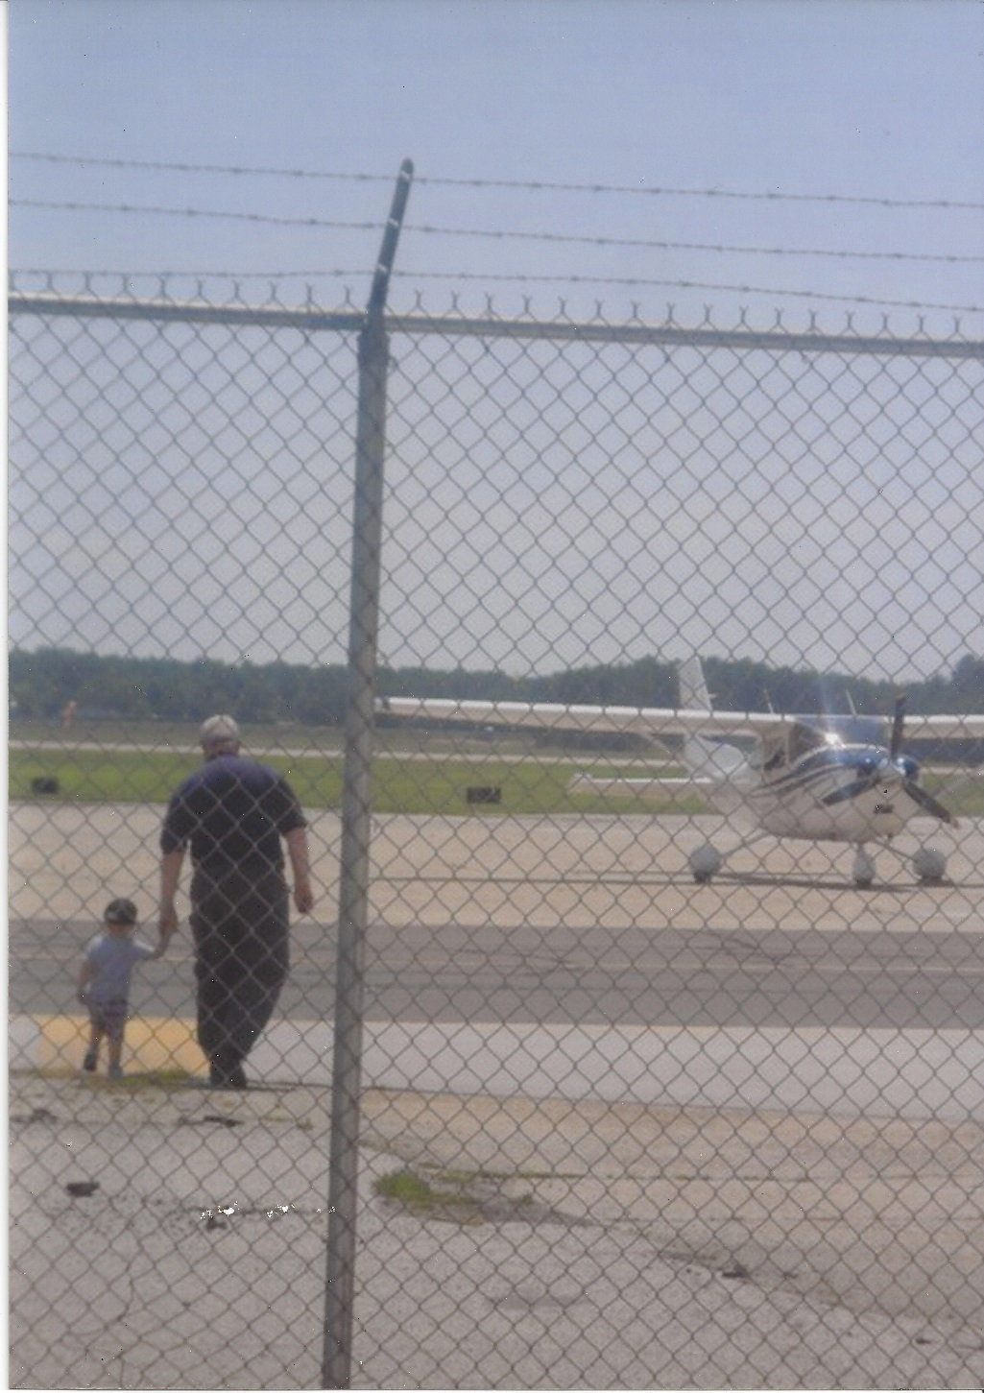
SRM 5P Check
Pilot
Current Experience
IMSAFE
I - Illness
M - Medication
S - Stress
A - Alcohol
F - Fatigue
E - Eating
Passengers
Pilots or Non-pilots
Nervous or Quiet
Experienced or New
Helpful or a Handful
Urgent or Optional
Business or Pleasure

Slide 97
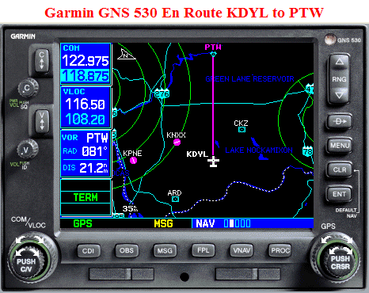
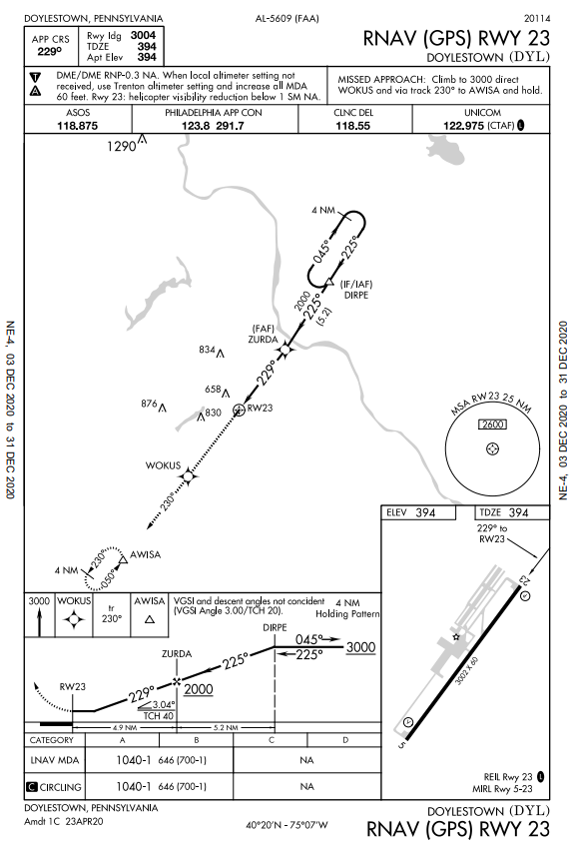
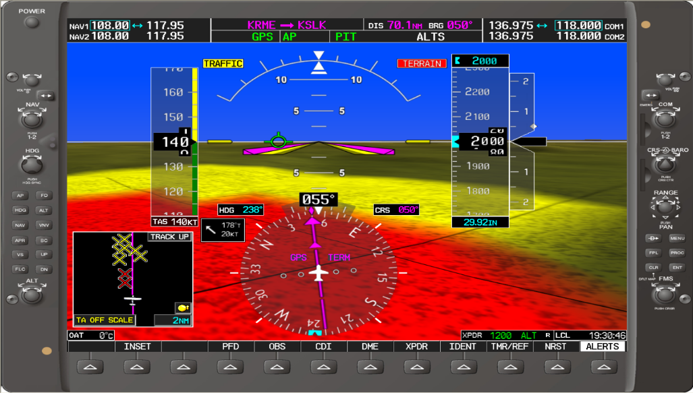
SRM 5P Check
Programming
Preprogram
Autopilot
GPS
MFD/PFD
Anticipate
Likely Reroutes & Clearances
Crunch Points
Manual Backup
High terrain Encounters
Ask Yourself
What’s it doing?
Why is it doing that?
Did I cause that?

Slide 98
Quickie Quiz
How do you use the 5P’s?
How do you “program” the systems in your airplane?
Do you have any backup systems? If so, what are they?
How do you analyze and troubleshoot issues?

Slide 99
SRM Decision Process
At predetermined decision points consider your situation and the 5 P’s
Has anything changed since your original Go/No Go decision?
Are there negative outcomes we could be exposed to?
Engine failure
Avionics failure
Missed approach
Pilot overload
Mistakes on approach / final
CFIT
Fuel exhaustion
Icing or loss of control

Slide 100
SRM Decision Process
At predetermined decision points consider your situation and the 5 P’s
What can we do to minimize the increased risk associated with those outcomes?
Use automation to reduce workload / increase awareness.
Use MFD to maintain terrain awareness, etc
Use passengers to share workload / monitor environment
As needed, ask ATC for
A simpler approach
Single frequency approach
Vectors to final
Declare minimum fuel
Ask for altitude / routing change
Just say “unable” for "difficult" ATC requests

Slide 101
SRM Decision Process
At predetermined decision points consider your situation and the 5 P’s
Prioritize tasks
If we can't do everything well, at least get the important things right.
What are they?
What can we shed?
Can I file IFR enroute?
Is the resulting risk acceptable?
Would I have taken off knowing this was going to happen?
If not …
Divert / terminate the flight early

Slide 102
Appendix – Airspace

Slide 103
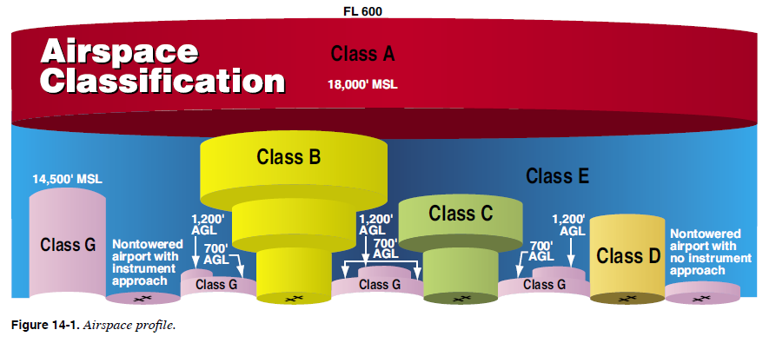
Airspace Classifications Pilot’s Handbook of Aeronautical Knowledge

Slide 104
Airspace Classifications Pilot’s Handbook of Aeronautical Knowledge
Controlled Airspace
Class A – airspace from 18,000 feet MSL up to and including FL 600. Operation in Class A airspace is conducted under instrument flight rules (IFR).
Class B – generally from surface to 10,000 feet MSL surrounding busiest airports. Some Class B airspace resembles upside-down wedding cakes. An ATC clearance is required for all aircraft to operate in the area.
Class C – generally from surface to 4,000 feet above the airport elevation (charted in MSL) surrounding those airports with a control tower, are serviced by a radar approach control, and have a certain number of IFR operations or passenger enplanements.
Airspace usually consists of a surface area with a five NM radius, an outer circle with a ten NM radius that extends from 1,200 feet to 4,000 feet above the airport elevation, and an outer area.
Each aircraft must establish two-way radio communications with the ATC facility providing air traffic services prior to entering the airspace and thereafter maintain those communications while within the airspace.

Slide 105
Airspace Classifications Pilot’s Handbook of Aeronautical Knowledge
Controlled Airspace (continued)
Class D – generally airspace from the surface to 2,500 feet above the airport elevation (charted in MSL) surrounding those airports that have an operational control tower.
Arrival extensions for instrument approach procedures (IAPs) may be Class D or Class E airspace.
Each aircraft must establish two-way radio communications with the ATC facility providing air traffic services prior to entering the airspace and thereafter maintain those communications while in the airspace.

Slide 106
Airspace Classifications Pilot’s Handbook of Aeronautical Knowledge
Controlled Airspace (continued)
Class E – If airspace is not Class A, B, C, or D, and is controlled airspace, then it is Class E airspace.
Class E airspace extends upward from either the surface or a designated altitude to the overlying or adjacent controlled airspace.
Class E airspace contains federal airways, airspace beginning at either 700 or 1,200 feet above ground level (AGL) used to transition to and from the terminal or enroute environment, and enroute domestic and offshore airspace areas designated below 18,000 feet MSL.
Unless designated at a lower altitude, Class E airspace begins at 14,500 feet MSL over the United States, including that airspace overlying the waters within 12 NM of the coast of the 48 contiguous states and Alaska, up to but not including 18,000 feet MSL, and the airspace above FL 600.

Slide 107
Quickie Quiz
What do you need to do to fly your airplane in the airspace listed below?
Class A?
Class B?
Class C?
Class D?

Slide 108
Philadelphia (PHL) Class B Airspace

Slide 109
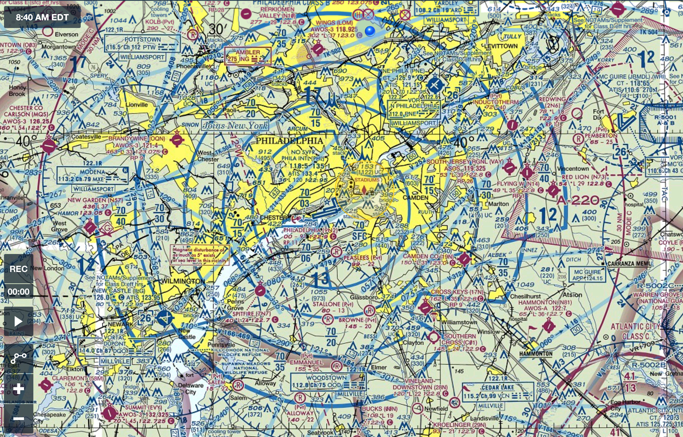
Philadelphia (PHL) Class B Airspace

Slide 110
Class C Airspace Allentown (ABE) Atlantic City (ACY)

Slide 111
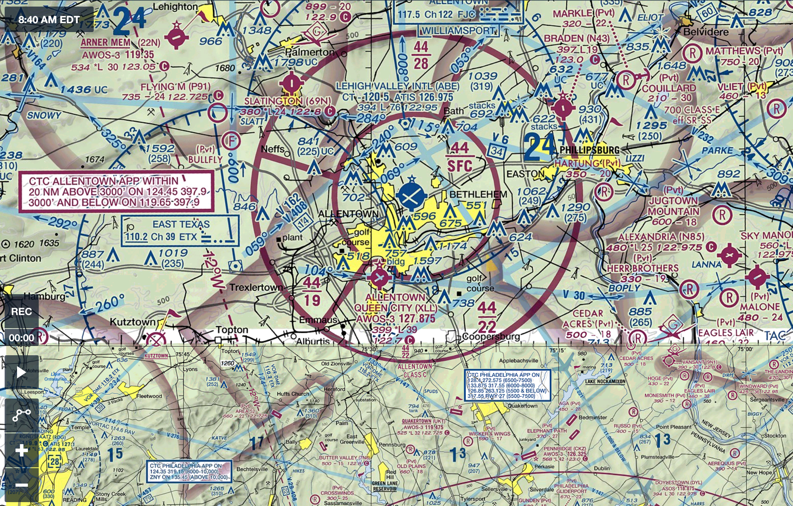
Allentown (ABE) Class C Airspace

Slide 112
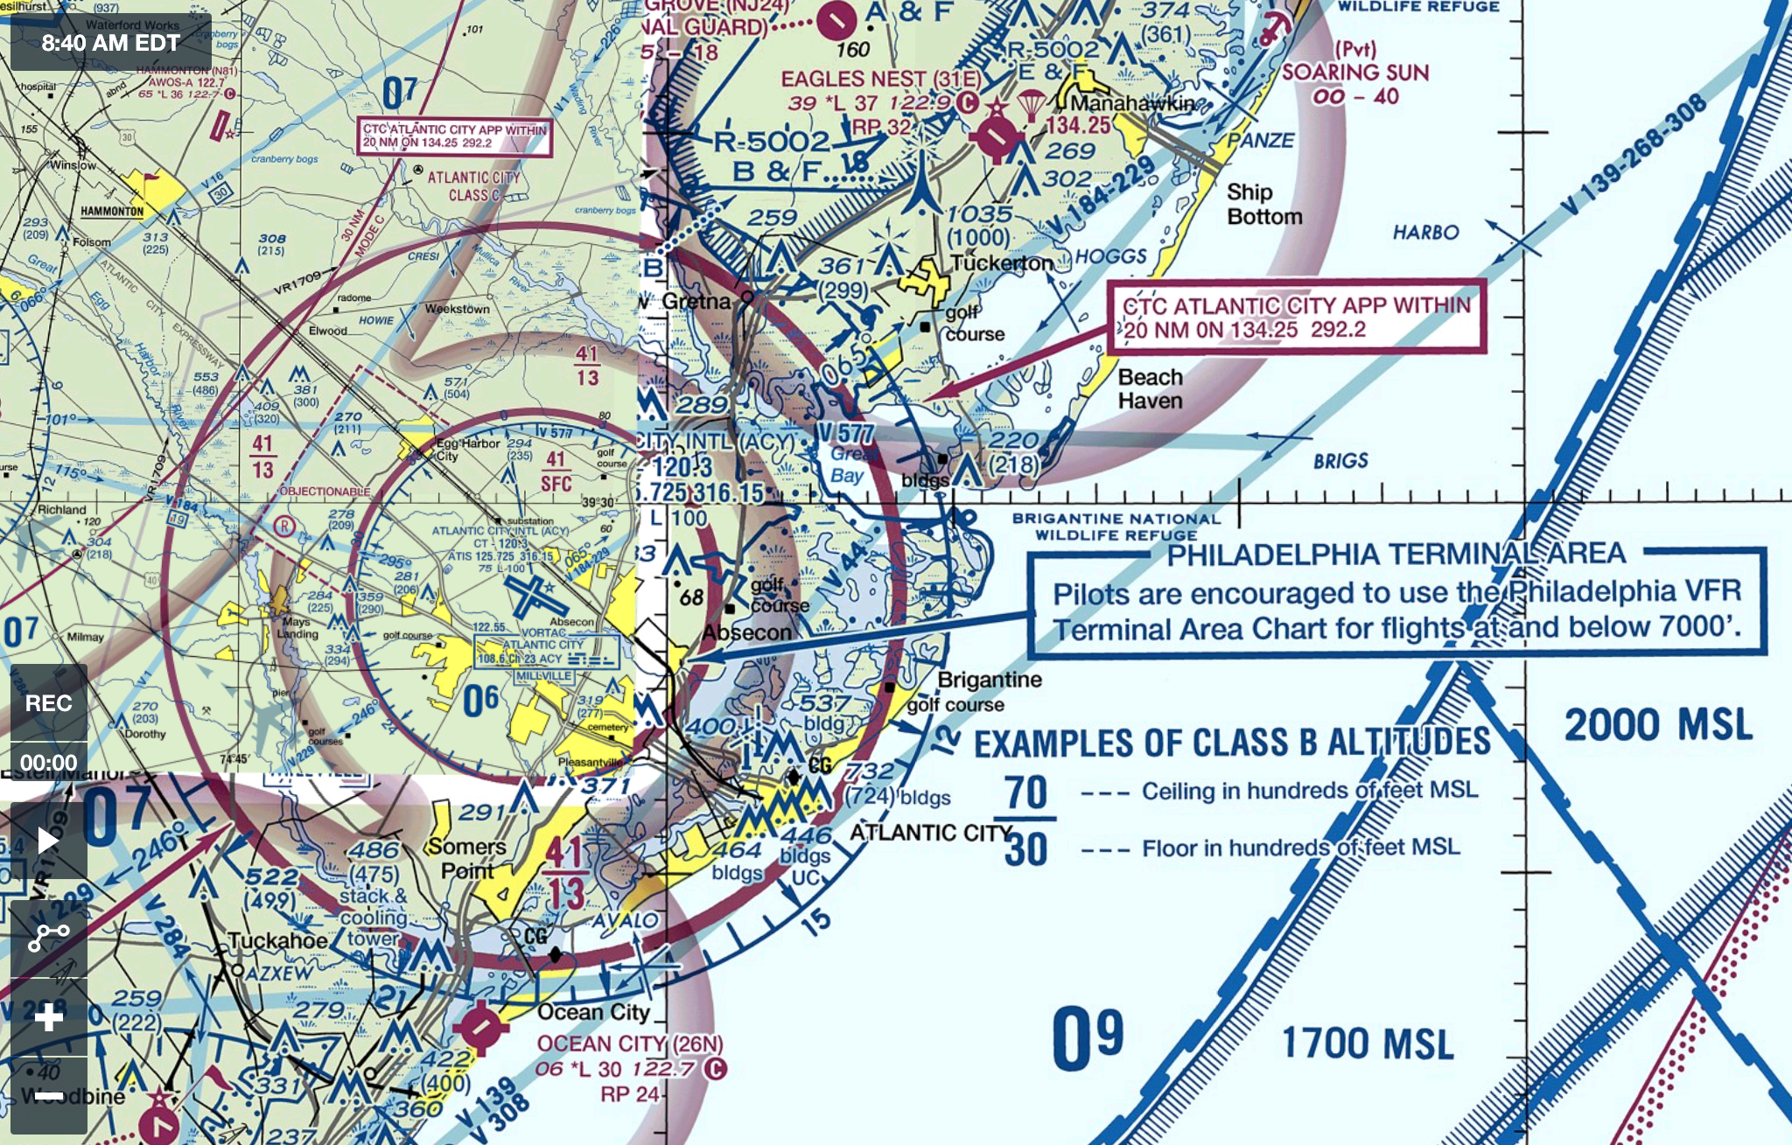
Atlantic City (ACY) Class C Airspace

Slide 113
Class D Airspace Philadelphia Northeast (PNE) Trenton Mercer County (TTN)

Slide 114
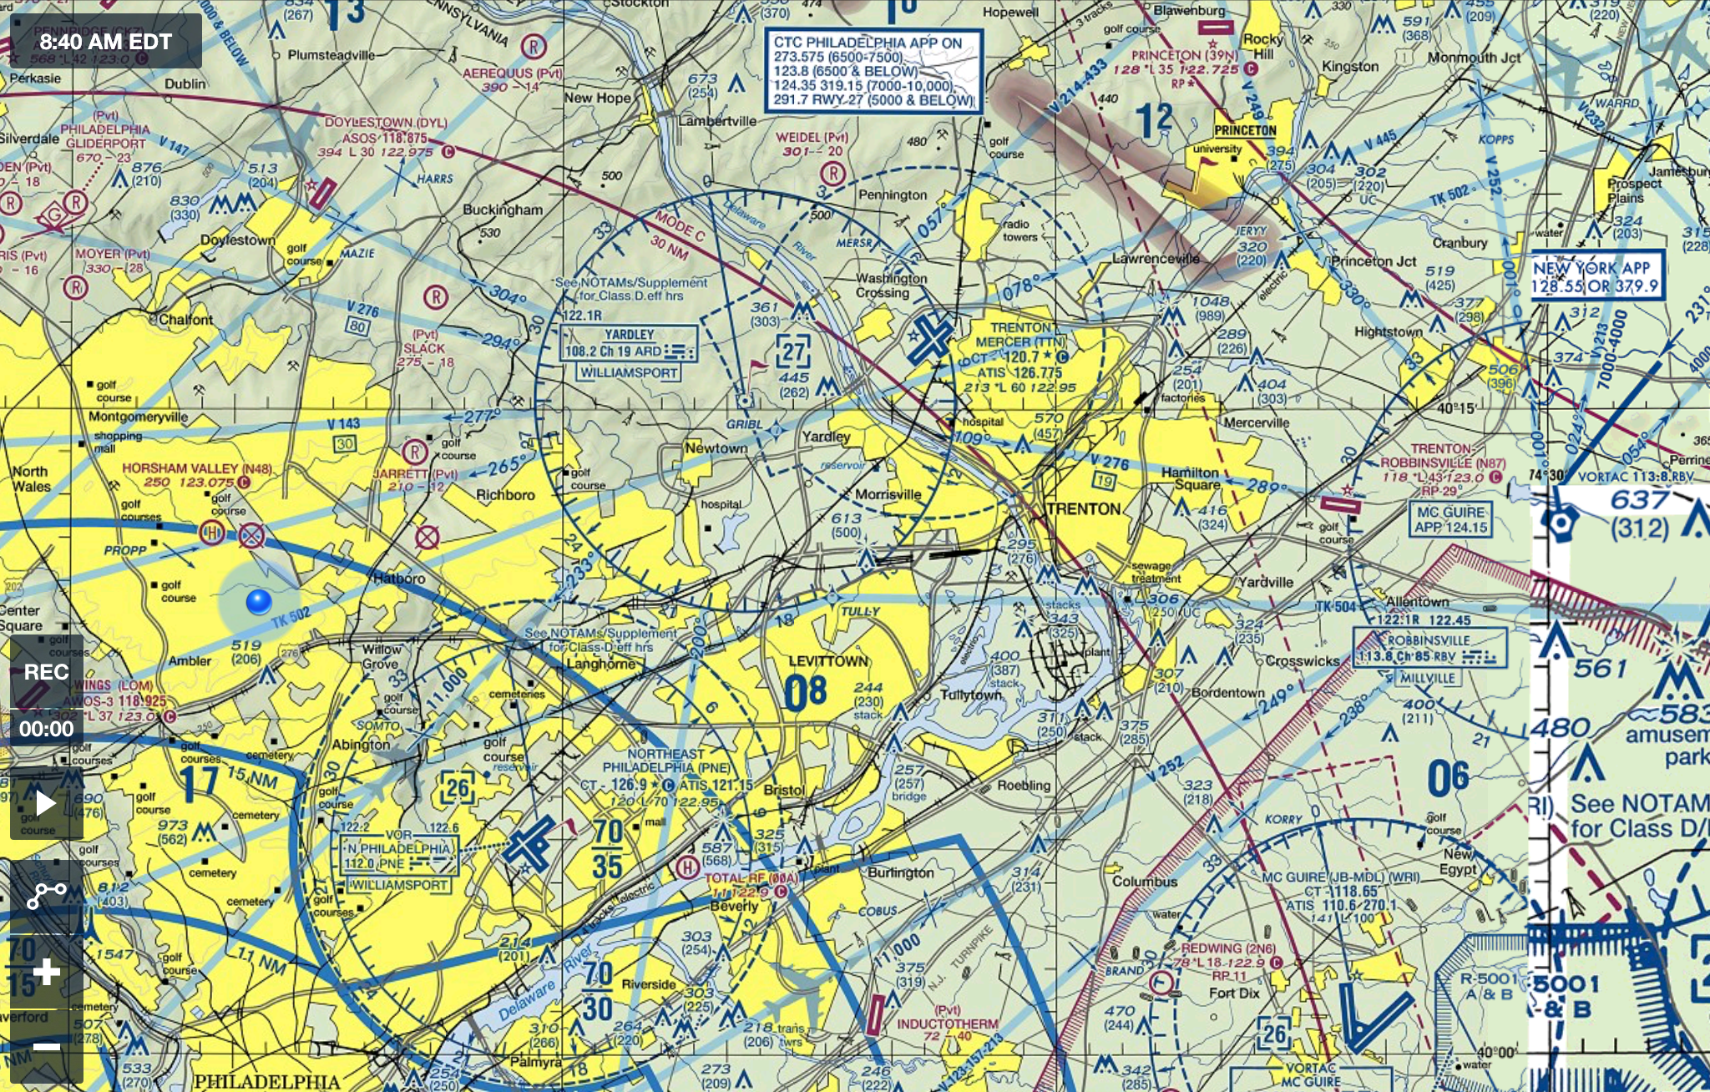
PNE & TTN Class D Airspace

Slide 115
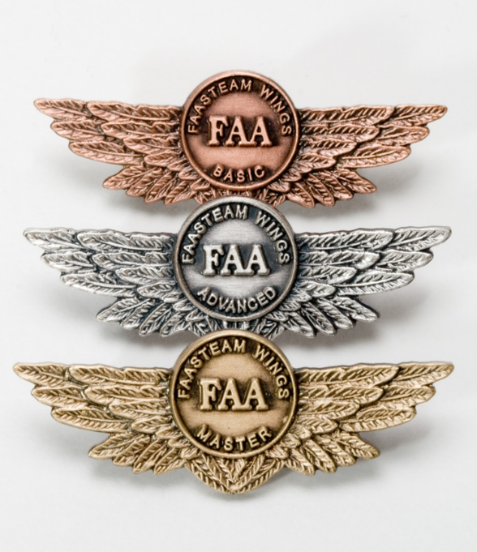
Proficiency and Peace of Mind
Fly regularly with your CFI
Practice to Perfection
Document in WINGS
Notes:
There’s nothing like the feeling you get when you know you’re playing your A game and in order to do that you need a good coach (Click)
So fly regularly with a CFI who will challenge you to review what you know, explore new horizons, and to always do your best. Of course you’ll have to dedicate time and money to your proficiency program but it’s well worth it for the peace of mind that comes with confidence. (Click)
Vince Lombardi, the famous football coach said, “Practice does not make perfect. Only perfect practice makes perfect.” For pilots that means flying with precision. On course, on altitude, on speed all the time. (Click)
And be sure to document your achievement in the Wings Proficiency Program. It’s a great way to stay on top of your game and keep you flight review current.
(Next Slide)

Slide 116
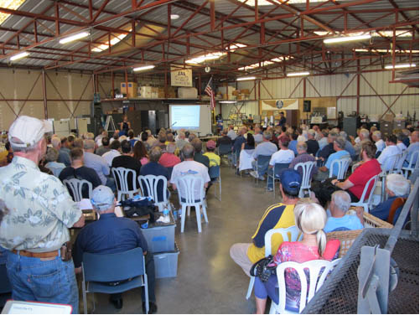
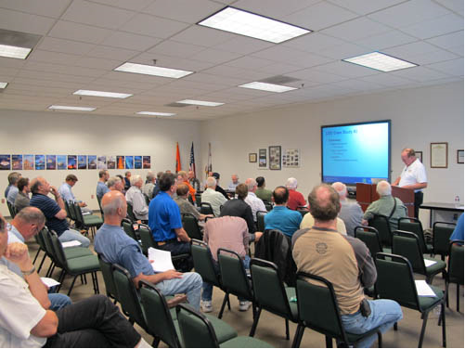
Thank you for attending
You are vital members of our GA safety community
Notes:
Your presence here shows that you are vital members of our General Aviation Safety Community. The high standards you keep and the examples you set are a great credit to you and to GA.
Thank you for attending.

