Slide 1
Pilot Decision Making
Crosswind Operations:
Takeoffs and Landings
FAA Safety Webinar Attendees
W. J. Doyle, Jr., CFI A&I, AGI, IGI, FAAST Rep
FAA Safety Webinar Attendees
2020-2021
01/01/2000 – 12/31/2019
Notes:
What can we learn from others mistakes?
How should we decide whether to continue with a landing in a crosswind?
Should we consider enroute diversions?
What does the FAA say about flight planning?
What should we consider when planning our flights?
Join us in looking at some flights that will address these and other important questions and considerations.
This presentation was built by FAASTeam Rep William J Doyle, Jr. doylewj@ix.netcom.com

Slide 2
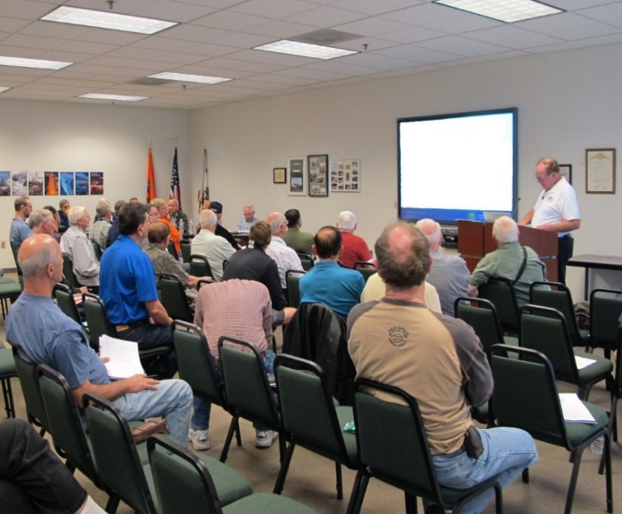
Welcome
Exits
Restrooms
Emergency Evacuation
Breaks
Sponsor Acknowledgment
Other information
Notes:
Presentation Instruction: Here’s where you can discuss venue logistics, acknowledge sponsors, and deliver other information you want your audience to know in the beginning. You can add slides after this one to fit your situation.
(Next Slide)

Slide 3
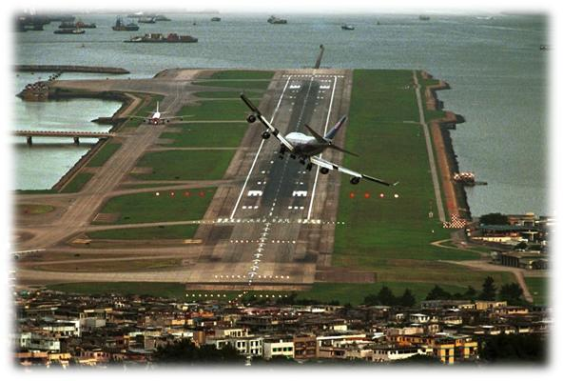
Setting the Stage – So How Good Are You?
Approach into Kai Tak Airport, Hong Kong
Runway 13-31 – 11,122 Feet
Closed 6 July 1998
Notes:
Kai Tak Airport is now closed.
Imagine doing a side slip into here.

Slide 4
Presentation Agenda
The Crosswind Component – What is it?
Crosswind Components for Selected Airplanes
Danger Zones and Personal Minimums
Crosswind Scenarios
Mishaps
Accidents
Events
Techniques for Calculating the Crosswind Component
NTSB Database Queries
Is Your Flight Review Expiring Because You Can’t Fly With A CFI Due To COVID-19?
Notes:
We will look at the following
Crosswind component, what it is and what it is not
Relevant FARs as well as some NTSB information
Crosswind components for selected airplanes
Suggestions on risk and personal minimums from the FAA Risk Management Handbook
Some crosswind mishap scenarios with excerpts from the relevant NTSB reports as well as some pertinent crosswind takeoff and landing techniques from the FAA Airplane Flying Handbook
Some techniques for calculating the crosswind component, both on the ground and in the air
An introduction to running NTSB accident database queries and the recommendation to use them when planning a flight into an airport you’ve never flown into before
An SFAR to assist pilots needing a BFR during the COVID-19 pandemic

Slide 5
Crosswind Component and NTSB Statistics
Notes:
Let’s get ready to talk about what the crosswind component is and what it is not
We’ll also talk about some NTSB statistics

Slide 6
Overview
Point 1
Point 2
Point 3
Notes:
Presentation Instruction: If you’ll be discussing additional items, add them to this list
(Next Slide)

Slide 7
Questions?
Notes:
Presentation Instruction: You may wish to provide your contact information and main FSDO phone number here. Modify with
Your information or leave blank.
(Next Slide)

Slide 8
Proficiency and Peace of Mind
Fly regularly with your CFI
Perfect Practice
Document in WINGS
Notes:
There’s nothing like the feeling you get when you know you’re playing your A game and in order to do that you need a good coach (Click)
So fly regularly with a CFI who will challenge you to review what you know, explore new horizons, and to always do your best. Of course you’ll have to dedicate time and money to your proficiency program but it’s well worth it for the peace of mind that comes with confidence. (Click)
Vince Lombardi, the famous football coach said, “Practice does not make perfect. Only perfect practice makes perfect.” For pilots that means flying with precision. On course, on altitude, on speed all the time. (Click)
And be sure to document your achievement in the Wings Proficiency Program. It’s a great way to stay on top of your game and keep you flight review current.
(Next Slide)

Slide 9
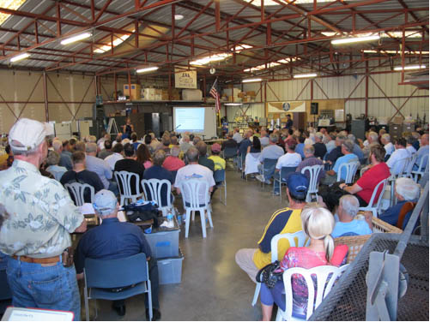
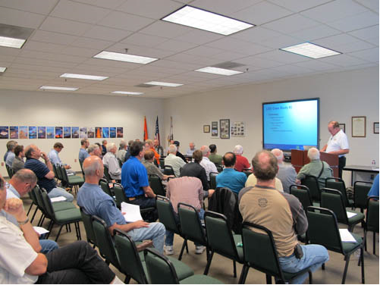
Thank you for attending
You are vital members of our GA safety community
Notes:
Your presence here shows that you are vital members of our General Aviation Safety Community. The high standards you keep and the examples you set are a great credit to you and to GA.
Thank you for attending.
(Next Slide)

Slide 10
Title
Sub Title
<Audience>
<Presenter>
< >
Notes:
(The End)

