Slide 1
Topic of the Month May Angle of Attack Systems
Notes:
2014/04/16-050
Original Author, FAASTeam; POC Kevin Clover, AFS-850 Operations Lead, Office 562-888-2020; reviewed by John Steuernagle, 04/16/2014. See separate Outreach Guidance and Notes document titled “Angle of Attack Systems Notes” and “Angle of Attack Systems - Outreach Guidance” located in approved presentations under GSJSC.
Presentation Note: This is the title slide for Angle of Attack Systems
Presentation notes (stage direction and presentation suggestions) will be preceded by a Bold header: the notes themselves will be in Italic fonts.
Program control instructions will be in bold fonts and look like this: (Click) for building information within a slide; or this: (Next Slide) for slide advance.
Some slides contain background information that supports the concepts presented in the program.
Background information will always appear last and will be preceded by a bold Background: identification.
We have included a script of suggested dialog with each slide. Presenters may read the script or modify it to suit their own presentation style.
The production team hope you and your audience will enjoy the show. Break a leg! (Next Slide)

Slide 2
Welcome
Exits
Restrooms
Emergency Evacuation
Breaks
Sponsor Acknowledgment
Other information
Notes:
Presentation Note: Here’s where you can discuss venue logistics, acknowledge sponsors, and deliver other information you want your audience to know in the beginning.
You can add slides after this one to fit your situation. (Next Slide)

Slide 3
Overview
Angle of attack systems
Stall/spin accidents
Airspeed/stall avoidance
AOA Solutions
Tips for Success
Notes:
We want to take just a few minutes to talk about angle of attack systems. (Click)
Stalls and spins are still major contributors to GA accidents so we’ll cover a few statistics (Click)
We’ll talk a bit about the problems in using airspeed for stall avoidance. (Click)
And we’ll discuss some angle of attack sollutions. (Click)
Finally we’ll offer some tips for successful maneuvering flight task accomplishment
Presentation Note: If you’ll be discussing additional items, add them to this list (Next Slide)

Slide 4
Stalls:
Can occur in any phase of flight
Are a factor in many fatal accidents
Usually involve low time pilots
Can occur at any airspeed
All of the above.
Notes:
Presentation Note: Ask the audience to consider these statements with respect to stalls. When they have answered; click to reveal the correct answer.
(Click)
That’s right. Stalls can occur at any airspeed in any phase of flight. They are a factor in many fatal accidents and often – but not always – involve low time pilots.
(Next Slide)

Slide 5
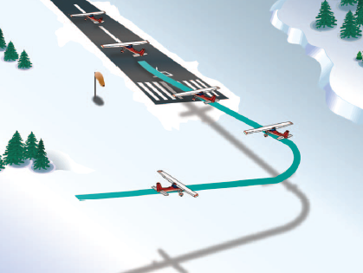
Stall/Spin Accidents
In the traffic pattern
Takeoff 28 %
Approach 18 %
Go Around 6 %
Crosswind
Maneuvering 41%
1 Fatal Accident/3 days
Notes:
Here’s the lowdown on Stall/Spin Accidents. They are deadly. More than half occur in the traffic pattern and most of the rest involve maneuvering – usually too close to the ground for recovery.
That all works out to one fatal accident every three days for the past ten years.
(Next Slide)

Slide 6
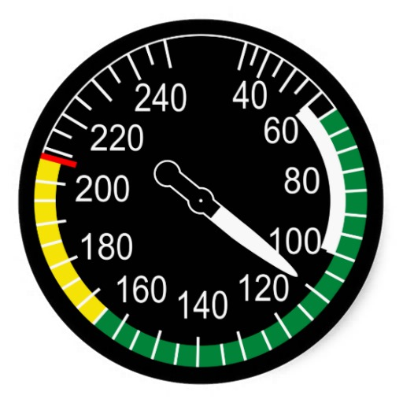
The Airspeed Problem
Notes:
We often discuss stalls with respect to airspeed and that can be a problem.
Wings stall when their critical angle of attack is exceeded. Airspeed is a secondary indication of how close we are to the critical angle of attack.
(Next Slide)

Slide 7
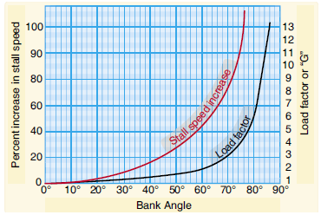
The Airspeed Problem
Aircraft configuration
Vs Cruise configuration
Vso Landing configuration
Load
Notes:
There are problems with using airspeed indications for stall avoidance. (Click)
One being that Stall speed changes with aircraft configuration. (Click)
Another has to do with aircraft load. As load or weight increase stall speed will also increase.
So if a wing can stall at any airspeed in any configuration pilots must manage angle of attack and that argues for an AOA display and/warning system in the aircraft.
(Next Slide)

Slide 8
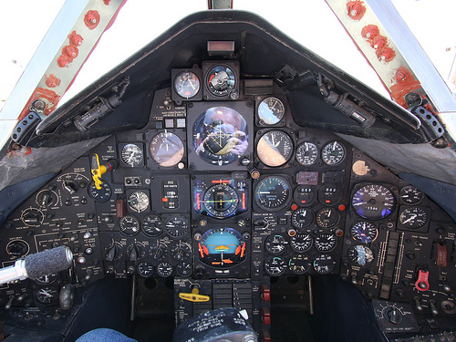
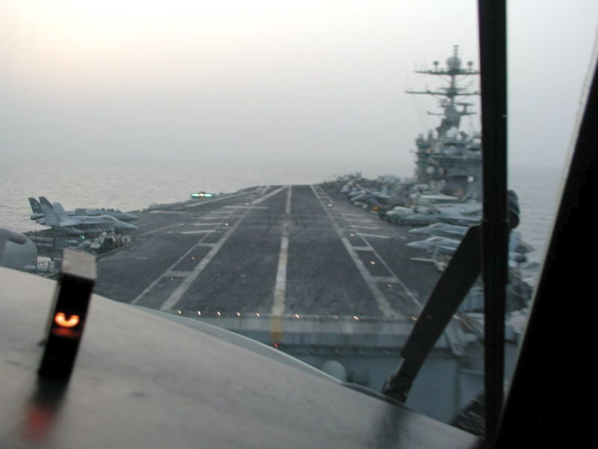
Angle of Attack Indicators
Notes:
Military aircraft have had AOA indicators for years. They’re essential to getting optimum performance in challenging situations but also very useful in routine flying as well. Only recently have they become more available and affordable for GA aircraft.
(Next Slide)

Slide 9
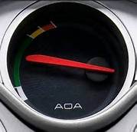
AOA For GA
Notes:
AOA indicators are showing up on many new aircraft and there are also a number of affordable options for retrofit as well. Angle of attack sensing & display that go a long way toward reducing the number of stall/spin accidents.
(Next Slide)

Slide 10
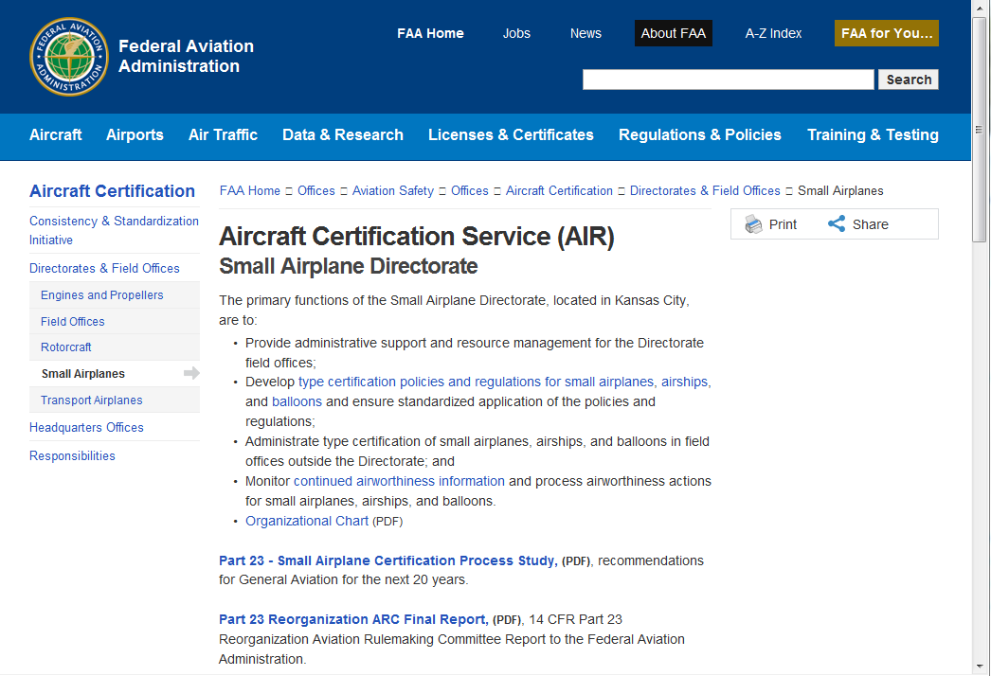
FAA Small Airplane Directorate
Notes:
FAA’s Small Airplane Directorate has streamlined the process for production and retrofit approval of AOA devices.
(Next Slide)

Slide 11
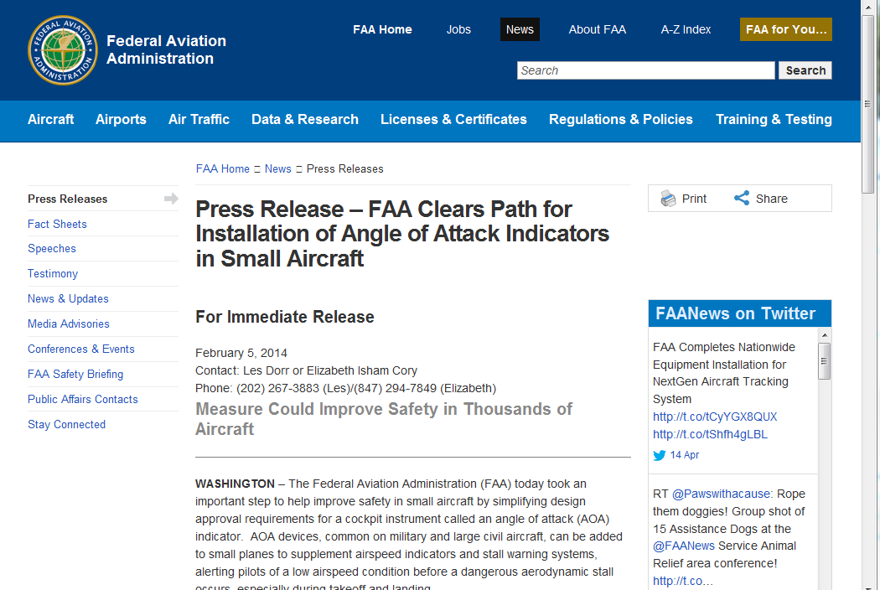
Streamlined Process
Notes:
FAA’s Small Airplane Directorate has streamlined the process for production and retrofit approval of AOA devices.
Presentation Note: If you have an internet connection you can access the Press Release by clicking on the information button on the lower right of the screen
(Next Slide)

Slide 12
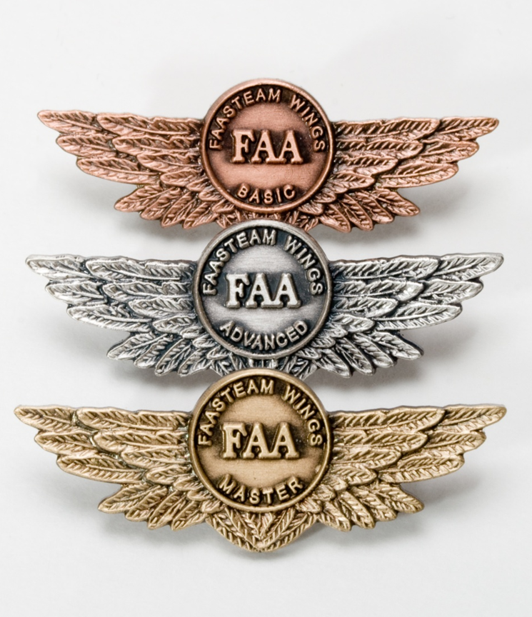
Safety Tip
Investigate AOA Systems
Practice
Stalls & slow flight
Pattern & Instrument
Fly with a CFI
Notes:
Angle of Attack systems promise so much benefit that we urge you to look into them for the aircraft you own or fly (Click)
And be sure to keep your skills sharp through practice of stalls & slow flight as well as pattern and instrument work. (Click)
Fly regularly with a CFI and be sure to document your achievement in the Wings Proficiency Program. It’s a great way to stay on top of your game.
(Next Slide)

Slide 13
Resources
FAA Small Airplane Directorate
http://www.faa.gov/about/office_org/headquarters_offices/avs/offices/air/directorates_field/small_airplanes/
AOA Press Release
http://www.faa.gov/news/press_releases/news_story.cfm?newsid=15714
FAA Safety Briefing Magazine
http://www.faa.gov/news/safety_briefing/
Notes:
Presentation Note: If you have an internet connection you can access the resources by clicking on text. If there’s no internet access the audience can copy the URLs below each item.
Here are some places you can go for more information.
(Next Slide)

Slide 14
Questions?
Notes:
Presentation Note: You may wish to provide your contact information and main FSDO phone number here. Modify with
Your information or leave blank.
(Next Slide)

Slide 15
Topic of the Month May Angle of Attack Systems
Notes:
The End

